Slide 1
Straight line graphs: Gradient and y-intercept (implicit 2)
Silent
Teacher
Intelligent Practice
Narration
Your Turn
$$2y=6x+12$$
$$2y=6x−12$$
$$3y=6x−12$$
Example
For more videos visit mrbartonmaths.com/videos

Slide 2
Worked Example
Your Turn
$$2y−6=4x$$
$$2y−6x=4$$
@mrbartonmaths

Slide 3
Gradient | y-intercept
$$y=6x+12$$
Gradient | y-intercept
Gradient | y-intercept
$$2y=6x+12$$
Gradient | y-intercept
Gradient | y-intercept
$$2y=6x−12$$
Gradient | y-intercept
Gradient | y-intercept
$$3y=6x−12$$
Gradient | y-intercept
Gradient | y-intercept
$$3y=9x−12$$
Gradient | y-intercept
@mrbartonmaths

Slide 4
Gradient | y-intercept
$$3y=12x−9$$
Gradient | y-intercept
Gradient | y-intercept
$$6y=12x−9$$
Gradient | y-intercept
Gradient | y-intercept
$$6y=9−12x$$
Gradient | y-intercept
Gradient | y-intercept
$$6y+12x=9$$
Gradient | y-intercept
Gradient | y-intercept
$$2y+4x=3$$
Gradient | y-intercept
@mrbartonmaths

Slide 5
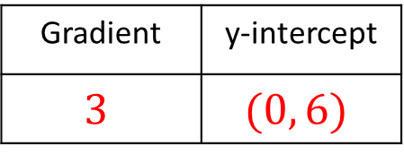
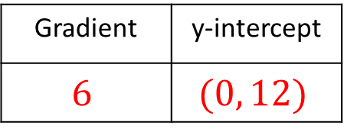
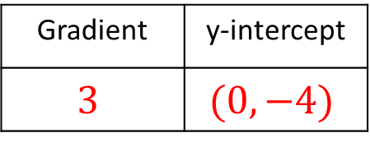
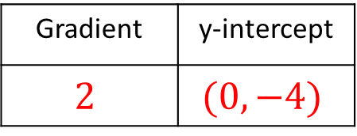
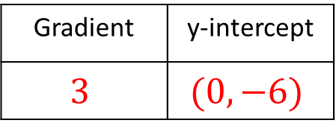
Gradient | y-intercept
$$6$$ | $$(0, 12)$$
$$y=6x+12$$
Gradient | y-intercept
$$3$$ | $$(0, 6)$$
$$2y=6x+12$$
Gradient | y-intercept
$$3$$ | $$(0,−6)$$
$$2y=6x−12$$
Gradient | y-intercept
$$2$$ | $$(0, −4)$$
$$3y=6x−12$$
Gradient | y-intercept
$$3$$ | $$(0, −4)$$
$$3y=9x−12$$
@mrbartonmaths

Slide 6
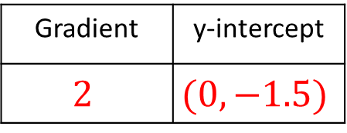
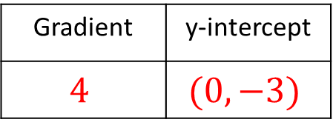
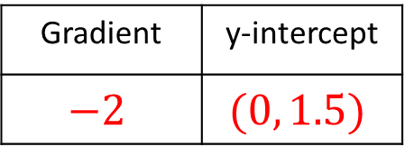
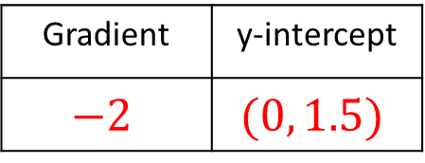
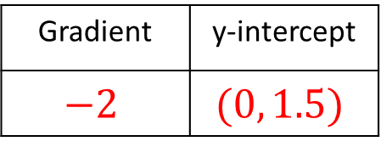
Gradient | y-intercept
$$4$$ | $$(0, −3)$$
$$3y=12x−9$$
Gradient | y-intercept
$$2$$ | $$(0, −1.5)$$
$$6y=12x−9$$
Gradient | y-intercept
$$−2$$ | $$(0, 1.5)$$
$$6y=9−12x$$
Gradient | y-intercept
$$−2$$ | $$(0, 1.5)$$
$$6y+12x=9$$
Gradient | y-intercept
$$−2$$ | $$(0, 1.5)$$
$$2y+4x=3$$
@mrbartonmaths

