Slide 1
Straight line graphs: Gradient and y-intercept (y =)
Silent
Teacher
Intelligent Practice
Narration
Your Turn
$$y=3x+2$$
$$y=3x−2$$
$$y=2−3x$$
Example
For more videos visit mrbartonmaths.com/videos

Slide 2
Worked Example
Your Turn
$$y=4x−3$$
$$y=4x+3$$
@mrbartonmaths

Slide 3
Gradient | y-intercept
$$y=x$$
Gradient | y-intercept
$$y=2x$$
Gradient | y-intercept
$$y=3x$$
Gradient | y-intercept
$$y=3x+1$$
Gradient | y-intercept
$$y=3x+2$$
@mrbartonmaths

Slide 4
Gradient | y-intercept
$$y=3x−2$$
Gradient | y-intercept
$$y=2−3x$$
Gradient | y-intercept
$$y=−3x+2$$
Gradient | y-intercept
$$y=2(−3x+2)$$
Gradient | y-intercept
$$y=\frac{1}{2}(−3x+2)$$
@mrbartonmaths

Slide 5
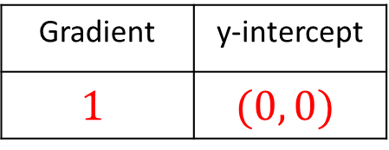
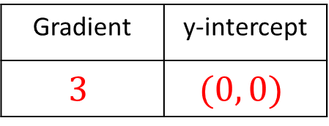
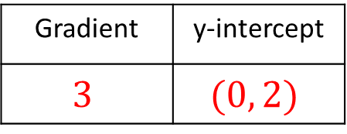
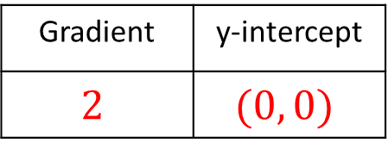
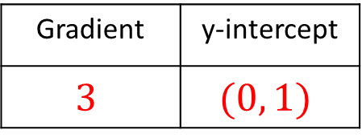
Gradient | y-intercept
$$1$$ | $$(0, 0)$$
$$y=x$$
Gradient | y-intercept
$$2$$ | $$(0, 0)$$
$$y=2x$$
Gradient | y-intercept
$$3$$ | $$(0, 0)$$
$$y=3x$$
Gradient | y-intercept
$$3$$ | $$(0, 1)$$
$$y=3x+1$$
Gradient | y-intercept
$$3$$ | $$(0, 2)$$
$$y=3x+2$$
@mrbartonmaths

Slide 6
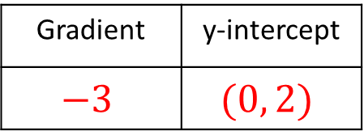
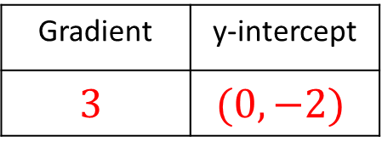
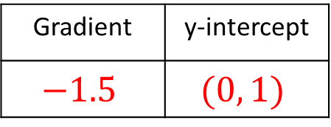
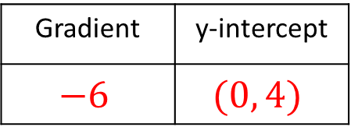
Gradient | y-intercept
$$3$$ | $$(0, −2)$$
$$y=3x−2$$
Gradient | y-intercept
$$−3$$ | $$(0, 2)$$
$$y=2−3x$$
Gradient | y-intercept
$$−3$$ | $$(0, 2)$$
$$y=−3x+2$$
Gradient | y-intercept
$$−6$$ | $$(0, 4)$$
$$y=2(−3x+2)$$
Gradient | y-intercept
$$−1.5$$ | $$(0, 1)$$
$$y=\frac{1}{2}(−3x+2)$$
@mrbartonmaths

