Slide 1
Rounding and estimating: How many significant figures?
True/false
Reflect
Your Turn
$$40 ?$$
$$4 ?$$
$$0.4 ?$$
Rule
For more videos visit mrbartonmaths.com/videos

Slide 2
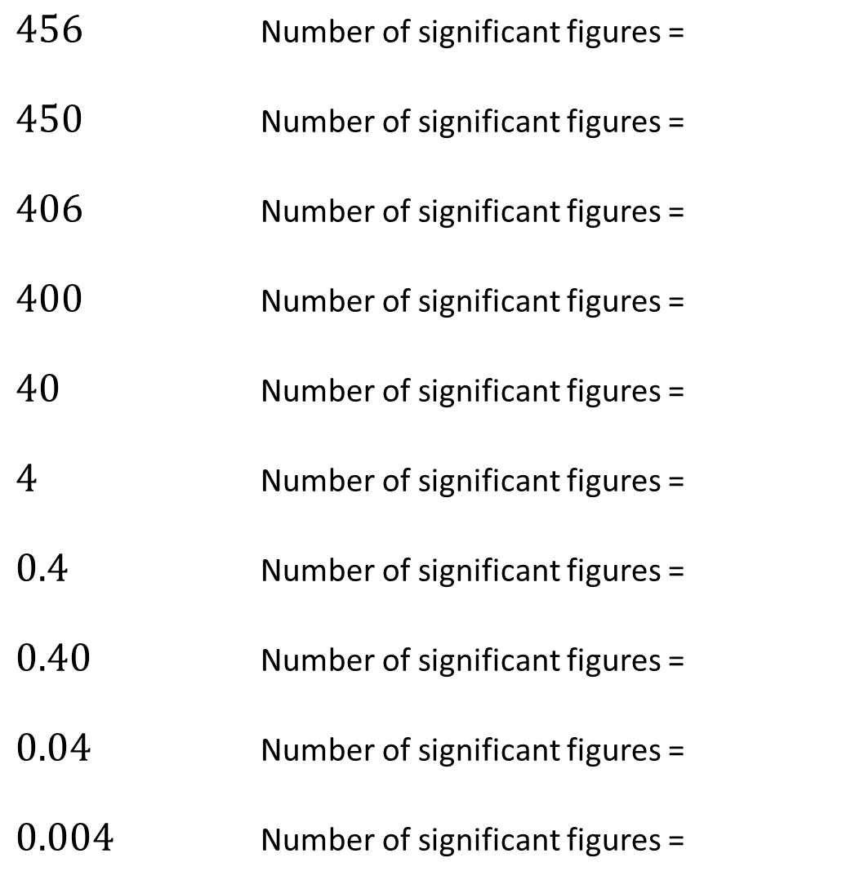
$456$ Number of significant figures =
$450$ Number of significant figures =
$406$ Number of significant figures =
$400$ Number of significant figures =
$40$ Number of significant figures =
$4$ Number of significant figures =
$0.4$ Number of significant figures =
$0.40$ Number of significant figures =
$0.04$ Number of significant figures =
$0.004$ Number of significant figures =
@mrbartonmaths

Slide 3
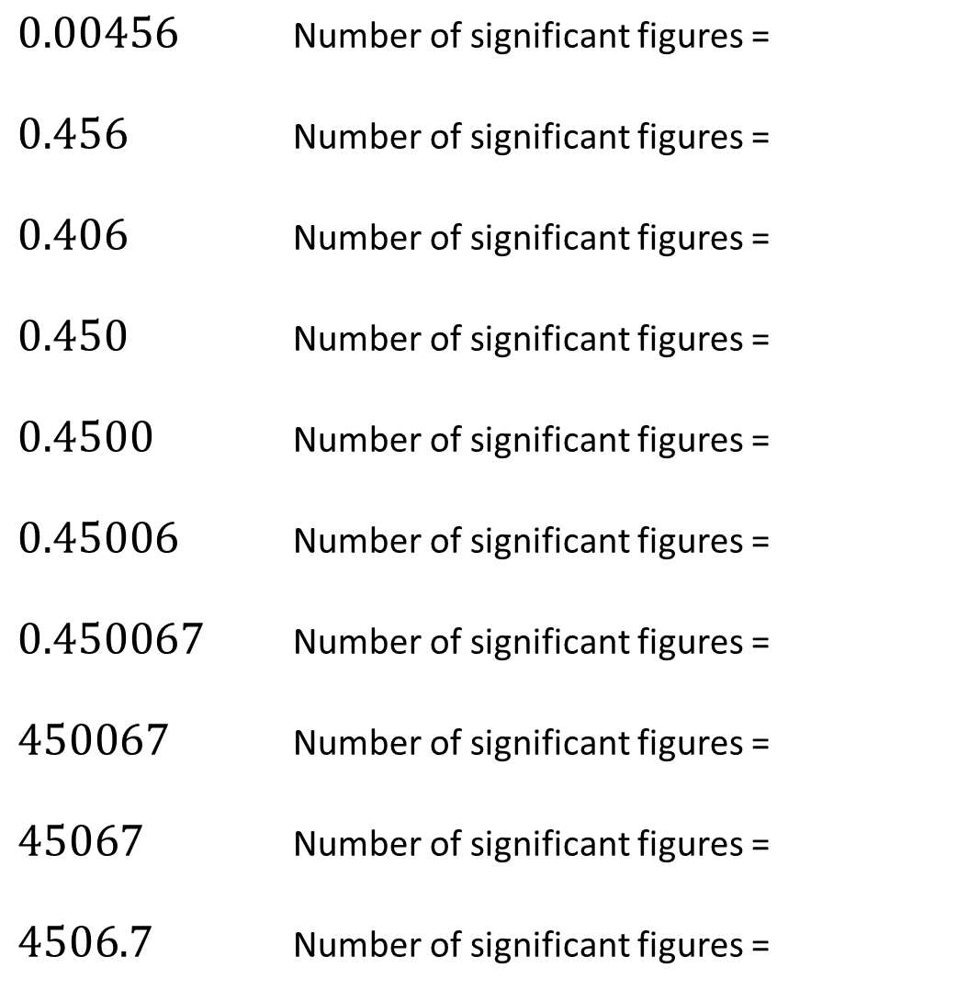
$0.00456$ Number of significant figures =
$0.456$ Number of significant figures =
$0.406$ Number of significant figures =
$0.450$ Number of significant figures =
$0.4500$ Number of significant figures =
$0.45006$ Number of significant figures =
$0.450067$ Number of significant figures =
$450067$ Number of significant figures =
$45067$ Number of significant figures =
$4506.7$ Number of significant figures =
@mrbartonmaths

Slide 4
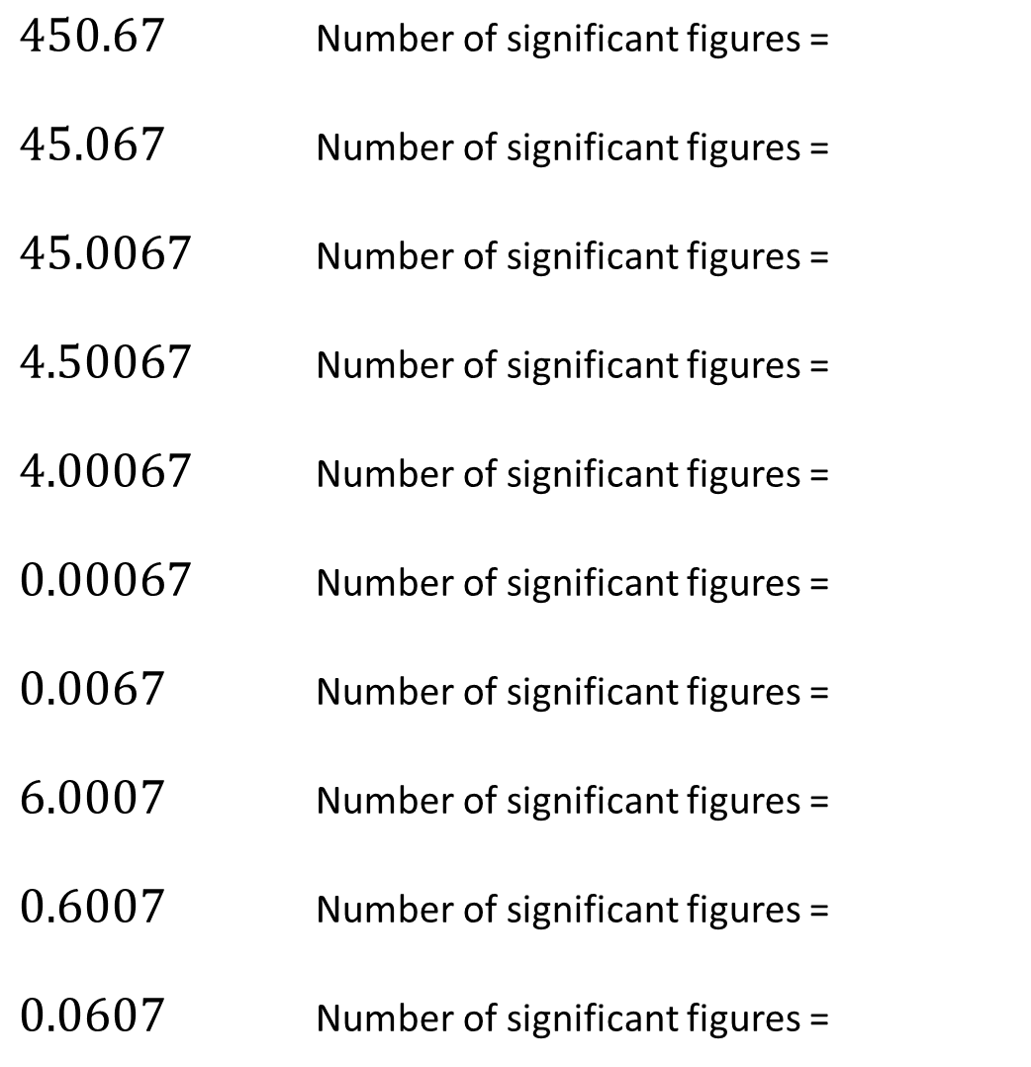
$450.67$ Number of significant figures =
$45.067$ Number of significant figures =
$45.0067$ Number of significant figures =
$4.50067$ Number of significant figures =
$4.00067$ Number of significant figures =
$0.00067$ Number of significant figures =
$0.0067$ Number of significant figures =
$6.0007$ Number of significant figures =
$0.6007$ Number of significant figures =
$0.0607$ Number of significant figures =
@mrbartonmaths

Slide 5
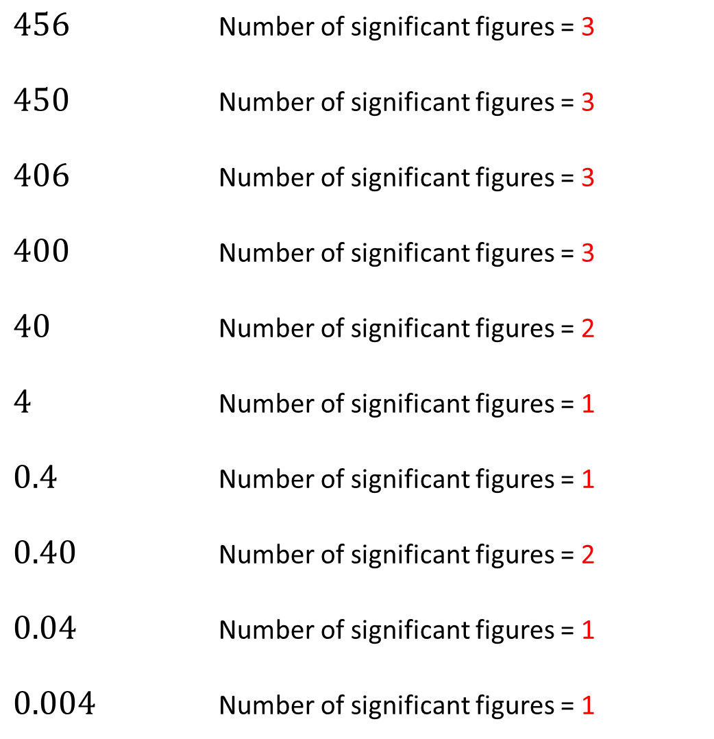
$456$ Number of significant figures = 3
$450$ Number of significant figures = 3
$406$ Number of significant figures = 3
$400$ Number of significant figures = 3
$40$ Number of significant figures = 2
$4$ Number of significant figures = 1
$0.4$ Number of significant figures = 1
$0.40$ Number of significant figures = 2
$0.04$ Number of significant figures = 1
$0.004$ Number of significant figures = 1
@mrbartonmaths

Slide 6
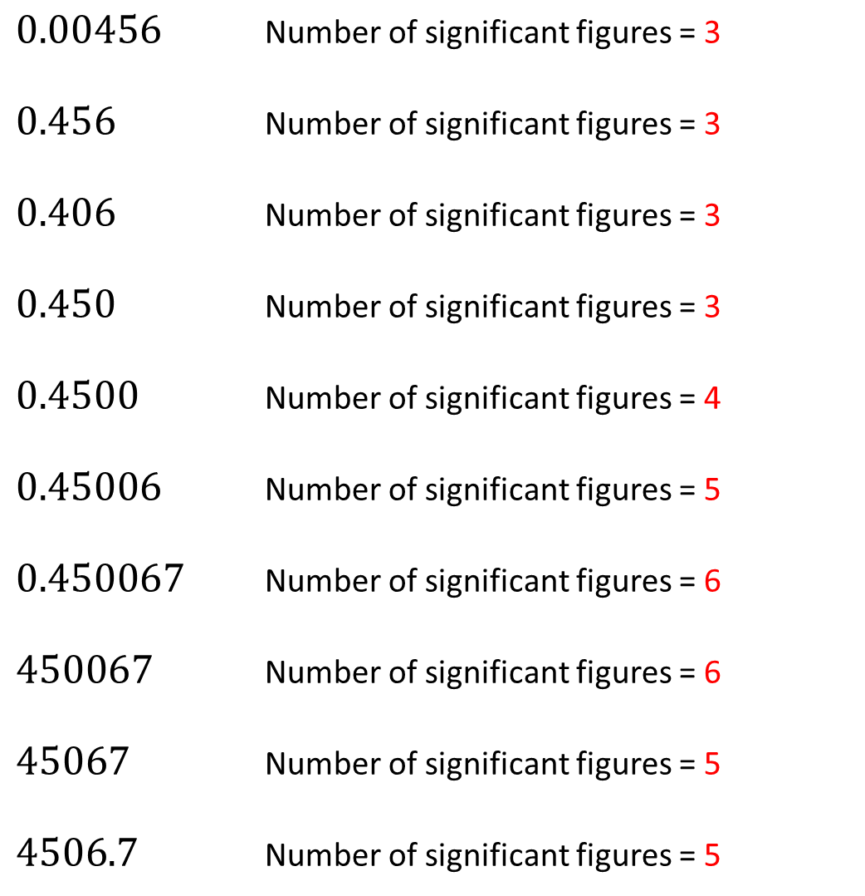
$0.00456$ Number of significant figures = 3
$0.456$ Number of significant figures = 3
$0.406$ Number of significant figures = 3
$0.450$ Number of significant figures = 3
$0.4500$ Number of significant figures = 4
$0.45006$ Number of significant figures = 5
$0.450067$ Number of significant figures = 6
$450067$ Number of significant figures = 6
$45067$ Number of significant figures = 5
$4506.7$ Number of significant figures = 5
@mrbartonmaths

Slide 7
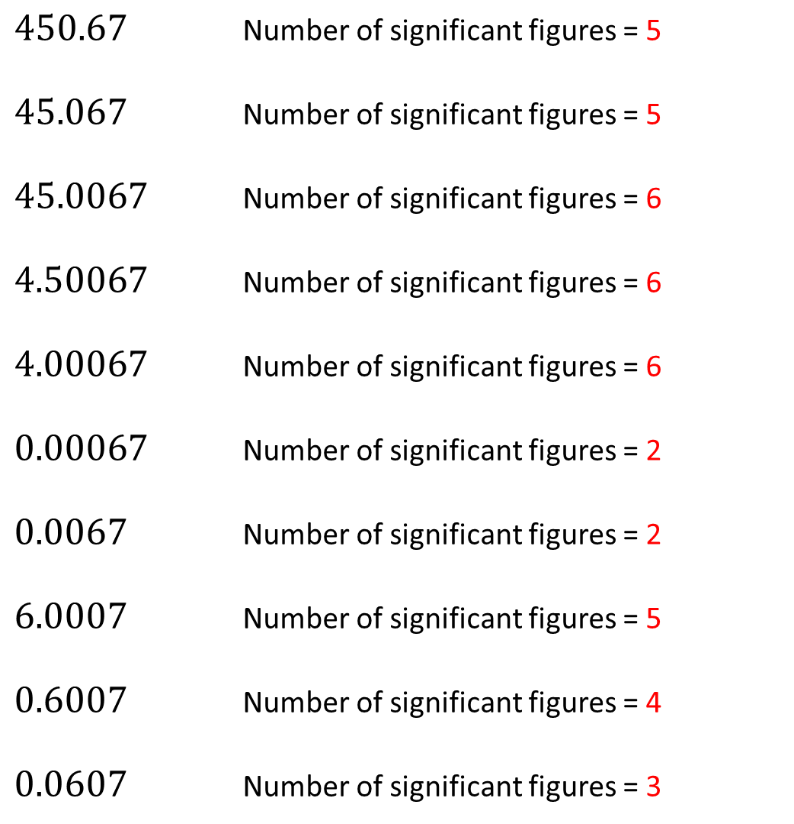
$450.67$ Number of significant figures = 5
$45.067$ Number of significant figures = 5
$45.0067$ Number of significant figures = 6
$4.50067$ Number of significant figures = 6
$4.00067$ Number of significant figures = 6
$0.00067$ Number of significant figures = 2
$0.0067$ Number of significant figures = 2
$6.0007$ Number of significant figures = 5
$0.6007$ Number of significant figures = 4
$0.0607$ Number of significant figures = 3
@mrbartonmaths

Slide 8
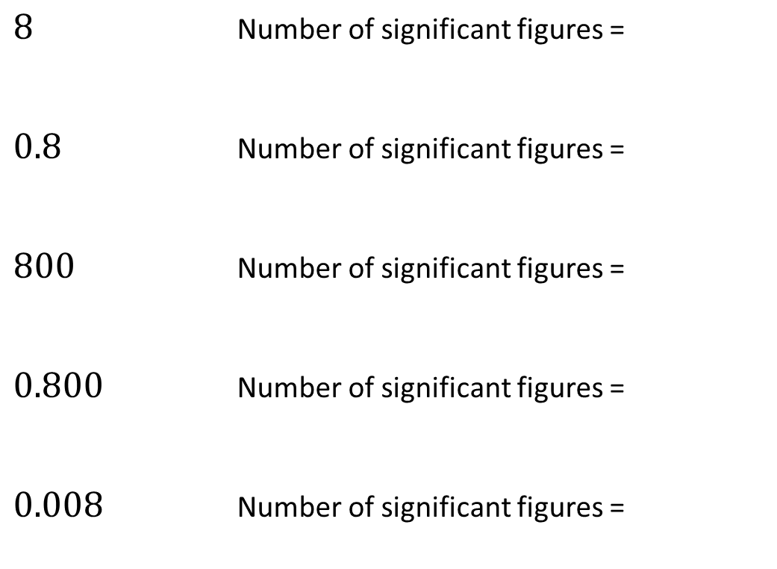
Your Turn
$8$ Number of significant figures =
$0.8$ Number of significant figures =
$800$ Number of significant figures =
$0.800$ Number of significant figures =
$0.008$ Number of significant figures =
@mrbartonmaths

Slide 9
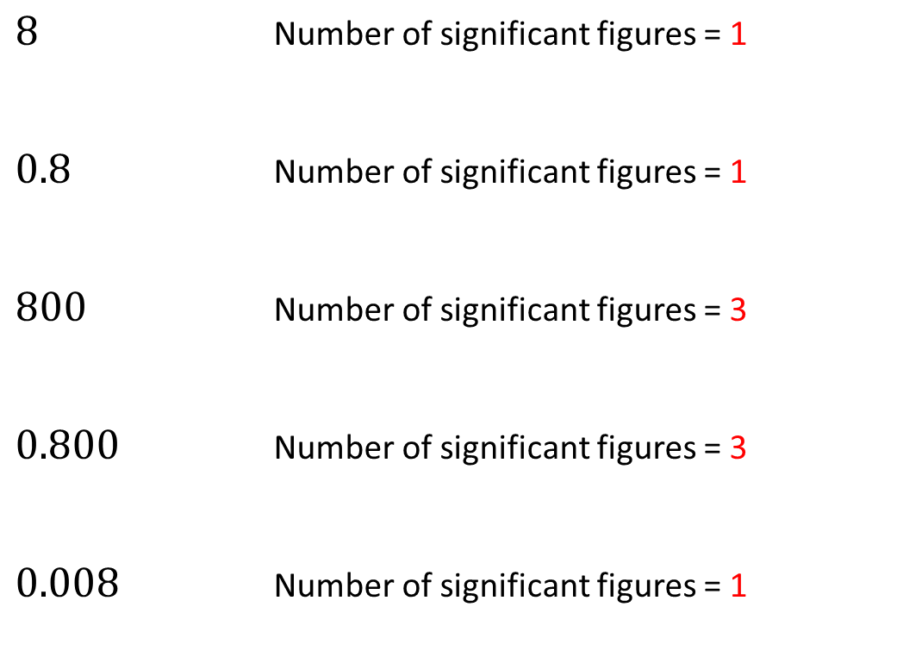
Your Turn - answers
$8$ Number of significant figures = 1
$0.8$ Number of significant figures = 1
$800$ Number of significant figures = 3
$0.800$ Number of significant figures = 3
$0.008$ Number of significant figures = 1
@mrbartonmaths

