Slide 1
Standard form: In standard form?
True/false
Reflect
Your Turn
$$3.37×{10}^{5}= ?$$
$$33.37×{10}^{5}= ?$$
$$3.037×{10}^{5}= ?$$
Rule
For more videos visit mrbartonmaths.com/videos

Slide 2
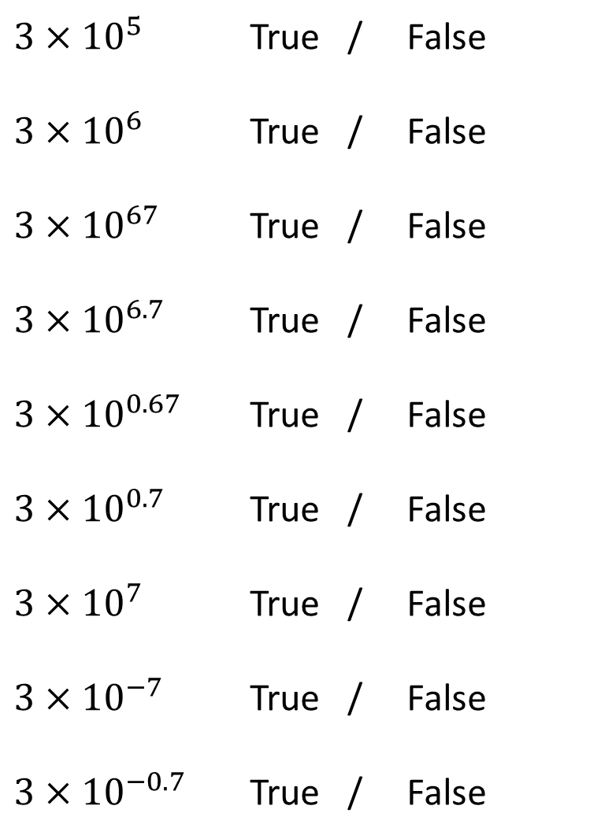
$3×{10}^{5}$ True / False
$3×{10}^{6}$ True / False
$3×{10}^{67}$ True / False
$3×{10}^{6.7}$ True / False
$3×{10}^{0.67}$ True / False
$3×{10}^{0.7}$ True / False
$3×{10}^{7}$ True / False
$3×{10}^{−7}$ True / False
$3×{10}^{−0.7}$ True / False
@mrbartonmaths

Slide 3
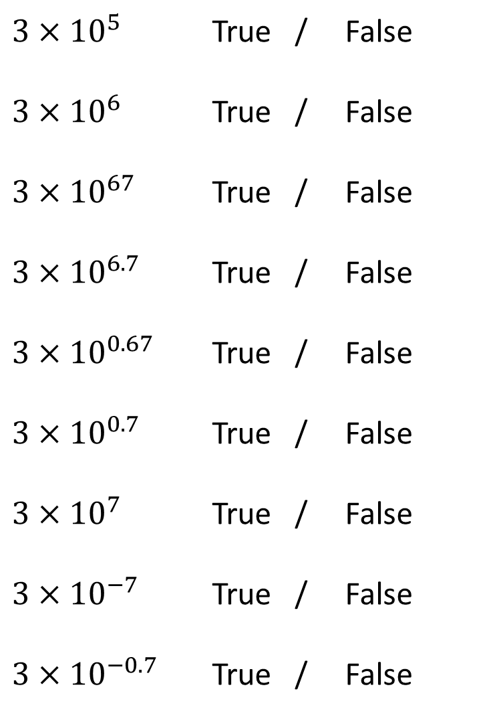
$3×{10}^{5}$ True / False
$3×{10}^{6}$ True / False
$3×{10}^{67}$ True / False
$3×{10}^{6.7}$ True / False
$3×{10}^{0.67}$ True / False
$3×{10}^{0.7}$ True / False
$3×{10}^{7}$ True / False
$3×{10}^{−7}$ True / False
$3×{10}^{−0.7}$ True / False
@mrbartonmaths

Slide 4
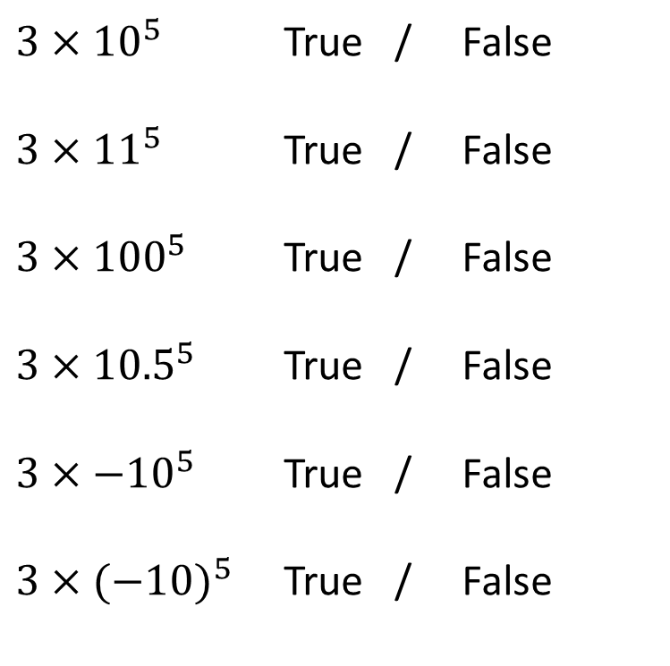
$3×{10}^{5}$ True / False
$3×{11}^{5}$ True / False
$3×{100}^{5}$ True / False
$3×{10.5}^{5}$ True / False
$3×{−10}^{5}$ True / False
$3×{(−10)}^{5}$ True / False
@mrbartonmaths

Slide 5
$3×{10}^{5}$ True / False
$3×{11}^{5}$ True / False
$3×{100}^{5}$ True / False
$3×{10.5}^{5}$ True / False
$3×{−10}^{5}$ True / False
$3×{(−10)}^{5}$ True / False
@mrbartonmaths

Slide 6
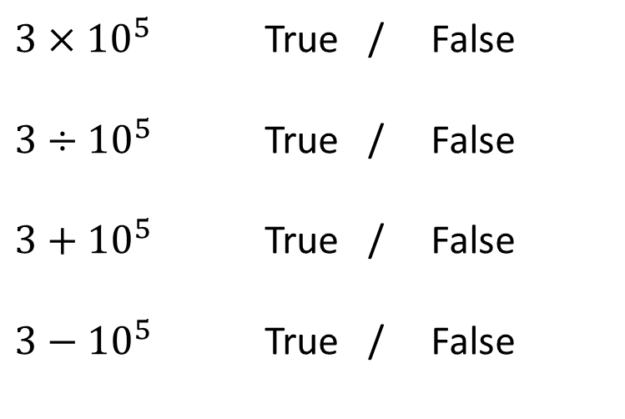
$3×{10}^{5}$ True / False
$3÷{10}^{5}$ True / False
$3+{10}^{5}$ True / False
$3−{10}^{5}$ True / False
@mrbartonmaths

Slide 7
$3×{10}^{5}$ True / False
$3÷{10}^{5}$ True / False
$3+{10}^{5}$ True / False
$3−{10}^{5}$ True / False
@mrbartonmaths

Slide 8
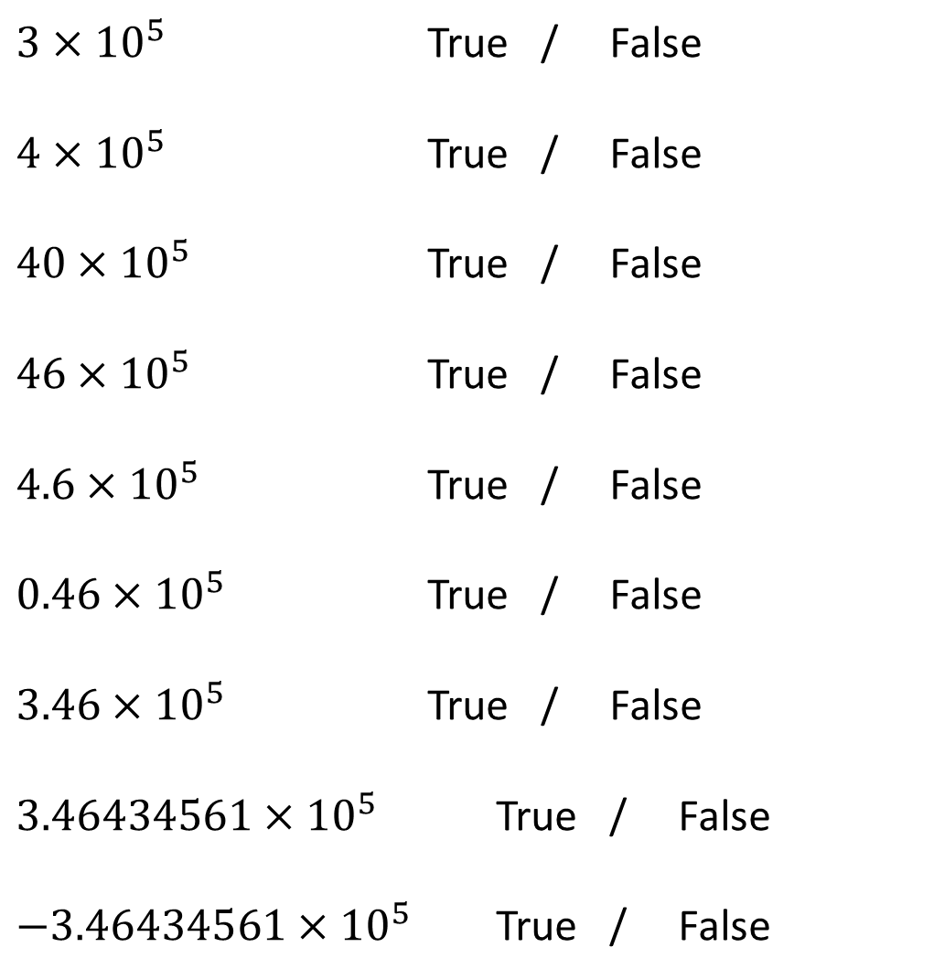
$3×{10}^{5}$ True / False
$4×{10}^{5}$ True / False
$40×{10}^{5}$ True / False
$46×{10}^{5}$ True / False
$4.6×{10}^{5}$ True / False
$0.46×{10}^{5}$ True / False
$3.46×{10}^{5}$ True / False
$3.46434561×{10}^{5}$ True / False
$−3.46434561×{10}^{5}$ True / False
@mrbartonmaths

Slide 9
$3×{10}^{5}$ True / False
$4×{10}^{5}$ True / False
$40×{10}^{5}$ True / False
$46×{10}^{5}$ True / False
$4.6×{10}^{5}$ True / False
$0.46×{10}^{5}$ True / False
$3.46×{10}^{5}$ True / False
$3.46434561×{10}^{5}$ True / False
$−3.46434561×{10}^{5}$ True / False
@mrbartonmaths

Slide 10
Your Turn
$$4.5×{10}^{9}$$
True / False
$$45×{10}^{9}$$
True / False
$$0.45×{10}^{9}$$
True / False
$$4.5×{10}^{−9}$$
True / False
$$−4.5×{10}^{9}$$
True / False
@mrbartonmaths

Slide 11
Your Turn - Answers
$$4.5×{10}^{9}$$
True / False
$$45×{10}^{9}$$
True / False
$$0.45×{10}^{9}$$
True / False
$$4.5×{10}^{−9}$$
True / False
$$−4.5×{10}^{9}$$
True / False
@mrbartonmaths

