Slide 1
Inequalities: Listing numbers with division
Silent
Teacher
Intelligent Practice
Narration
Your Turn
List the integers that satisfy$−9<3y<3$
List the integers that satisfy$−9<2y<3$
List the integers that satisfy$−9≤2y≤3$
Practice

Slide 2
Worked Examples
Your Turn
List the integers that satisfy $−2<2y≤4$
List the integers that satisfy $−2≤2y<4$
@mathsmrgordon

Slide 3
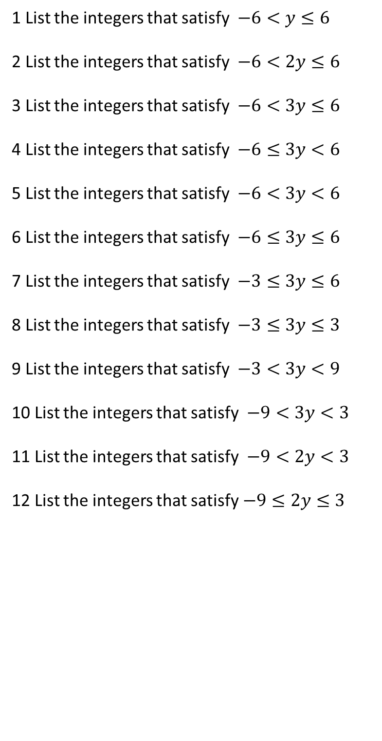
1 List the integers that satisfy$−6<y≤6$
2 List the integers that satisfy$−6<2y≤6$
3 List the integers that satisfy$−6<3y≤6$
4 List the integers that satisfy$−6≤3y<6$
5 List the integers that satisfy$−6<3y<6$
6 List the integers that satisfy$−6≤3y≤6$
7 List the integers that satisfy$−3≤3y≤6$
8 List the integers that satisfy$−3≤3y≤3$
9 List the integers that satisfy$−3<3y<9$
10 List the integers that satisfy$−9<3y<3$
11 List the integers that satisfy$−9<2y<3$
12 List the integers that satisfy$−9≤2y≤3$
@mathsmrgordon

Slide 4

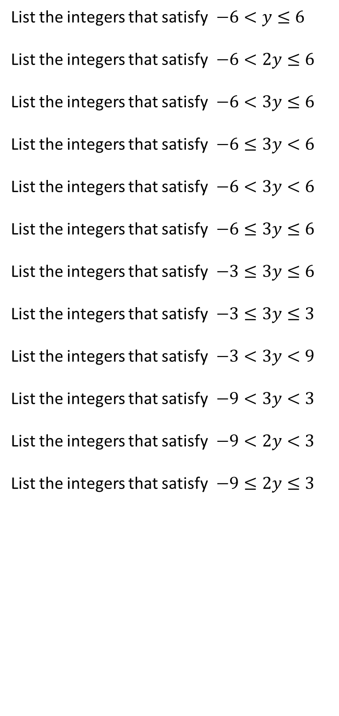
List the integers that satisfy$−6<y≤6$
List the integers that satisfy$−6<2y≤6$
List the integers that satisfy$−6<3y≤6$
List the integers that satisfy$−6≤3y<6$
List the integers that satisfy$−6<3y<6$
List the integers that satisfy$−6≤3y≤6$
List the integers that satisfy$−3≤3y≤6$
List the integers that satisfy$−3≤3y≤3$
List the integers that satisfy$−3<3y<9$
List the integers that satisfy$−9<3y<3$
List the integers that satisfy$−9<2y<3$
List the integers that satisfy$−9≤2y≤3$
$$−5, −4, −3, −2, −1, 0, 1, 2, 3, 4, 5, 6$$
$$−2,−1,0,1,2,3$$
-1,0,1,2
-2,-1,0,1
-1,0,1
-2,-1,0,1,2
-1,0,1,2
-1,0,1
0,1,2
-2,-1,0
-4,-3,-2,-1,0,1
-4,-3,-2,-1,0,1
@mathsmrgordon

