Slide 1
Straight line graphs: Intercepts: $y=mx+c$
Silent
Teacher
Intelligent Practice
Narration
Your Turn
$$y=6x+18$$
$$y=3x+18$$
$$y=3x−18$$
Example
For more videos visit mrbartonmaths.com/videos

Slide 2
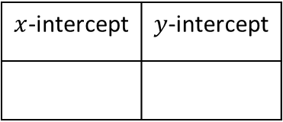
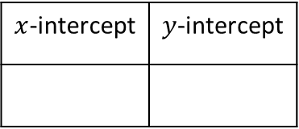
Worked Example
Your Turn
$$y=2x+10$$
$$y=2x−10$$
$x$-intercept | $y$-intercept
$x$-intercept | $y$-intercept
@mrbartonmaths

Slide 3
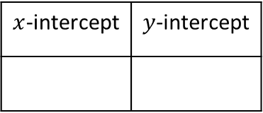
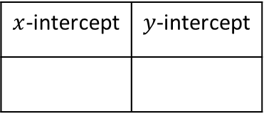
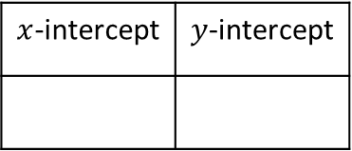
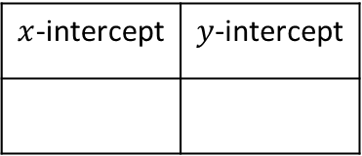
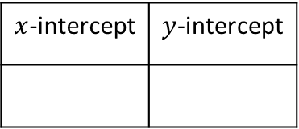
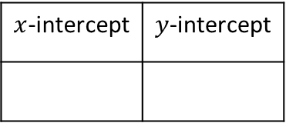
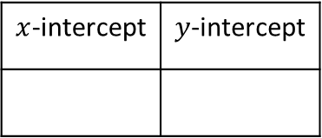
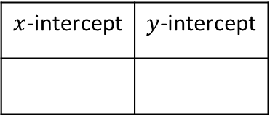
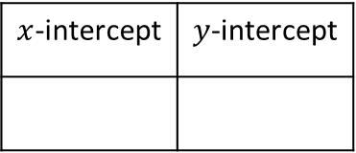
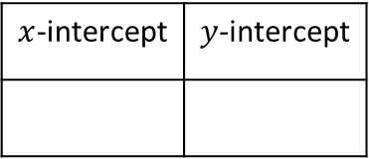
$x$-intercept | $y$-intercept
Gradient | y-intercept
$x$-intercept | $y$-intercept
$$y=3x+6$$
$$y=2x−18$$
$x$-intercept | $y$-intercept
Gradient | y-intercept
$x$-intercept | $y$-intercept
$$y=3x+9$$
$$y=18−2x$$
$x$-intercept | $y$-intercept
$x$-intercept | $y$-intercept
$$y=6x+18$$
$$y=−2x+18$$
$x$-intercept | $y$-intercept
$x$-intercept | $y$-intercept
$$y=3x+18$$
$$y=−4x+18$$
$x$-intercept | $y$-intercept
$x$-intercept | $y$-intercept
$$y=3x−18$$
$$y=−4x+9$$
@mrbartonmaths

Slide 4
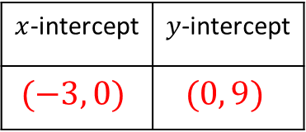
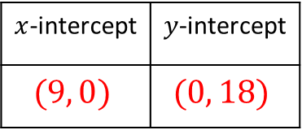
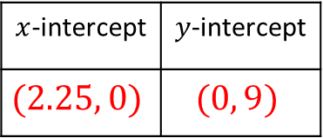
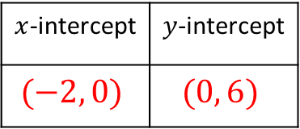
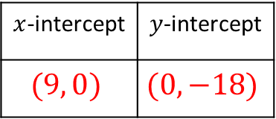
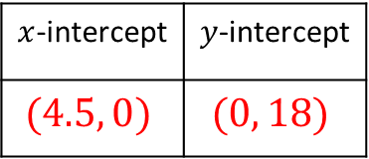
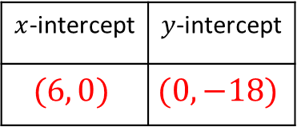
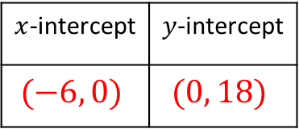
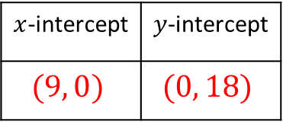
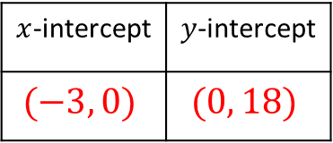
$x$-intercept | $y$-intercept
$$(−2, 0)$$ | $$(0, 6)$$
Gradient | y-intercept
$x$-intercept | $y$-intercept
$$(9, 0)$$ | $$(0, −18)$$
$$y=3x+6$$
$$y=2x−18$$
$x$-intercept | $y$-intercept
$$(−3, 0)$$ | $$(0, 9)$$
Gradient | y-intercept
$x$-intercept | $y$-intercept
$$(9, 0)$$ | $$(0, 18)$$
$$y=3x+9$$
$$y=18−2x$$
$x$-intercept | $y$-intercept
$$(−3, 0)$$ | $$(0, 18)$$
$x$-intercept | $y$-intercept
$$(9, 0)$$ | $$(0, 18)$$
$$y=6x+18$$
$$y=−2x+18$$
$x$-intercept | $y$-intercept
$$(−6, 0)$$ | $$(0, 18)$$
$x$-intercept | $y$-intercept
$$(4.5, 0)$$ | $$(0, 18)$$
$$y=3x+18$$
$$y=−4x+18$$
$x$-intercept | $y$-intercept
$$(6, 0)$$ | $$(0, −18)$$
$x$-intercept | $y$-intercept
$$(2.25, 0)$$ | $$(0, 9)$$
$$y=3x−18$$
$$y=−4x+9$$
@mrbartonmaths

