Slide 1
Fractions: Multiplying or dividing an integer by a fraction
True/false
Reflect
Your Turn
$$6 × \frac{1}{3}=$$
$$6 ÷ \frac{1}{3}=$$
$$6 ÷ \frac{2}{3}=$$
@mathsmrgordon
Rule
For more videos visit mrbartonmaths.com/videos

Slide 2
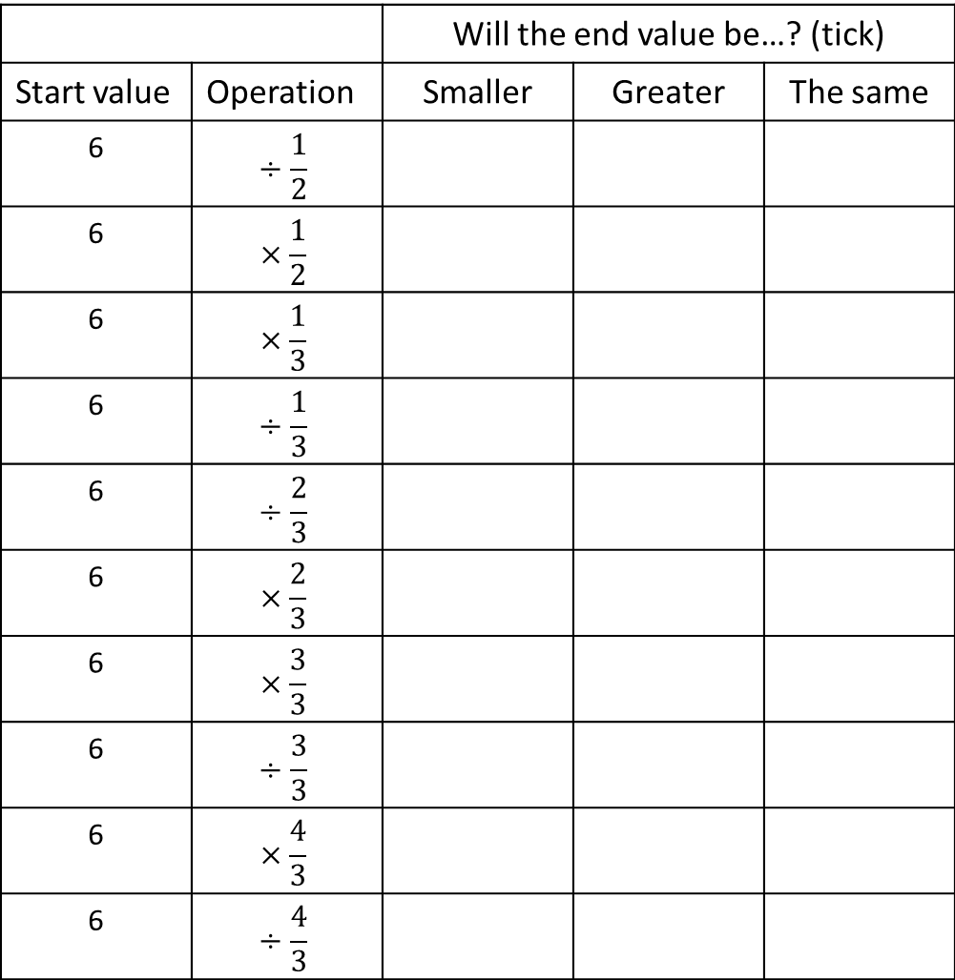
 |  | Will the end value be…? (tick)
Start value | Operation | Smaller | Greater | The same
6
6
6
6
6
6
6
6
6
6
@mathsmrgordon

Slide 3
 |  | Will the end value be…? (tick)
Start value | Operation | Greater | Smaller | The same
6
6
6
6
6
6
6
6
6
6
@mathsmrgordon

Slide 4
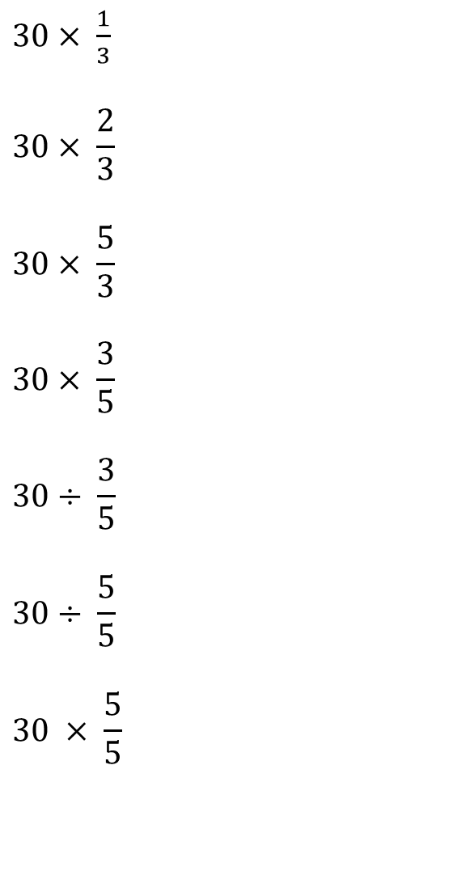
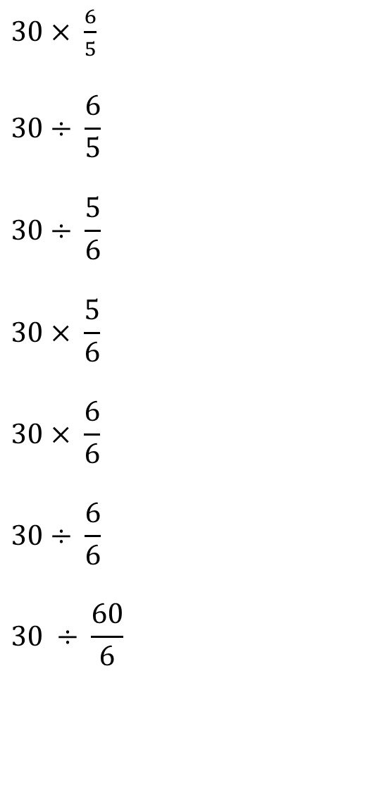
Your Turn
Greater Smaller The Same
Greater Smaller The Same
Greater Smaller The Same
Greater Smaller The Same
Greater Smaller The Same
Greater Smaller The Same
Greater Smaller The Same
Greater Smaller The Same
Greater Smaller The Same
Greater Smaller The Same
Greater Smaller The Same
Greater Smaller The Same
@mathsmrgordon
Greater Smaller The Same
Greater Smaller The Same

Slide 5
Your Turn - answers
Greater Smaller The Same
Greater Smaller The Same
Greater Smaller The Same
Greater Smaller The Same
Greater Smaller The Same
Greater Smaller The Same
Greater Smaller The Same
Greater Smaller The Same
Greater Smaller The Same
Greater Smaller The Same
Greater Smaller The Same
Greater Smaller The Same
@mathsmrgordon
Greater Smaller The Same
Greater Smaller The Same

