Slide 1
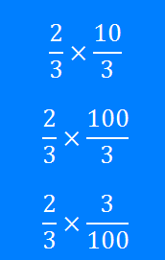
Fractions: Multiplying
Silent
Teacher
Intelligent Practice
Narration
Your Turn
Example
For more videos visit mrbartonmaths.com/videos

Slide 2
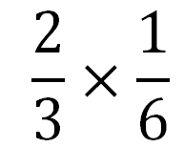
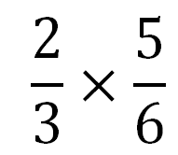
Worked Example
Your Turn
@fortyninecubed

Slide 3
@fortyninecubed

Slide 4
@fortyninecubed

Slide 5
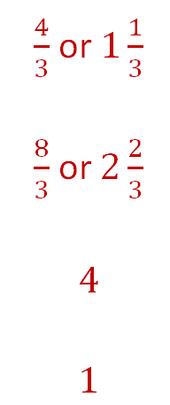
@fortyninecubed

Slide 6
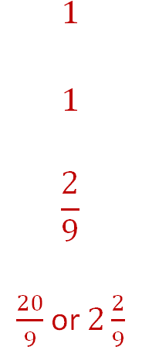
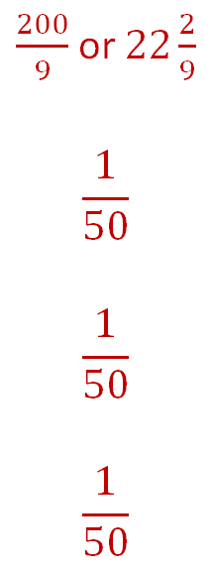
@fortyninecubed

