Slide 1
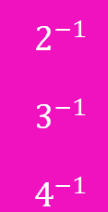
Powers and Indices: Negative indices
Pattern spot
Reflect
Your Turn
Pattern
For more videos visit mrbartonmaths.com/videos

Slide 2
$$. . .$$
$$. . .$$
@fortyninecubed

Slide 3
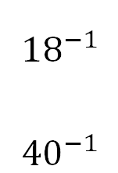
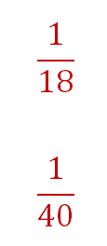
@fortyninecubed

Slide 4
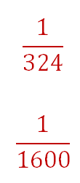
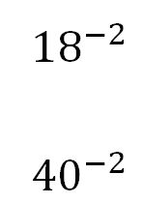
@fortyninecubed

Slide 5
Your Turn
@fortyninecubed

Slide 6
Your Turn - answers
@fortyninecubed

