Slide 1
Negative indices
Pattern spot
Reflect
Your Turn
$$2^{−4}= ?$$
$$3^{−2}= ?$$
$$5^{−3}= ?$$
Pattern
For more videos visit mrbartonmaths.com/videos

Slide 2
$$2^{6}=$$
$$3^{6}=$$
$$2^{5}=$$
$$3^{5}=$$
$$2^{4}=$$
$$3^{4}=$$
$$2^{3}=$$
$$3^{3}=$$
$$2^{2}=$$
$$3^{2}=$$
$$2^{1}=$$
$$3^{1}=$$
$$2^{0}=$$
$$3^{0}=$$
$$2^{−1}=$$
$$3^{−1}=$$
$$2^{−2}=$$
$$3^{−2}=$$
$$2^{−3}=$$
$$3^{−3}=$$
$$2^{−4}=$$
$$3^{−4}=$$
$$2^{−5}=$$
$$3^{−5}=$$
$$2^{−6}=$$
$$3^{−6}=$$

Slide 3
$$2^{6}=64$$
$$3^{6}=729$$
$$2^{5}=32$$
$$3^{5}=243$$
$$2^{4}=16$$
$$3^{4}=81$$
$$2^{3}=8$$
$$3^{3}=27$$
$$2^{2}=4$$
$$3^{2}=9$$
$$2^{1}=2$$
$$3^{1}=3$$
$$2^{0}=1$$
$$3^{0}=1$$
$$2^{−1}=\frac{1}{2}$$
$$3^{−1}=\frac{1}{3}$$
$$2^{−2}=\frac{1}{4}$$
$$3^{−2}=\frac{1}{9}$$
$$2^{−3}=\frac{1}{8}$$
$$3^{−3}=\frac{1}{27}$$
$$2^{−4}=\frac{1}{16}$$
$$3^{−4}=\frac{1}{81}$$
$$2^{−5}=\frac{1}{32}$$
$$3^{−5}=\frac{1}{243}$$
$$2^{−6}=\frac{1}{64}$$
$$3^{−6}=\frac{1}{729}$$

Slide 4
Your Turn
$$5^{3}=$$
$$5^{2}=$$
$$5^{1}=$$
$$5^{0}=$$
$$5^{−1}=$$
$$5^{−2}=$$
$$5^{−3}=$$

Slide 5
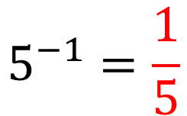
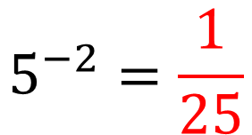
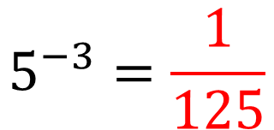
Your Turn
$$5^{3}=125$$
$$5^{2}=25$$
$$5^{1}=5$$
$$5^{0}=1$$
$$5^{−1}=\frac{1}{5}$$
$$5^{−2}=\frac{1}{25}$$
$$5^{−3}=\frac{1}{125}$$

