Slide 1
Straight line graphs: Parallel or perpendicular? (positive integer gradient)
True/false
Reflect
Your Turn
$$y=3x−7$$
$$y=−3x−7$$
$$y=\frac{1}{3}x−7$$
Rule
For more videos visit mrbartonmaths.com/videos

Slide 2
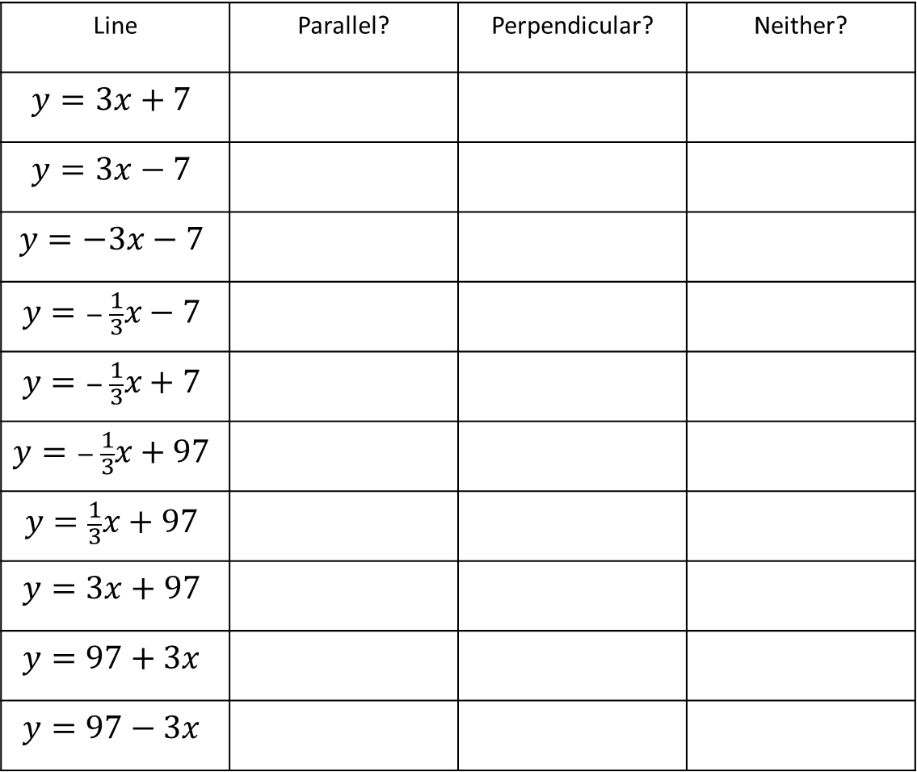
Always compare to: $y=3x+6$
Line | Parallel? | Perpendicular? | Neither?
$$y=3x+7$$
$$y=3x−7$$
$$y=−3x−7$$
$$y=− \frac{1}{3}x−7$$
$$y=− \frac{1}{3}x+7$$
$$y=− \frac{1}{3}x+97$$
$$y=\frac{1}{3}x+97$$
$$y=3x+97$$
$$y=97+3x$$
$$y=97−3x$$
@mrbartonmaths

Slide 3
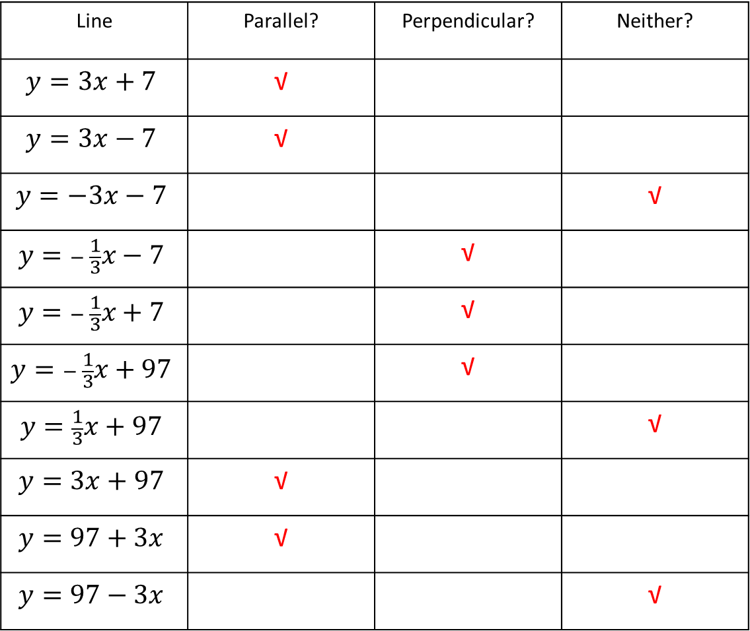
Always compare to: $y=3x+6$
Line | Parallel? | Perpendicular? | Neither?
$$y=3x+7$$ | √
$$y=3x−7$$ | √
$$y=−3x−7$$ |  |  | √
$$y=− \frac{1}{3}x−7$$ |  | √
$$y=− \frac{1}{3}x+7$$ |  | √
$$y=− \frac{1}{3}x+97$$ |  | √
$$y=\frac{1}{3}x+97$$ |  |  | √
$$y=3x+97$$ | √
$$y=97+3x$$ | √
$$y=97−3x$$ |  |  | √
@mrbartonmaths

Slide 4
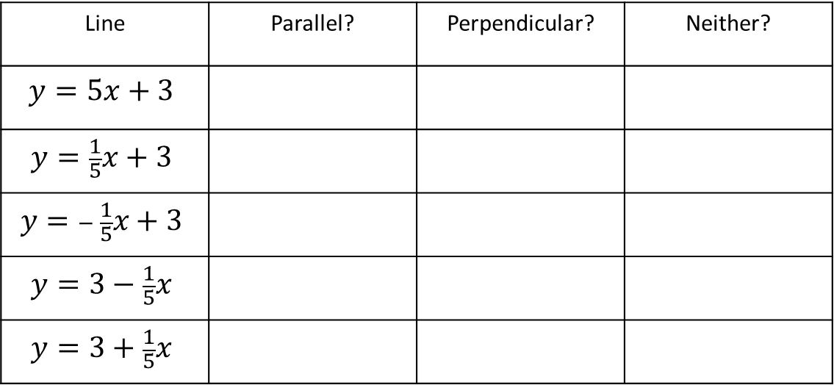
Your Turn
Always compare to: $y=5x−3$
Line | Parallel? | Perpendicular? | Neither?
$$y=5x+3$$
$$y=\frac{1}{5}x+3$$
$$y=− \frac{1}{5}x+3$$
$$y=3−\frac{1}{5}x$$
$$y=3+\frac{1}{5}x$$
@mrbartonmaths

Slide 5
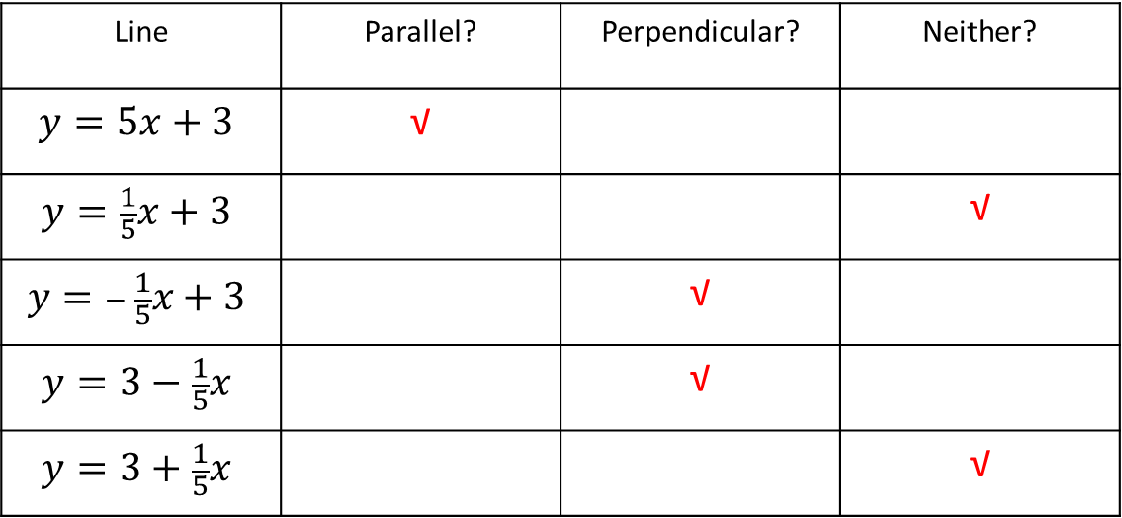
Your Turn - answers
Always compare to: $y=5x−3$
Line | Parallel? | Perpendicular? | Neither?
$$y=5x+3$$ | √
$$y=\frac{1}{5}x+3$$ |  |  | √
$$y=− \frac{1}{5}x+3$$ |  | √
$$y=3−\frac{1}{5}x$$ |  | √
$$y=3+\frac{1}{5}x$$ |  |  | √
@mrbartonmaths

