Slide 1
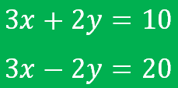
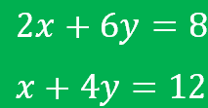
Simultaneous Equations: Ready to be Added/Subtracted?
True/false
Reflect
Your Turn
Rule
For more videos visit mrbartonmaths.com/videos

Slide 2
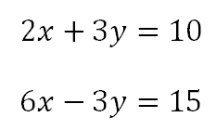
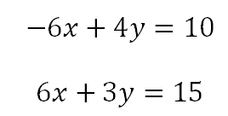
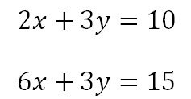
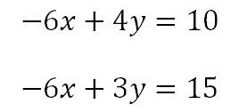
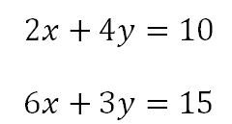
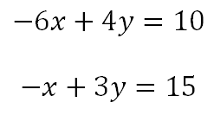
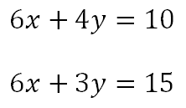
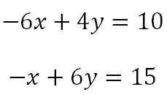
Yes / No
Yes / No
Yes / No
Yes / No
Yes / No
Yes / No
Yes / No
Yes / No
@fortyninecubed

Slide 3
Yes / No
Yes / No
Yes / No
Yes / No
Yes / No
Yes / No
Yes / No
Yes / No
@fortyninecubed

Slide 4
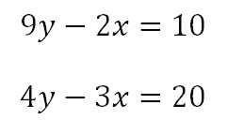
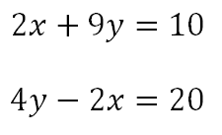
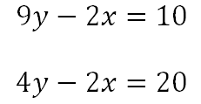
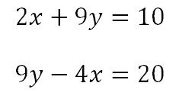
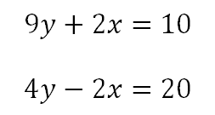
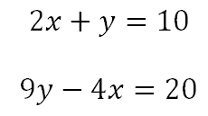
Your Turn
Yes / No
Yes / No
Yes / No
Yes / No
Yes / No
Yes / No
@fortyninecubed

Slide 5
Your Turn - ANSWERS
Yes / No
Yes / No
Yes / No
Yes / No
Yes / No
Yes / No
@fortyninecubed

