Slide 1
Rounding and estimating: Spot the significant figure
True/false
Reflect
Your Turn
$$4500 ?$$
$$4506 ?$$
$$45.06 ?$$
Rule
For more videos visit mrbartonmaths.com/videos

Slide 2
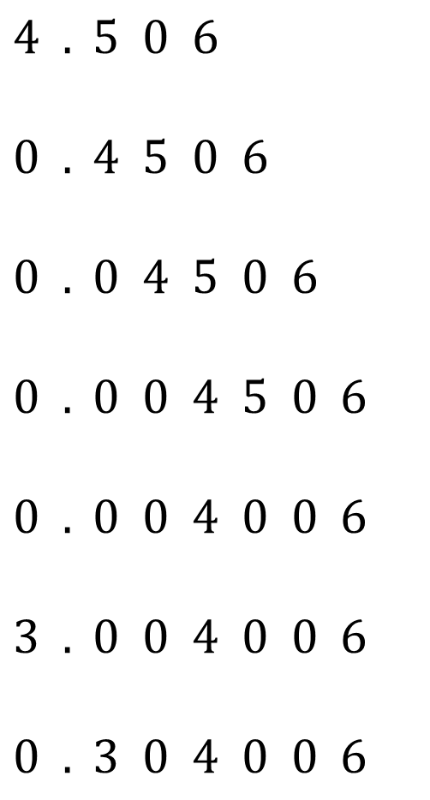

Circle the 2nd significant figure
$$4 5 6$$
$$4 0 6$$
$$4 0 0$$
$$4 0 0 0$$
$$4 5 0 0$$
$$4 5 0 6$$
$$4 5 . 0 6$$
$$4 . 5 0 6$$
$$0 . 4 5 0 6$$
$$0 . 0 4 5 0 6$$
$$0 . 0 0 4 5 0 6$$
$$0 . 0 0 4 0 0 6$$
$$3 . 0 0 4 0 0 6$$
$$0 . 3 0 4 0 0 6$$
@mrbartonmaths

Slide 3
Circle the 2nd significant figure
$$4 5 6$$
$$4 0 6$$
$$4 0 0$$
$$4 0 0 0$$
$$4 5 0 0$$
$$4 5 0 6$$
$$4 5 . 0 6$$
$$4 . 5 0 6$$
$$0 . 4 5 0 6$$
$$0 . 0 4 5 0 6$$
$$0 . 0 0 4 5 0 6$$
$$0 . 0 0 4 0 0 6$$
$$3 . 0 0 4 0 0 6$$
$$0 . 3 0 4 0 0 6$$
@mrbartonmaths

Slide 4

Your Turn
Circle the 2nd significant figure
$$7 8 0 0$$
$$7 0 0 8$$
$$7 . 0 0 8$$
$$0 . 0 0 7 8$$
$$0 . 7 0 0 8$$
@mrbartonmaths

Slide 5
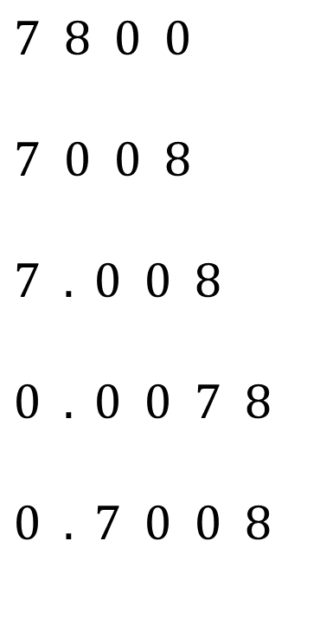
Your Turn - answers
Circle the 2nd significant figure
$$7 8 0 0$$
$$7 0 0 8$$
$$7 . 0 0 8$$
$$0 . 0 0 7 8$$
$$0 . 7 0 0 8$$
@mrbartonmaths

