Slide 1
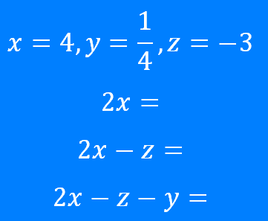
Formula: Substitution – part 2
Silent
Teacher
Intelligent Practice
Narration
Your Turn
Example
For more videos visit mrbartonmaths.com/videos

Slide 2
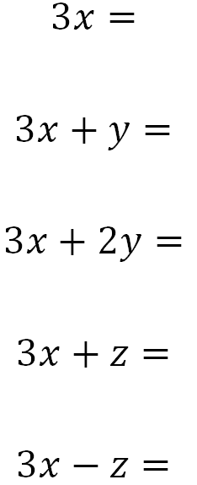
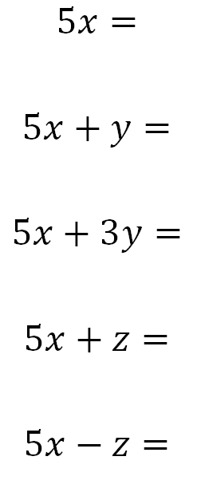
Worked Example
Your Turn
@fortyninecubed

Slide 3
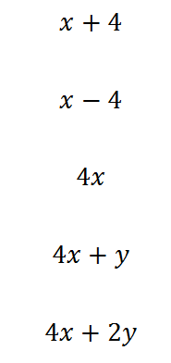
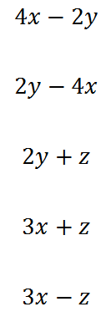
@fortyninecubed

Slide 4
@fortyninecubed

Slide 5
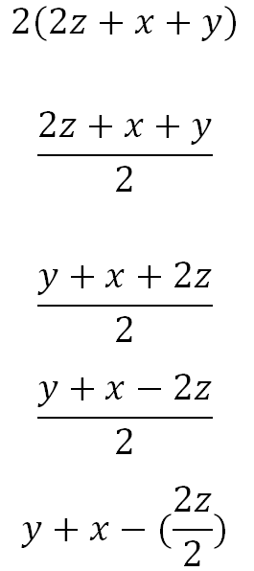
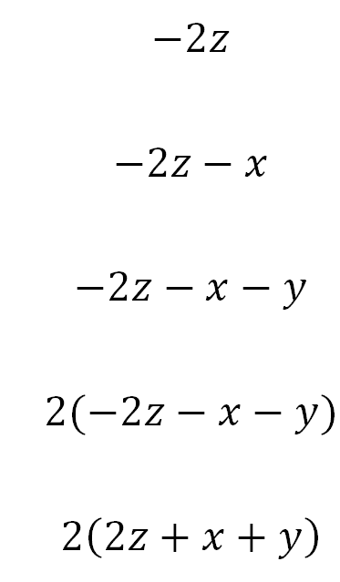
@fortyninecubed

Slide 6

$$−\frac{13}{2}$$
$$10$$
$$7$$
$$6\frac{1}{2}$$
$$13$$
$$−13$$
@fortyninecubed

