Slide 1
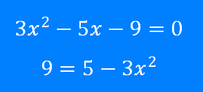
Solving Quadratics: Using the Quadratic Formula 1
Silent
Teacher
Intelligent Practice
Narration
Your Turn
Example
For more videos visit mrbartonmaths.com/videos

Slide 2
Worked Example
Your Turn
@fortyninecubed

Slide 3
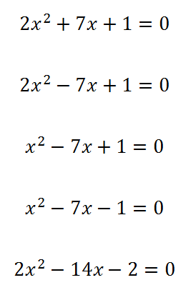

$$−2−14x+{2x}^{2}=0$$
$$−14x+{2x}^{2}=0$$
$$−2+{2x}^{2}=0$$
$${2x}^{2}=2$$
@fortyninecubed

Slide 4
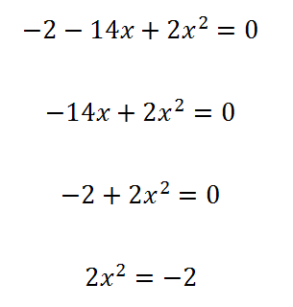
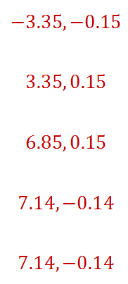
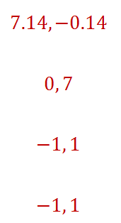
$$2$$
@fortyninecubed

