Slide 1
Surface area and volume: Volume of a cuboid
Silent
Teacher
Intelligent Practice
Narration
Your Turn
Example
For more videos visit mrbartonmaths.com/videos

Slide 2
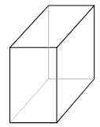
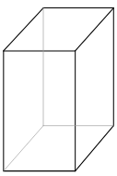
Worked Example
Your turn
6cm
10cm
10cm
8cm
8cm
6cm
Calculate the volume.
Calculate the volume.
@mathsmrgordon

Slide 3
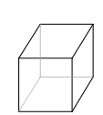
4cm
8cm
8cm
80cm
5cm
5cm
4cm
40cm
4cm
4cm
5cm
50cm
0.4cm
4cm
4cm
40cm
20cm
200cm
200cm
20cm
2.5cm
25cm
25cm
25cm
@mathsmrgordon

Slide 4
4cm
8cm
8cm
80cm
5cm
5cm
4cm
40cm
4cm
4cm
5cm
50cm
Volume = 80cm³
Volume = 160cm³
Volume = 160cm³
Volume = 160 000cm³
0.4cm
4cm
4cm
40cm
20cm
200cm
200cm
20cm
2.5cm
25cm
25cm
25cm
Volume = 10cm³
Volume = 10 000cm³
Volume = 20 000cm³
Volume = 20 000cm³
@mathsmrgordon

