Slide 1
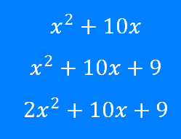
Quadratics: Completing the Square 1
Silent
Teacher
Intelligent Practice
Narration
Your Turn
Example
For more videos visit mrbartonmaths.com/videos

Slide 2
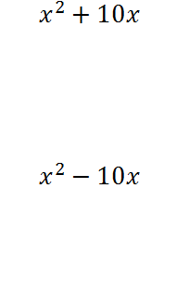
Worked Example
Your Turn
@fortyninecubed

Slide 3
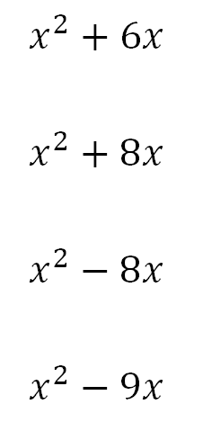
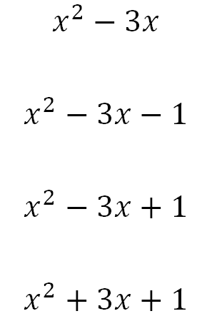
@fortyninecubed

Slide 4
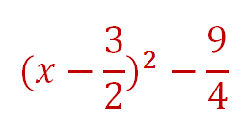
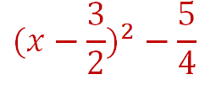
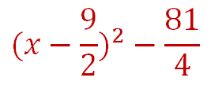
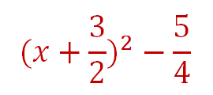
@fortyninecubed

