Slide 1
Surds: Surds with Powers
Silent
Teacher
Intelligent Practice
Narration
Your Turn
$${\left(2\sqrt{10}\right)}^{2}$$
$${\left(3\sqrt{10}\right)}^{2}$$
$${3\left(\sqrt{10}\right)}^{2}$$
Example
For more videos visit mrbartonmaths.com/videos

Slide 2
Worked Example
Your Turn
$$({√6)}^{2}$$
$$({√7)}^{2}$$
$$2({√6)}^{2}$$
$$2({√7)}^{2}$$
$$2({√6)}^{3}$$
$$2({√7)}^{3}$$
@fortyninecubed

Slide 3
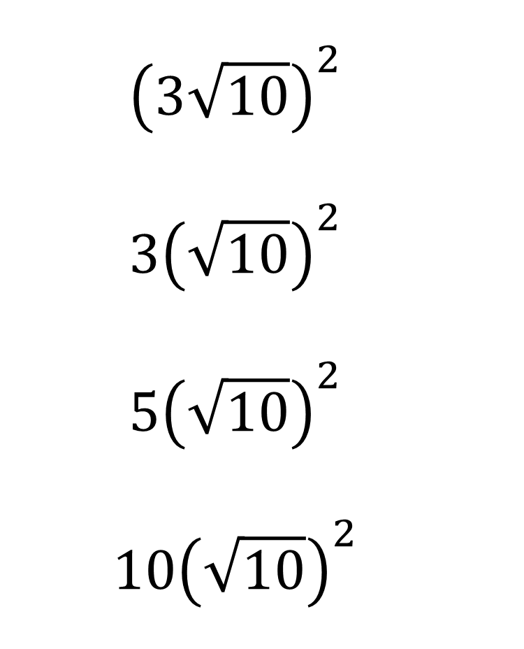

$${\left(\sqrt{2}\right)}^{2}$$
$${\left(\sqrt{3}\right)}^{2}$$
$${\left(\sqrt{5}\right)}^{2}$$
$${\left(\sqrt{10}\right)}^{2}$$
$${\left(2\sqrt{10}\right)}^{2}$$
$${\left(3\sqrt{10}\right)}^{2}$$
$${3\left(\sqrt{10}\right)}^{2}$$
$${5\left(\sqrt{10}\right)}^{2}$$
$${10\left(\sqrt{10}\right)}^{2}$$
@fortyninecubed

Slide 4


$$2$$
$$3$$
$$5$$
$$10$$
$$40$$
$${\left(\sqrt{2}\right)}^{2}$$
$${\left(\sqrt{3}\right)}^{2}$$
$${\left(\sqrt{5}\right)}^{2}$$
$${\left(\sqrt{10}\right)}^{2}$$
$${\left(2\sqrt{10}\right)}^{2}$$
$${\left(3\sqrt{10}\right)}^{2}$$
$${3\left(\sqrt{10}\right)}^{2}$$
$${5\left(\sqrt{10}\right)}^{2}$$
$${10\left(\sqrt{10}\right)}^{2}$$
$$90$$
$$30$$
$$50$$
$$100$$
@fortyninecubed

Slide 5


$${10\left(\sqrt{2}\right)}^{2}$$
$$10{\left(2\sqrt{2}\right)}^{2}$$
$${\left(2\sqrt{2}\right)}^{2}$$
$${\left(2\sqrt{2}\right)}^{3}$$
$${\left(\sqrt{2}\right)}^{3}$$
$${\left(\sqrt{3}\right)}^{3}$$
$${\left(\sqrt{5}\right)}^{3}$$
$${\left(\sqrt{5}\right)}^{4}$$
$${\left(\sqrt{5}\right)}^{5}$$
@fortyninecubed

Slide 6


$${10\left(\sqrt{2}\right)}^{2}$$
$$10{\left(2\sqrt{2}\right)}^{2}$$
$${\left(2\sqrt{2}\right)}^{2}$$
$${\left(2\sqrt{2}\right)}^{3}$$
$${\left(\sqrt{2}\right)}^{3}$$
$$3\sqrt{3}$$
$$5\sqrt{5}$$
$$25$$
$$25\sqrt{5}$$
$$20$$
$$80$$
$$8$$
$$16\sqrt{2}$$
$$2\sqrt{2}$$
$${\left(\sqrt{3}\right)}^{3}$$
$${\left(\sqrt{5}\right)}^{3}$$
$${\left(\sqrt{5}\right)}^{4}$$
$${\left(\sqrt{5}\right)}^{5}$$
@fortyninecubed

Slide 7
@fortyninecubed

