Slide 1
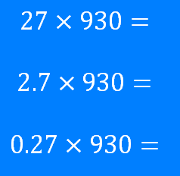
Place Value Using Place Value
Silent
Teacher
Intelligent Practice
Narration
Your Turn
Example
For more videos visit mrbartonmaths.com/videos

Slide 2
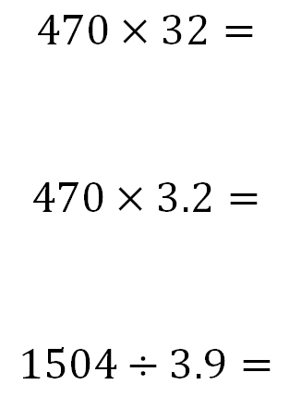
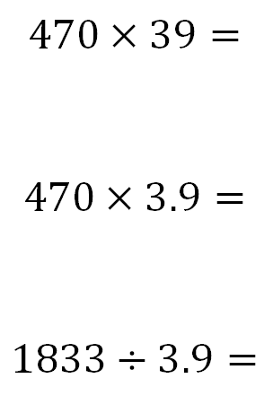
Worked Example
Your Turn
@fortyninecubed

Slide 3
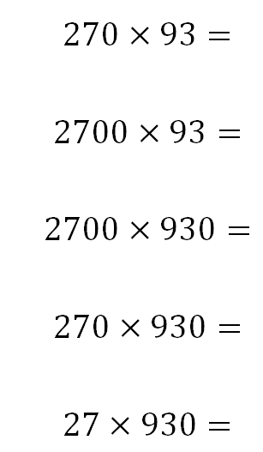
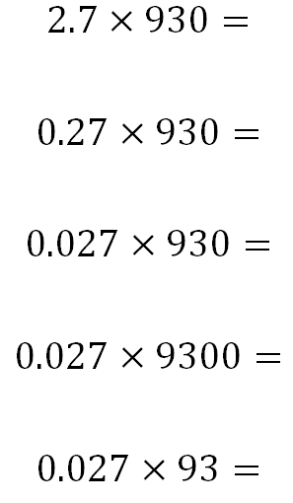
@fortyninecubed

Slide 4
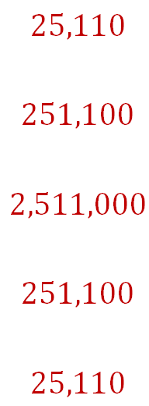
@fortyninecubed

Slide 5
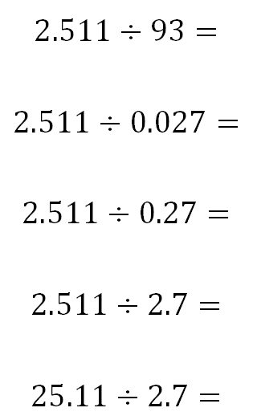
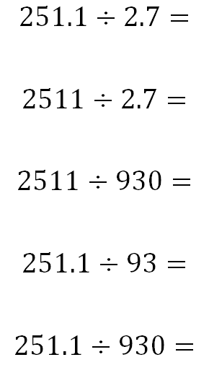
@fortyninecubed

Slide 6
@fortyninecubed

