Slide 1
Introducing algebra: Algebraic Notation
Silent
Teacher
Intelligent Practice
Narration
Your Turn
$$x^{2}$$
$${3x}^{2}$$
$3x^{2}y$
Example
For more videos visit mrbartonmaths.com/videos

Slide 2
Worked Example
Your Turn
$$7x$$
$$7a$$
$$xy$$
$$ab$$
$$xy^{2}$$
$$ab^{2}$$
@fortyninecubed

Slide 3
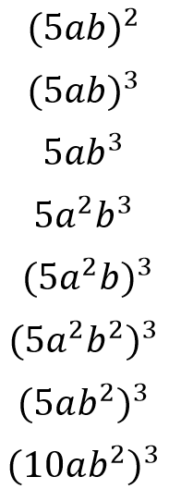
@fortyninecubed

Slide 4
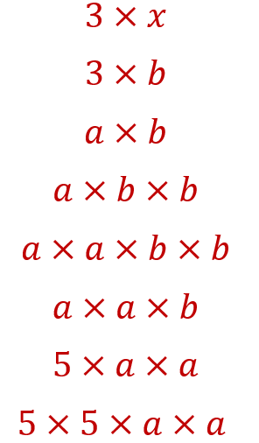
@fortyninecubed

Slide 5
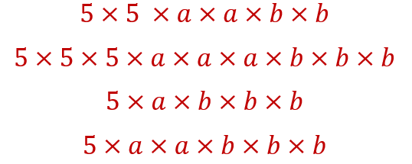
@fortyninecubed

