Slide 1
Circles: Area of a Circle
Silent
Teacher
Intelligent Practice
Narration
Your Turn
Example
For more videos visit mrbartonmaths.com/videos

Slide 2
Worked Example
Your Turn
10cm
5cm
@mathsmrgordon

Slide 3
3cm
6cm
6cm
@mathsmrgordon

Slide 4
1.2cm
12cm
24cm
@mathsmrgordon

Slide 5
240cm
120cm
12cm
@mathsmrgordon

Slide 6
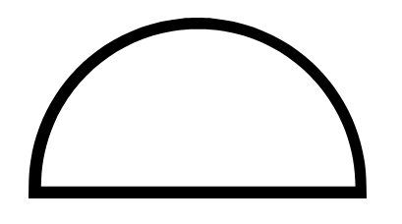
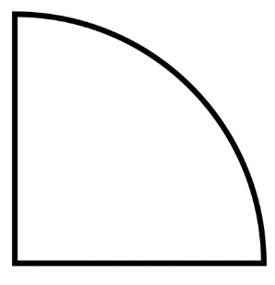
12cm
12cm
12cm
@mathsmrgordon

Slide 7
3cm
6cm
6cm
@mathsmrgordon

Slide 8
1.2cm
12cm
24cm
@mathsmrgordon

Slide 9
240cm
120cm
12cm
@mathsmrgordon

Slide 10
12cm
12cm
12cm

