Slide 1
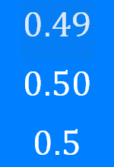
Fractions, Decimals, Percentages: Converting decimals to percentages
Silent
Teacher
Intelligent Practice
Narration
Your Turn
Example
For more videos visit mrbartonmaths.com/videos

Slide 2
Worked Example
Your Turn
@fortyninecubed

Slide 3
@fortyninecubed

Slide 4
@fortyninecubed

