Slide 1
Transformations: Reflecting a shape using y = x or y= -x
Silent
Teacher
Intelligent Practice
Narration
Your Turn
Example
For more videos visit mrbartonmaths.com/videos

Slide 2
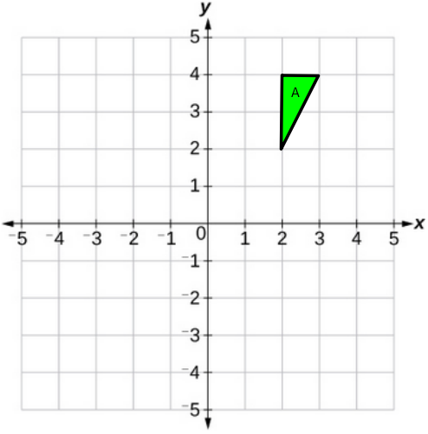
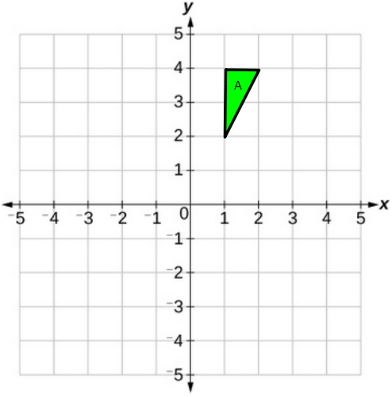
Worked Example
Your turn
Reflect triangle A using the line y = x
Reflect triangle A using the line y = x
@mathsmrgordon
Notes:
Talk about which point remains invariant due to it being on the line of reflection.

Slide 3
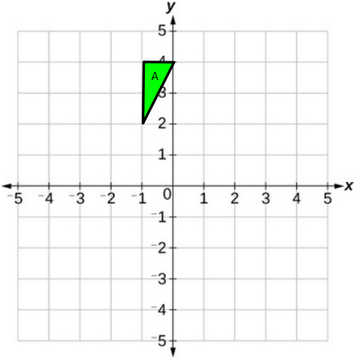
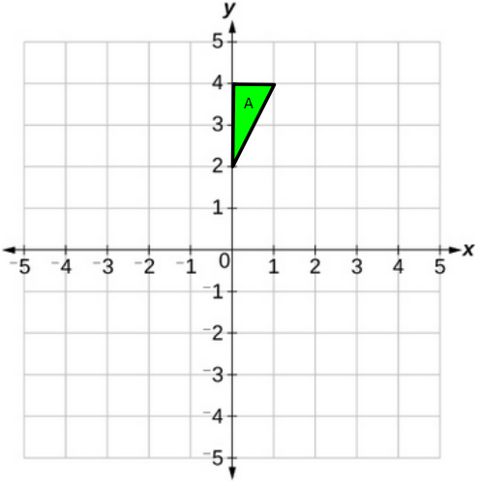
Worked Example
Your turn
Reflect triangle A using the line y = -x
Reflect triangle A using the line y = -x
@mathsmrgordon
Notes:
Talk about which point remains invariant due to it being on the line of reflection.

Slide 4
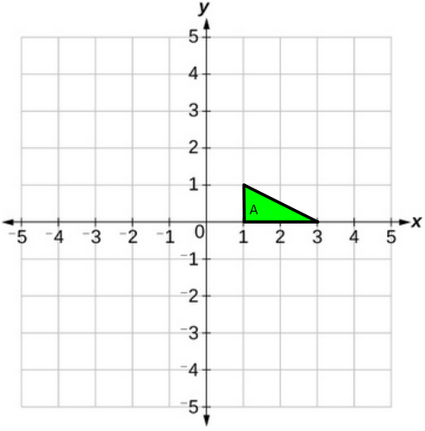
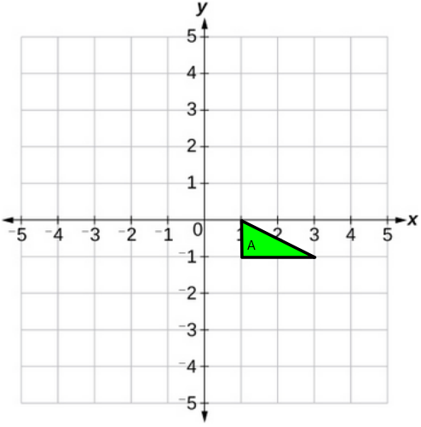
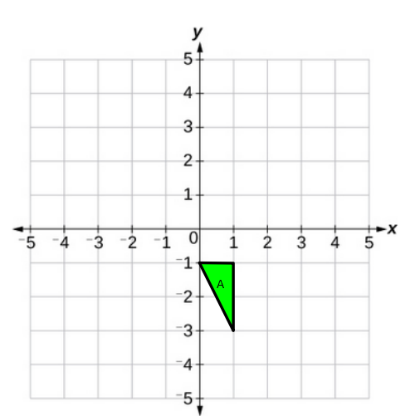
1)
3)
Reflect triangle A using y = x
Reflect triangle A using y = -x
2)
4)
@mathsmrgordon
Reflect triangle A using y = x
Reflect triangle A using y = -x

Slide 5
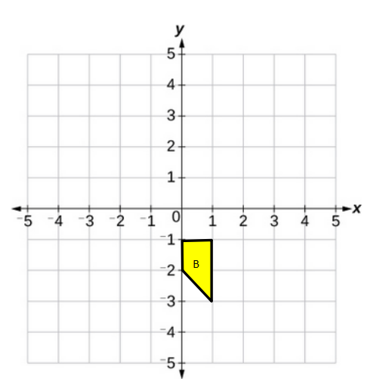
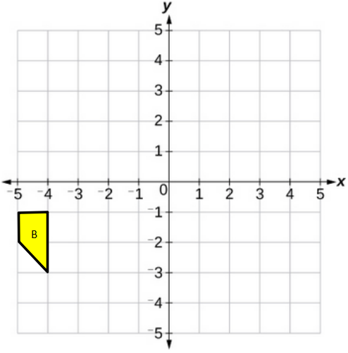
5)
7)
Reflect trapezium B using y = -x
Reflect trapezium B using y = x
6)
8)
@mathsmrgordon
Reflect trapezium B using y = x
Reflect trapezium B using y = -x

Slide 6
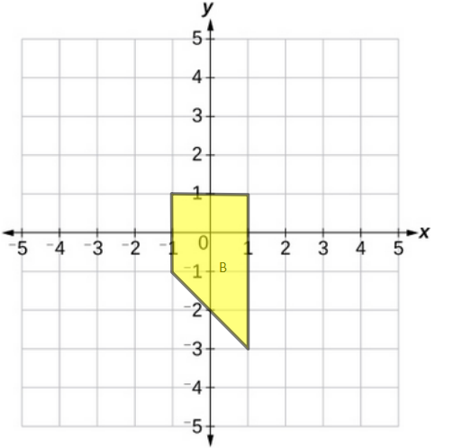
9)
Reflect the trapezium B using the line y = -x
10)
@mathsmrgordon
Reflect the trapezium B using the line y = x

Slide 7
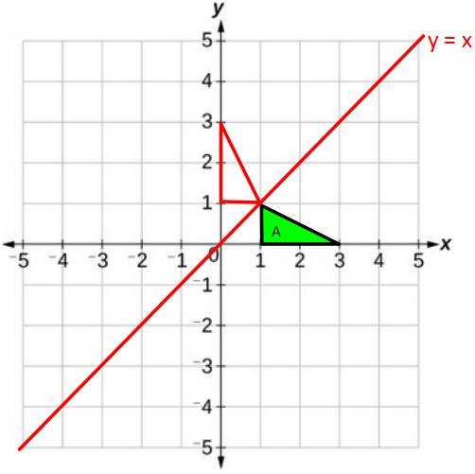
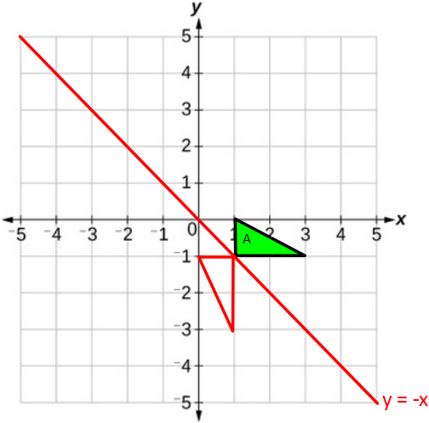
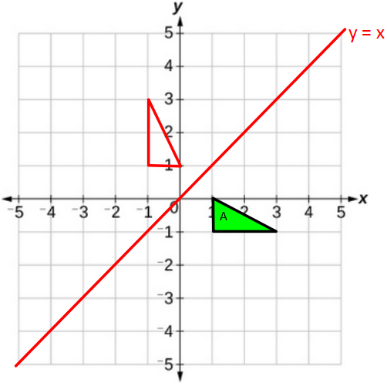
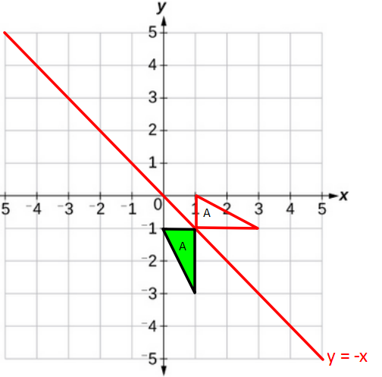
1)
3)
Reflect triangle A using y = x
Reflect triangle A using y = -x
2)
4)
@mathsmrgordon
Reflect triangle A using y = x
Reflect triangle A using y = -x

Slide 8
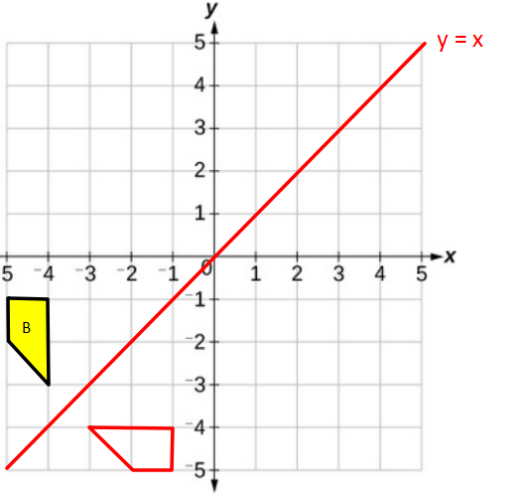
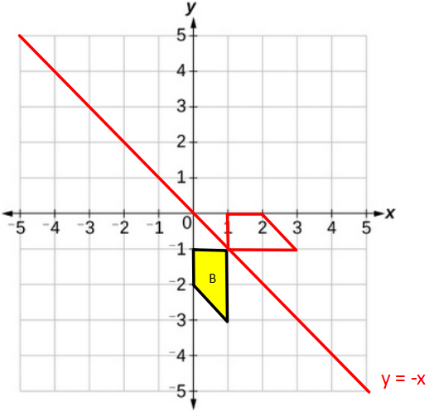
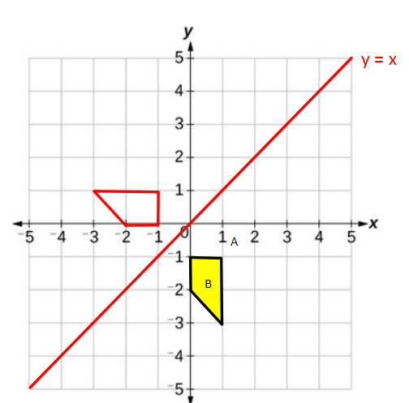
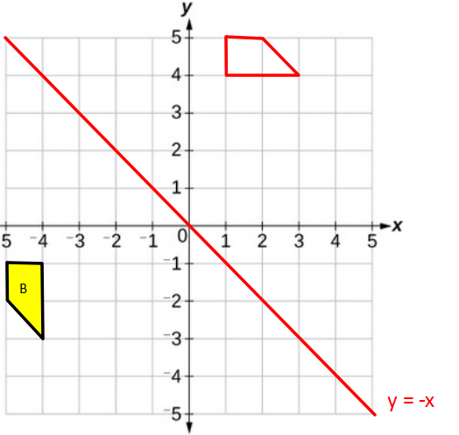
5)
7)
Reflect trapezium B using y = -x
Reflect trapezium B using y = x
6)
8)
@mathsmrgordon
Reflect trapezium B using y = x
Reflect trapezium using y = -x

Slide 9
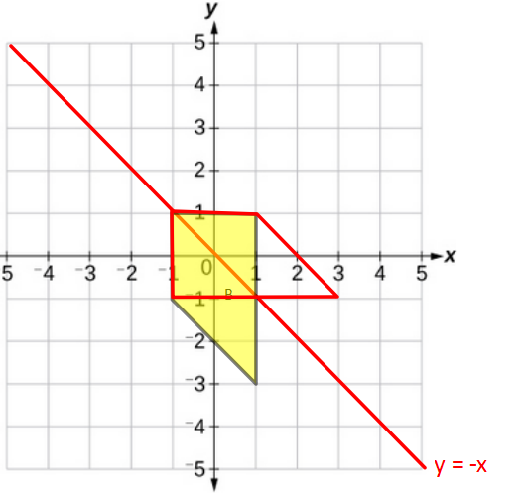
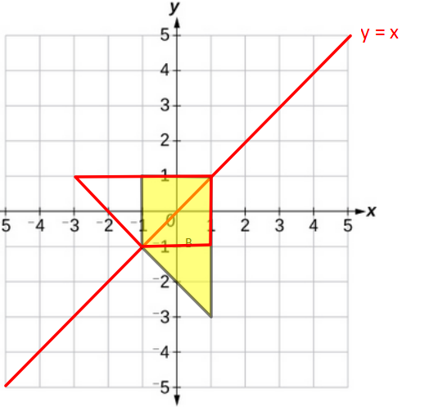
9)
Reflect the trapezium B using the line y = -x
10)
@mathsmrgordon
Reflect the trapezium B using the line y = x

