Slide 1
Proportion: Direct proportion (rulers)
Silent
Teacher
Intelligent Practice
Narration
Your Turn
$$\text{3 }\text{rulers} \text{cost}\text{ £12. }\text{How} \text{much} \text{do}\text{ 4 }\text{rulers} \text{cost}\text{?}$$
$$\text{6} \text{rulers} \text{cost}\text{ £12. }\text{How} \text{much} \text{do}\text{ 4 }\text{rulers} \text{cost}\text{?}$$
$$\text{6} \text{rulers} \text{cost}\text{ £24. }\text{How} \text{much} \text{do}\text{ 4 }\text{rulers} \text{cost}\text{?}$$
Example
For more videos visit mrbartonmaths.com/videos

Slide 2
Worked Example
Your Turn
4 rulers cost £32.
How much does 1 ruler cost?
How much do 5 rulers cost?
8 rulers cost £32.
How much does 1 ruler cost?
How much do 5 rulers cost?
@mrbartonmaths

Slide 3
6 rulers cost £30.
How much does 1 ruler cost?
3 rulers cost £30.
How much does 1 ruler cost?
15 rulers cost £30.
How much does 1 ruler cost?
15 rulers cost £60.
How much does 1 ruler cost?
30 rulers cost £60.
How much does 1 ruler cost?
60 rulers cost £30.
How much does 1 ruler cost?
6 rulers cost £3.
How much does 1 ruler cost?
12 rulers cost £3.
How much does 1 ruler cost?
3 rulers cost £12.
How much does 1 ruler cost?
3 rulers cost £12.
How much do 2 rulers cost?
3 rulers cost £12.
How much do 4 rulers cost?
6 rulers cost £12.
How much do 4 rulers cost?
6 rulers cost £24.
How much do 4 rulers cost?
6 rulers cost £24.
How much do 20 rulers cost?
60 rulers cost £24.
How much do 20 rulers cost?
60 rulers cost £24.
How much do 5 rulers cost?
60 rulers cost £4.80.
How much do 5 rulers cost?
15 rulers cost £4.80.
How much do 5 rulers cost?
@mrbartonmaths

Slide 4
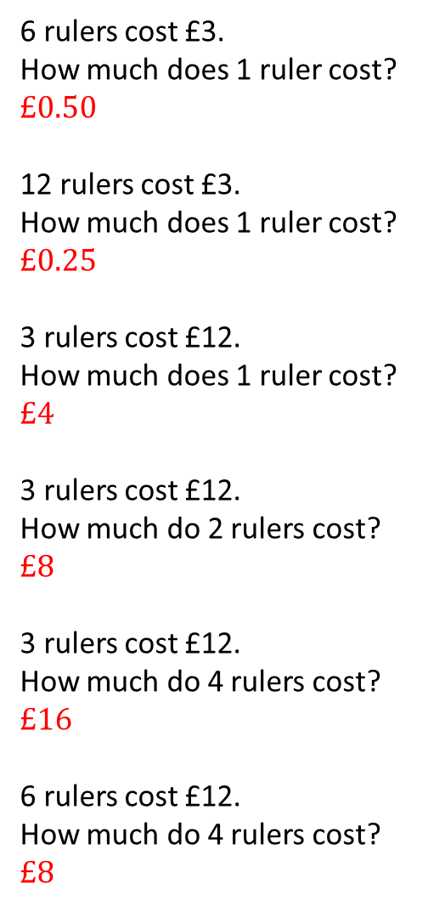
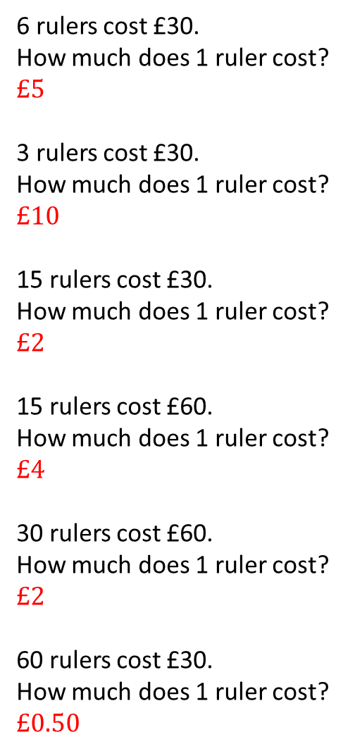
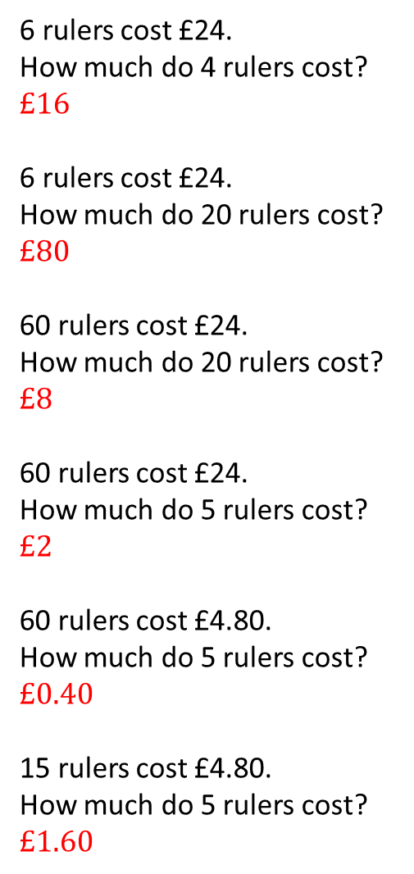
6 rulers cost £30.
How much does 1 ruler cost?
$$£5$$
3 rulers cost £30.
How much does 1 ruler cost?
$$£10$$
15 rulers cost £30.
How much does 1 ruler cost?
$$£2$$
15 rulers cost £60.
How much does 1 ruler cost?
$$£4$$
30 rulers cost £60.
How much does 1 ruler cost?
$$£2$$
60 rulers cost £30.
How much does 1 ruler cost?
$$£0.50$$
6 rulers cost £3.
How much does 1 ruler cost?
$$£0.50$$
12 rulers cost £3.
How much does 1 ruler cost?
$$£0.25$$
3 rulers cost £12.
How much does 1 ruler cost?
$$£4$$
3 rulers cost £12.
How much do 2 rulers cost?
$$£8$$
3 rulers cost £12.
How much do 4 rulers cost?
$$£16$$
6 rulers cost £12.
How much do 4 rulers cost?
$$£8$$
6 rulers cost £24.
How much do 4 rulers cost?
$$£16$$
6 rulers cost £24.
How much do 20 rulers cost?
$$£80$$
60 rulers cost £24.
How much do 20 rulers cost?
$$£8$$
60 rulers cost £24.
How much do 5 rulers cost?
$$£2$$
60 rulers cost £4.80.
How much do 5 rulers cost?
$$£0.40$$
15 rulers cost £4.80.
How much do 5 rulers cost?
$$£1.60$$
@mrbartonmaths

