Slide 1
Powers and Indices: Division law
Silent
Teacher
Intelligent Practice
Narration
Your Turn
$$5^{6}÷5^{2}=$$
$$5^{−6}÷5^{−2}=$$
$$\frac{4^{m}}{4^{p}}=$$
Example
For more videos visit mrbartonmaths.com/videos

Slide 2
Worked Example
Your Turn
$$3^{5}÷3^{2}=$$
$$3^{7}÷3^{5}=$$
@mrbartonmaths

Slide 3
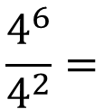
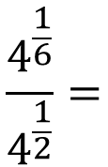
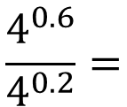
$${(−5)}^{6}÷{(−5)}^{2}=$$
$$6^{6}÷6^{3}=$$
$${(−4)}^{6}÷{(−5)}^{2}=$$
$$6^{6}÷6^{2}=$$
$$6^{6}÷5^{2}=$$
$${(4)}^{6}÷{(5)}^{2}=$$
$$5^{6}÷5^{2}=$$
$${(4)}^{6}÷{(4)}^{2}=$$
$$5^{2}÷5^{6}=$$
$$\frac{4^{6}}{4^{2}}=$$
$$5^{−2}÷5^{6}=$$
$$\frac{4^{0.6}}{4^{0.2}}=$$
$$5^{2}÷5^{−6}=$$
$$5^{−2}÷5^{−6}=$$
$$\frac{4^{\frac{1}{6}}}{4^{\frac{1}{2}}}=$$
$$5^{−6}÷5^{−2}=$$
@mrbartonmaths

Slide 4
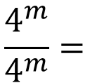
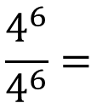
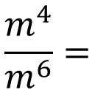
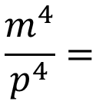
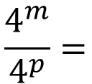
$$\frac{4^{6}}{4^{6}}=$$
$$\frac{4^{m}}{4^{m}}=$$
$$\frac{4^{m}}{4^{p}}=$$
$$\frac{m^{4}}{p^{4}}=$$
$$\frac{m^{4}}{m^{6}}=$$
@mrbartonmaths

Slide 5
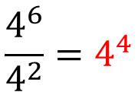
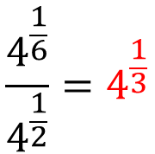
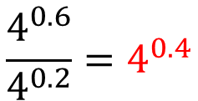
$${(−5)}^{6}÷{(−5)}^{2}={(−5)}^{4}$$
$$6^{6}÷6^{3}=6^{3}$$
$${(−4)}^{6}÷{(−5)}^{2}={(−4)}^{6}÷{(−5)}^{2}$$
$$6^{6}÷6^{2}=6^{4}$$
$$6^{6}÷5^{2}=6^{6}÷5^{2}$$
$${(4)}^{6}÷{(5)}^{2}={(4)}^{6}÷{(5)}^{2}$$
$$5^{6}÷5^{2}=5^{4}$$
$${(4)}^{6}÷{(4)}^{2}={(4)}^{4}$$
$$5^{2}÷5^{6}=5^{−4}$$
$$\frac{4^{6}}{4^{2}}=4^{4}$$
$$5^{−2}÷5^{6}=5^{−8}$$
$$\frac{4^{0.6}}{4^{0.2}}=4^{0.4}$$
$$5^{2}÷5^{−6}=5^{8}$$
$$5^{−2}÷5^{−6}=5^{4}$$
$$\frac{4^{\frac{1}{6}}}{4^{\frac{1}{2}}}=4^{\frac{1}{3}}$$
$$5^{−6}÷5^{−2}=5^{−4}$$
@mrbartonmaths

Slide 6
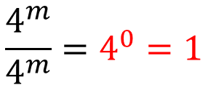
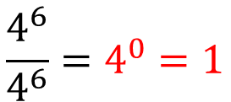
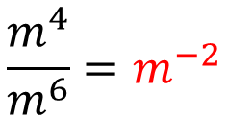
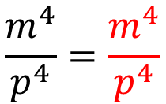
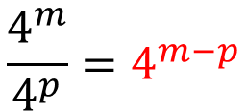
$$\frac{4^{6}}{4^{6}}=4^{0}=1$$
$$\frac{4^{m}}{4^{m}}=4^{0}=1$$
$$\frac{4^{m}}{4^{p}}=4^{m−p}$$
$$\frac{m^{4}}{p^{4}}=\frac{m^{4}}{p^{4}}$$
$$\frac{m^{4}}{m^{6}}=m^{−2}$$
@mrbartonmaths

