Slide 1
Straight line graphs: Drawing appropriate axes
Silent
Teacher
Intelligent Practice
Narration
Your Turn
X | -2 | -1 | 0 | 1 | 2
Y | -1 | 1 | 3 | 5 | 7
X | -3 | -2 | -1 | 0 | 1
Y | -1 | 1 | 3 | 5 | 7
X | -3 | -2 | -1 | 0 | 1
Y | -2 | -1 | 0 | 1 | 2
Example
For more videos visit mrbartonmaths.com/videos

Slide 2
Worked Example
Your turn
X | -1 | 0 | 1 | 2 | 3
Y | -1 | 1 | 3 | 5 | 7
X | -3 | -2 | -1 | 0 | 1
Y | -7 | -5 | -3 | -1 | 1
@mathsmrgordon

Slide 3
Your turn:
Draw an appropriate set of axes for these tables of values:
X | -2 | -1 | 0 | 1 | 2
Y | -1 | 1 | 3 | 5 | 7
6)
7)
8)
9)
10)
X | 0 | 1 | 2 | 3 | 4
Y | -4 | -2 | 0 | 2 | 4
1)
2)
3)
4)
5)
X | -3 | -2 | -1 | 0 | 1
Y | -1 | 1 | 3 | 5 | 7
X | -4 | -3 | -2 | -1 | 0
Y | -1 | 1 | 3 | 5 | 7
X | -3 | -2 | -1 | 0 | 1
Y | -2 | -1 | 0 | 1 | 2
X | -4 | -3 | -2 | -1 | 0
Y | -2 | -1 | 0 | 1 | 2
X | -3 | -2 | -1 | 0 | 1
Y | -4 | -2 | 0 | 2 | 4
X | -1 | 0 | 1 | 2 | 3
Y | 0 | 2 | 4 | 6 | 8
X | -1 | 0 | 1 | 2 | 3
Y | -4 | -2 | 0 | 2 | 4
X | -2 | 0 | 2 | 4 | 6
Y | 0 | -2 | -4 | -6 | -8
@mathsmrgordon

Slide 4
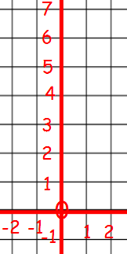
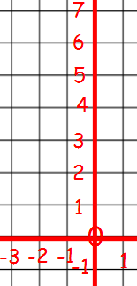
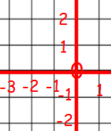
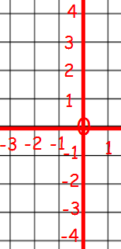
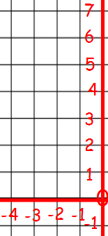
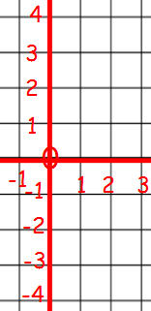
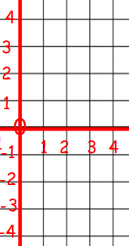
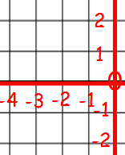
Answers
1)
2)
3)
4)
5)
6)
7)
8)
@mathsmrgordon

Slide 5
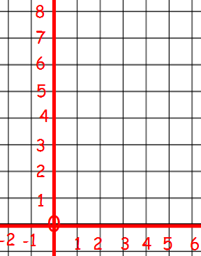
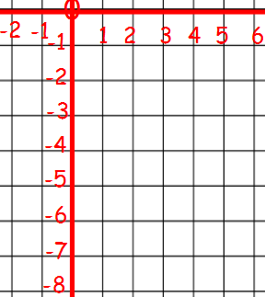
9)
10)
@mathsmrgordon

