Slide 1
Equations: Eliminating variables from both sides
True/false
Reflect
Your Turn
Rule
For more videos visit mrbartonmaths.com/videos

Slide 2
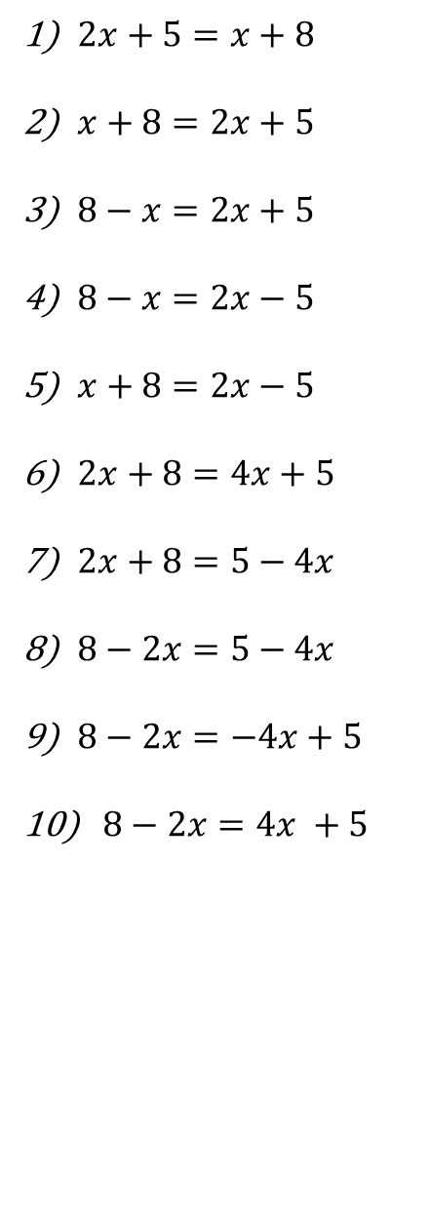
How would you balance both sides?
@mathsmrgordon

Slide 3
How would you balance both sides?
@mathsmrgordon

Slide 4
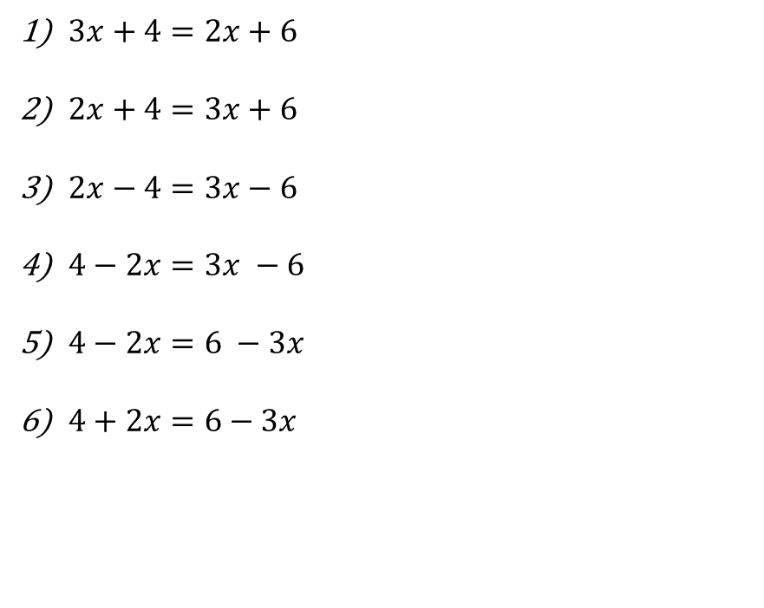
Your Turn
@mathsmrgordon

Slide 5
Your Turn
@mathsmrgordon

