Slide 1
Transformations: Enlarging a shape on axes - positive scale factors
Silent
Teacher
Intelligent Practice
Narration
Your Turn
Example
For more videos visit mrbartonmaths.com/videos

Slide 2
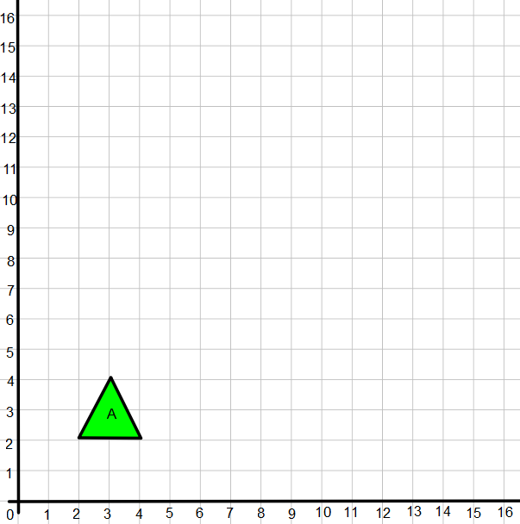
Worked Example
Your turn
@mathsmrgordon
Enlarge the triangle A by a scale factor of 4 from origin
Enlarge the triangle A by a scale factor of 2 from origin

Slide 3
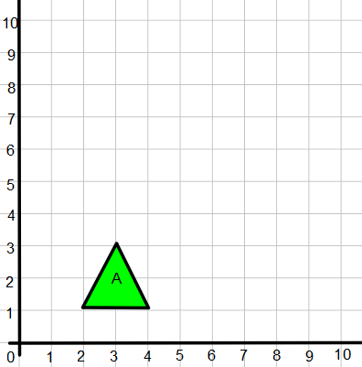
Worked Example
Your turn
@mathsmrgordon
Enlarge the triangle A by a scale factor of 2 from centre (2,1)
Enlarge the triangle A by a scale factor of 3 from the centre (2,1)

Slide 4
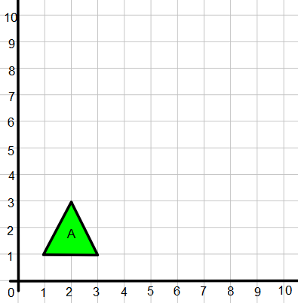
1)
3)
Enlarge using a scale factor of 2 from the origin
Enlarge using a scale factor of 2 from centre (0,2)
2)
4)
@mathsmrgordon
Enlarge using a scale factor of 2 from centre (1,1)
Enlarge using a scale factor of 2 from centre (2,0)

Slide 5
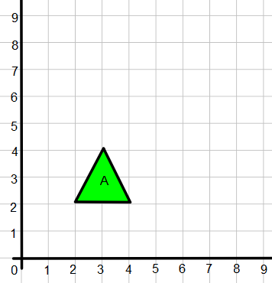
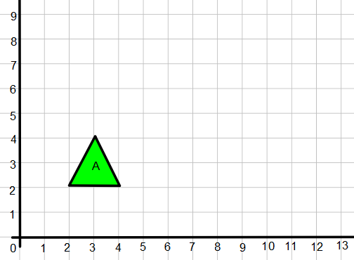
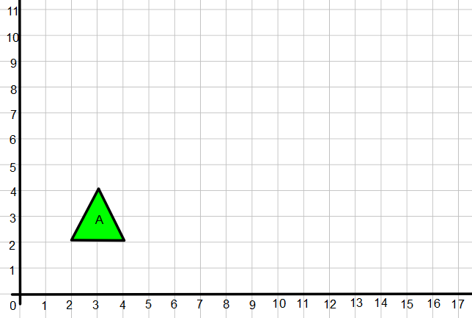
5)
7)
Enlarge using a scale factor of 2 from centre (0,2)
Enlarge using a scale factor of 3 from centre (0,2)
6)
8)
@mathsmrgordon
Enlarge using a scale factor of 4 from centre (0,2)
Enlarge using a scale factor of 1.5 from centre (0,2)

Slide 6
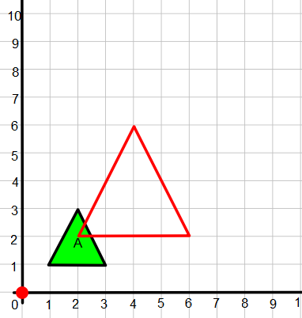
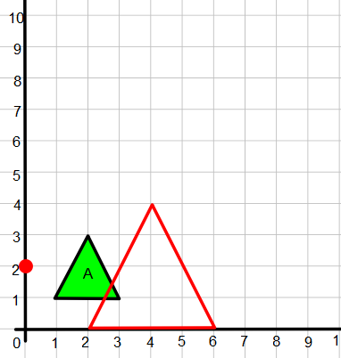
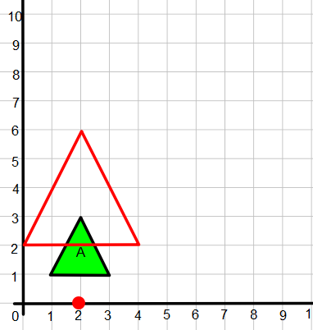
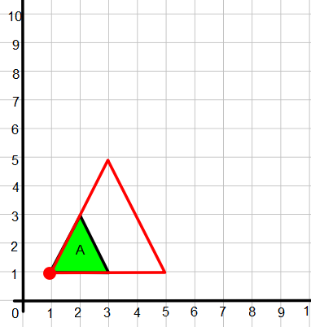
1)
3)
Enlarge using a scale factor of 2 from the origin
Enlarge using a scale factor of 2 from centre (0,2)
2)
4)
@mathsmrgordon
Enlarge using a scale factor of 2 from centre (1,1)
Enlarge using a scale factor of 2 from centre (2,0)

Slide 7
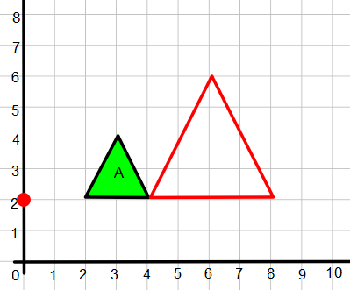
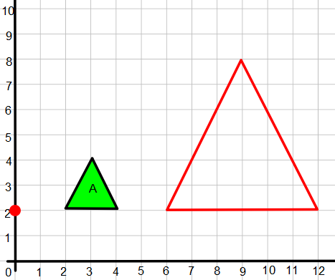
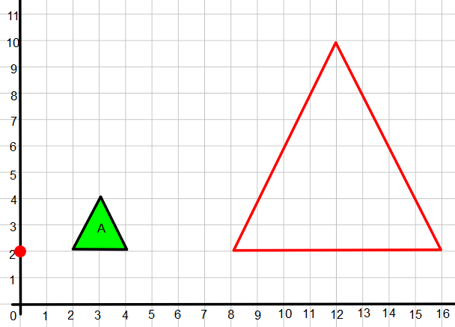
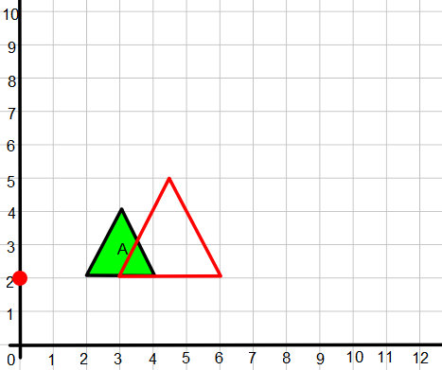
5)
7)
Enlarge using a scale factor of 2 from centre (0,2)
Enlarge using a scale factor of 3 from centre (0,2)
6)
8)
@mathsmrgordon
Enlarge using a scale factor of 4 from centre (0,2)
Enlarge using a scale factor of 1.5 from centre (0,2)

