Slide 1
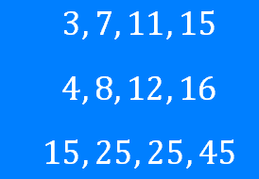
Sequences: Finding the Nth term
Silent
Teacher
Intelligent Practice
Narration
Your Turn
Example
For more videos visit mrbartonmaths.com/videos

Slide 2
Worked Example
Your Turn
@fortyninecubed

Slide 3
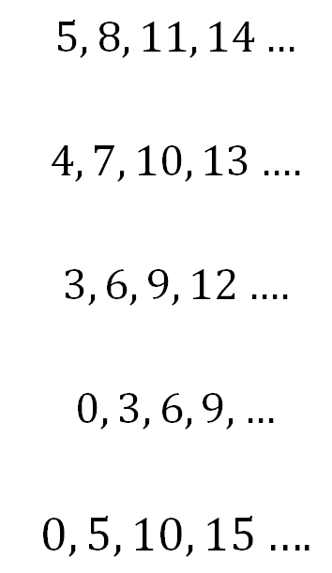
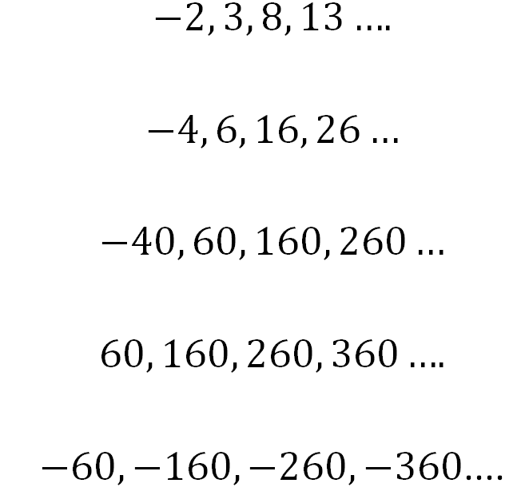
@fortyninecubed

Slide 4
@fortyninecubed

