Slide 1
Fractions: Fractions of fractions
Pattern spot
Reflect
Your Turn
$$\frac{3}{4} \text{of} \frac{1}{2}= ?$$
$$\frac{3}{4} \text{of} \frac{1}{4}= ?$$
Pattern
For more videos visit mrbartonmaths.com/videos

Slide 2
$\frac{3}{4}$ of $48=$
$\frac{3}{4}$ of $24=$
$\frac{3}{4}$ of $12=$
$\frac{3}{4}$ of $6=$
$\frac{3}{4}$ of $3=$
$\frac{3}{4}$ of $\frac{3}{2}=$
$\frac{3}{4}$ of $\frac{3}{4}=$
$\frac{3}{4}$ of $\frac{3}{8}=$
…….
$\frac{3}{4}$ of $\frac{3}{20}=$
$\frac{1}{4}$ of $16=$
$\frac{1}{4}$ of $8=$
$\frac{1}{4}$ of $4=$
$\frac{1}{4}$ of $2=$
$\frac{1}{4}$ of $1=$
$\frac{1}{4}$ of $\frac{1}{2}=$
$\frac{1}{4}$ of $\frac{1}{4}=$
$\frac{1}{4}$ of $\frac{1}{8}=$
…….
$\frac{1}{4}$ of $\frac{1}{20}=$
$\frac{3}{4}$ of $16=$
$\frac{3}{4}$ of $8=$
$\frac{3}{4}$ of $4=$
$\frac{3}{4}$ of $2=$
$\frac{3}{4}$ of $1=$
$\frac{3}{4}$ of $\frac{1}{2}=$
$\frac{3}{4}$ of $\frac{1}{4}=$
$\frac{3}{4}$ of $\frac{1}{8}=$
…….
$\frac{3}{4}$ of $\frac{1}{20}=$
@mrbartonmaths

Slide 3
$\frac{3}{4}$ of $48=36$
$\frac{3}{4}$ of $24=18$
$\frac{3}{4}$ of $12=9$
$\frac{3}{4}$ of $6=\frac{9}{2}$
$\frac{3}{4}$ of $3=\frac{9}{4}$
$\frac{3}{4}$ of $\frac{3}{2}=\frac{9}{8}$
$\frac{3}{4}$ of $\frac{3}{4}=\frac{9}{16}$
$\frac{3}{4}$ of $\frac{3}{8}=\frac{9}{32}$
…….
$\frac{3}{4}$ of $\frac{3}{20}=\frac{9}{80}$
$\frac{1}{4}$ of $16=4$
$\frac{1}{4}$ of $8=2$
$\frac{1}{4}$ of $4=1$
$\frac{1}{4}$ of $2=\frac{1}{2}$
$\frac{1}{4}$ of $1=\frac{1}{4}$
$\frac{1}{4}$ of $\frac{1}{2}=\frac{1}{8}$
$\frac{1}{4}$ of $\frac{1}{4}=\frac{1}{16}$
$\frac{1}{4}$ of $\frac{1}{8}=\frac{1}{32}$
…….
$\frac{1}{4}$ of $\frac{1}{20}=\frac{1}{8}$
$\frac{3}{4}$ of $16=12$
$\frac{3}{4}$ of $8=6$
$\frac{3}{4}$ of $4=3$
$\frac{3}{4}$ of $2=\frac{3}{2}$
$\frac{3}{4}$ of $1=\frac{3}{4}$
$\frac{3}{4}$ of $\frac{1}{2}=\frac{3}{8}$
$\frac{3}{4}$ of $\frac{1}{4}=\frac{3}{16}$
$\frac{3}{4}$ of $\frac{1}{8}=\frac{3}{32}$
…….
$\frac{3}{4}$ of $\frac{1}{20}=\frac{3}{80}$
@mrbartonmaths

Slide 4
Your Turn
$\frac{1}{3}$ of $15=$
$\frac{1}{3}$ of $\frac{1}{15}=$
$\frac{1}{3}$ of $\frac{7}{15}=$
$\frac{7}{15}$ of $\frac{1}{3}=$
$\frac{7}{3}$ of $\frac{1}{15}=$
@mrbartonmaths

Slide 5
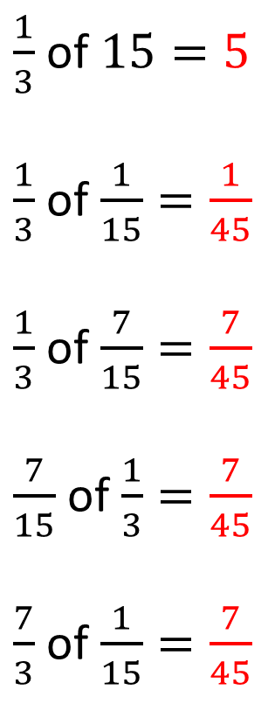
Your Turn - answers
$\frac{1}{3}$ of $15=5$
$\frac{1}{3}$ of $\frac{1}{15}=\frac{1}{45}$
$\frac{1}{3}$ of $\frac{7}{15}=\frac{7}{45}$
$\frac{7}{15}$ of $\frac{1}{3}=\frac{7}{45}$
$\frac{7}{3}$ of $\frac{1}{15}=\frac{7}{45}$
@mrbartonmaths

