Slide 1
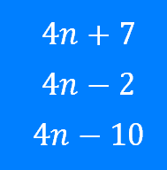
Sequences: Generating from the nth term
Silent
Teacher
Intelligent Practice
Narration
Your Turn
Example
For more videos visit mrbartonmaths.com/videos

Slide 2
Worked Example
Your Turn
Generate the first 5 terms of each sequence:
Generate the first 5 terms of each sequence:
@fortyninecubed

Slide 3
Generate the first 5 terms of each sequence:
@fortyninecubed

Slide 4
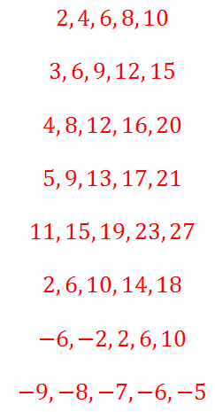
Generate the first 5 terms of each sequence:

