Slide 1
Straight Line Graphs: Gradient of implicit equations
Silent
Teacher
Intelligent Practice
Narration
Your Turn
2y = 4x – 8
2y = 8 – 4x
2y – 4x = 8
Example
For more videos visit mrbartonmaths.com/videos

Slide 2
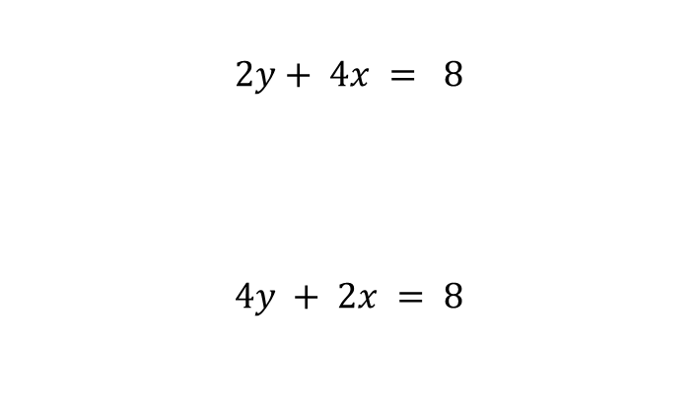
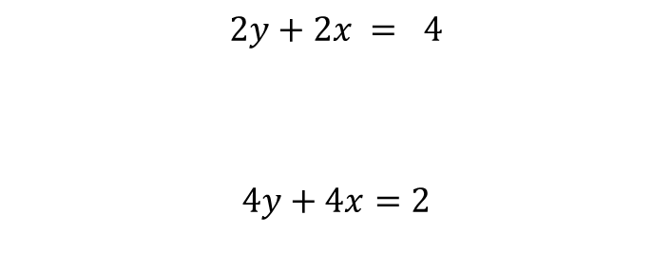
Worked Examples
Your turn
@mathsmrgordon

Slide 3
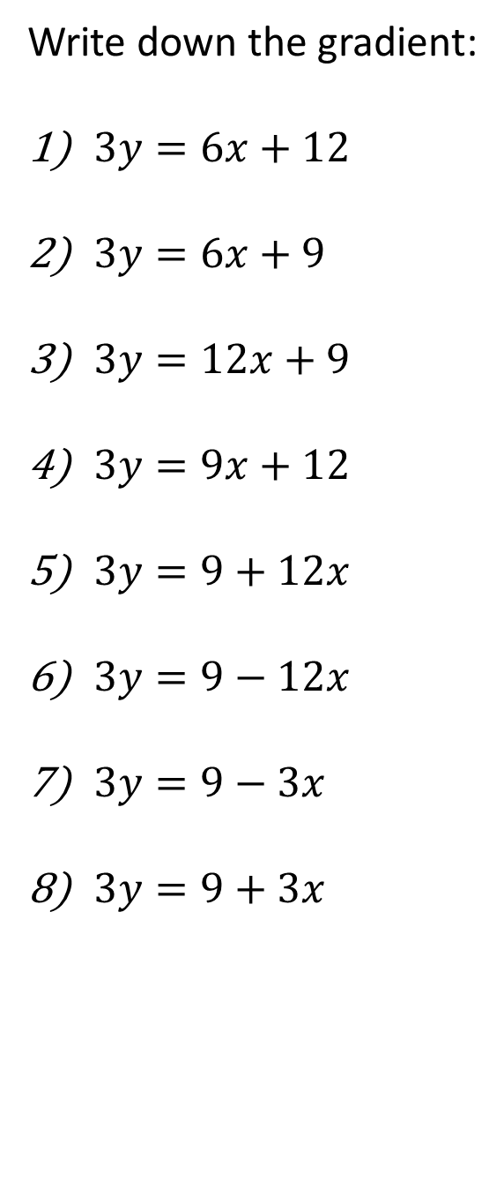
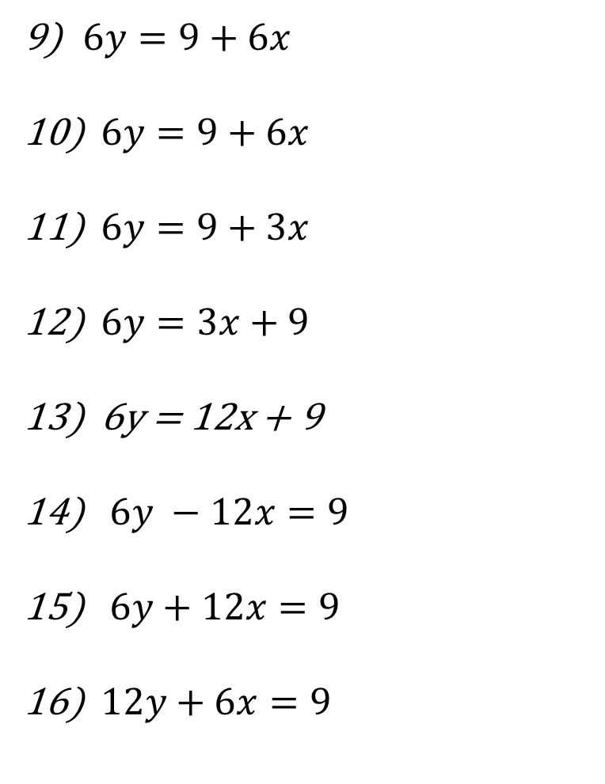
@mathsmrgordon

Slide 4
@mathsmrgordon

Slide 5
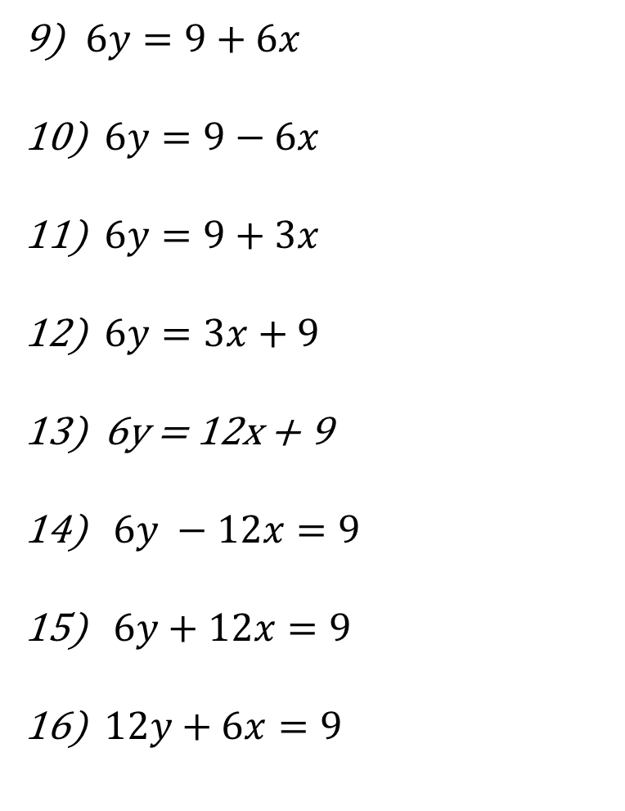
@mathsmrgordon

Slide 6
@mathsmrgordon

