Slide 1
Transformations: Reflecting a shape using x = a or y = b
Silent
Teacher
Intelligent Practice
Narration
Your Turn
Example
For more videos visit mrbartonmaths.com/videos

Slide 2
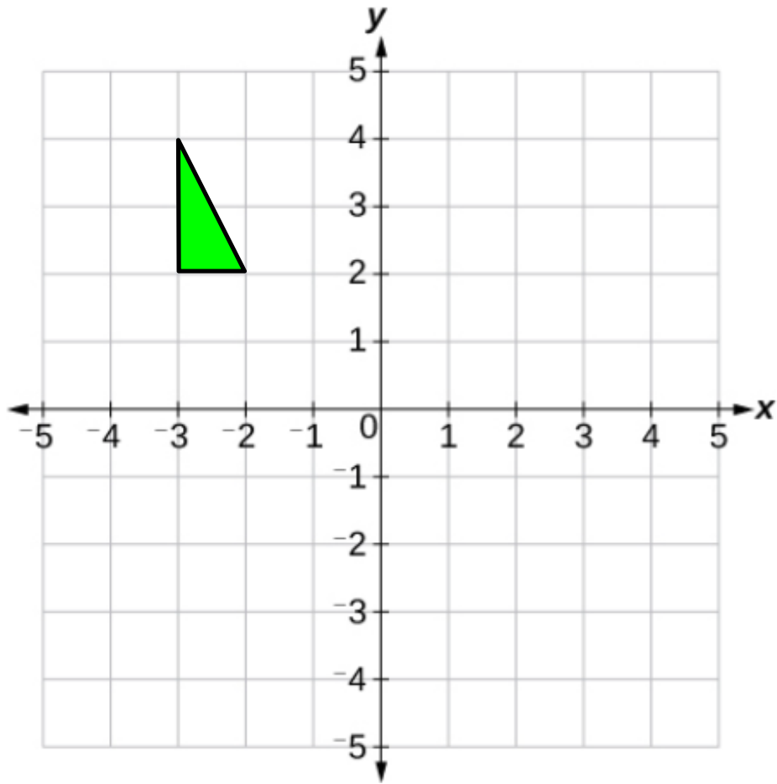
Worked Example
Your turn
A
A
Reflect triangle A using the line x = -2
Reflect triangle A using the line x = -1
@mathsmrgordon

Slide 3
Worked Example
Your turn
A
A
Reflect triangle A using the line y = 1
Reflect triangle A using the line y = 0
@mathsmrgordon

Slide 4
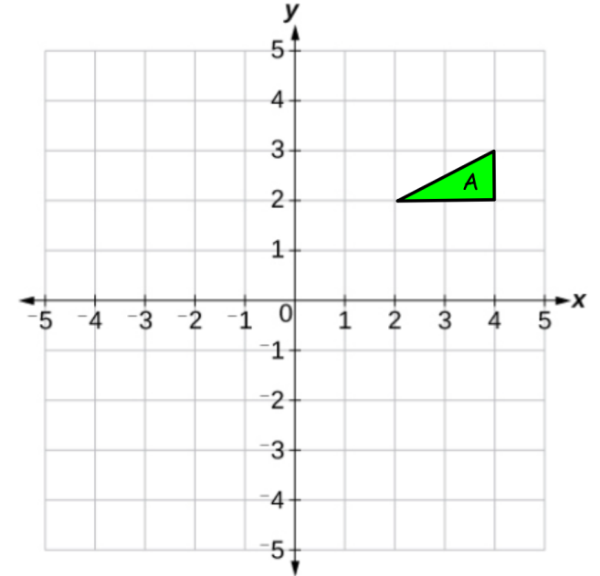
1)
3)
Reflect triangle A using x = 1
Reflect triangle A using y = 2
2)
4)
@mathsmrgordon
Reflect triangle A using x = 2
Reflect triangle A using y = 1

Slide 5
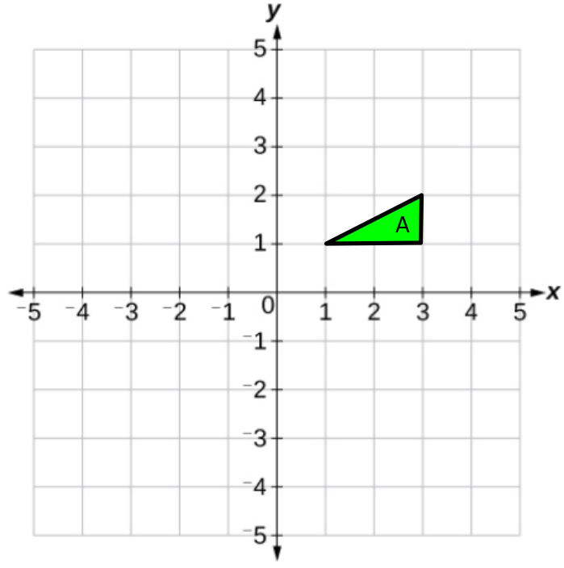
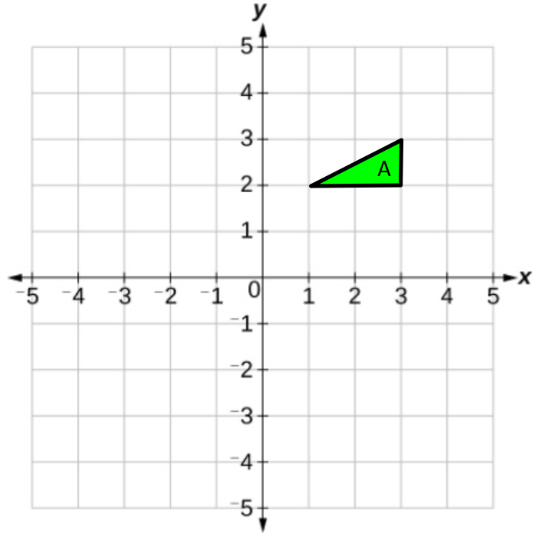
5)
7)
Reflect triangle A using y = -1
Reflect triangle A using x = -1
6)
8)
@mathsmrgordon
Reflect triangle A using y = -1
Reflect triangle A using x = -1

Slide 6
9)
11)
Reflect triangle A using x = 0
Reflect triangle A using y = 0
10)
12)
@mathsmrgordon
Reflect triangle A using the x-axis
Reflect triangle A using the y-axis

Slide 7
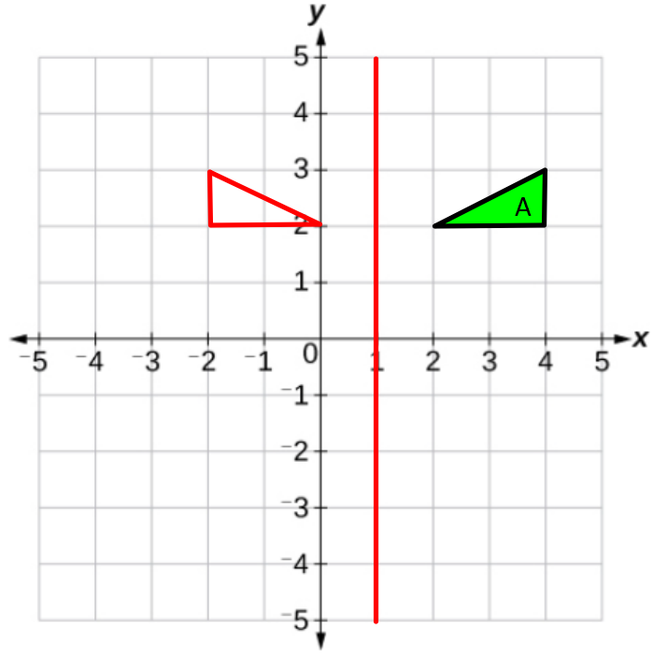
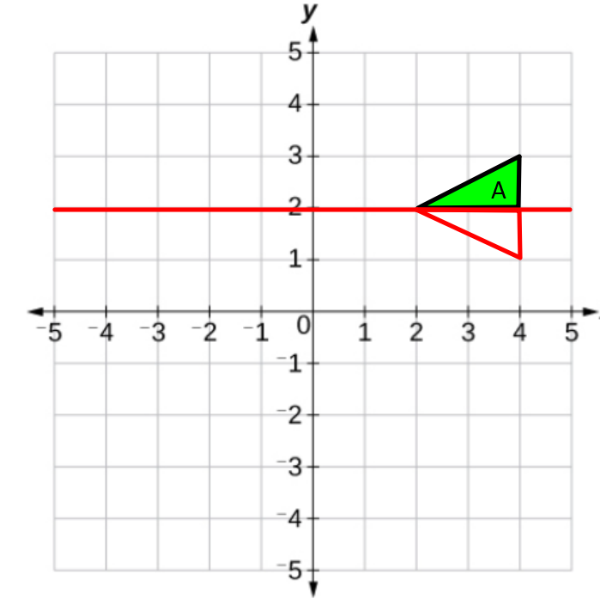
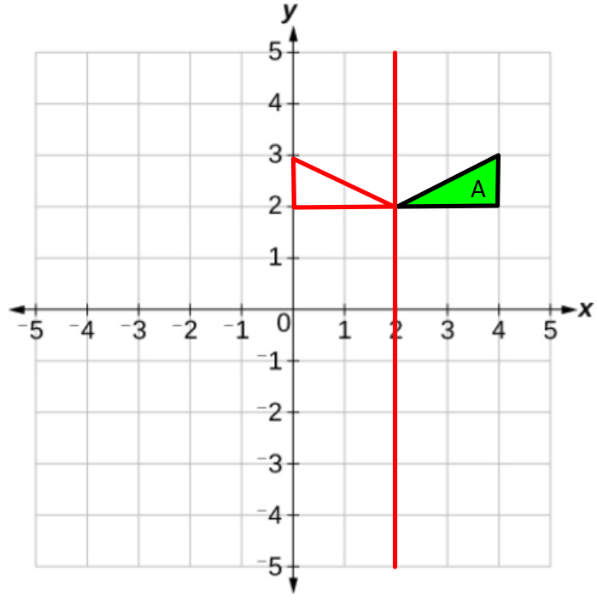
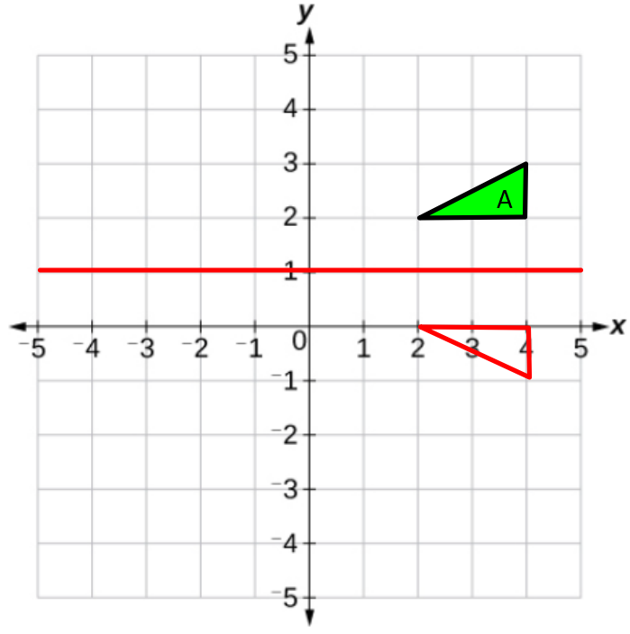
1)
3)
Reflect triangle A using x = 1
Reflect triangle A using y = 2
2)
4)
@mathsmrgordon
Reflect triangle A using x = 2
Reflect triangle A using y = 1

Slide 8
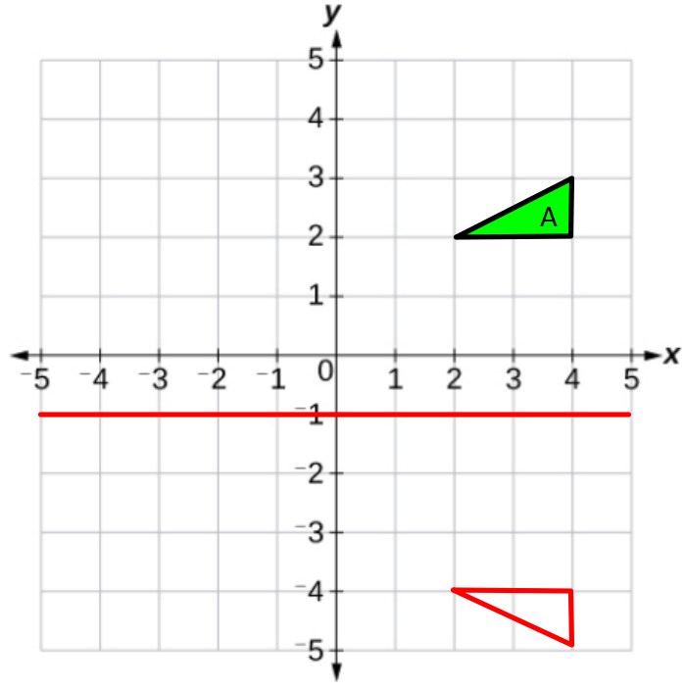
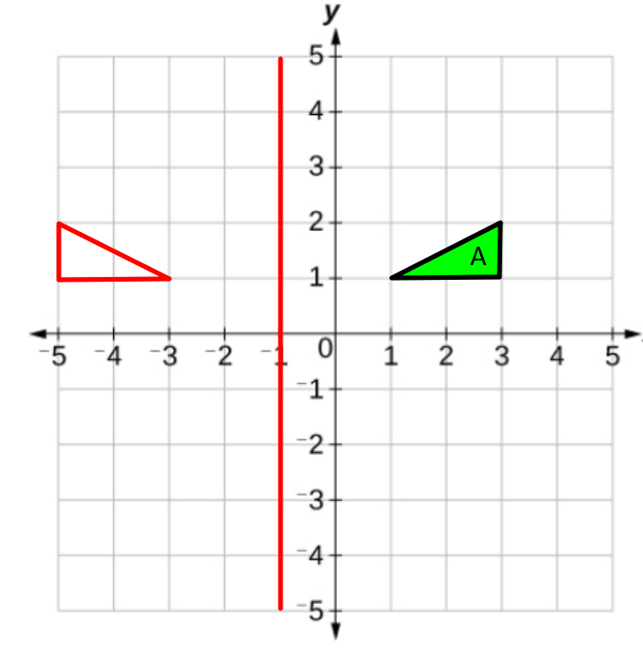
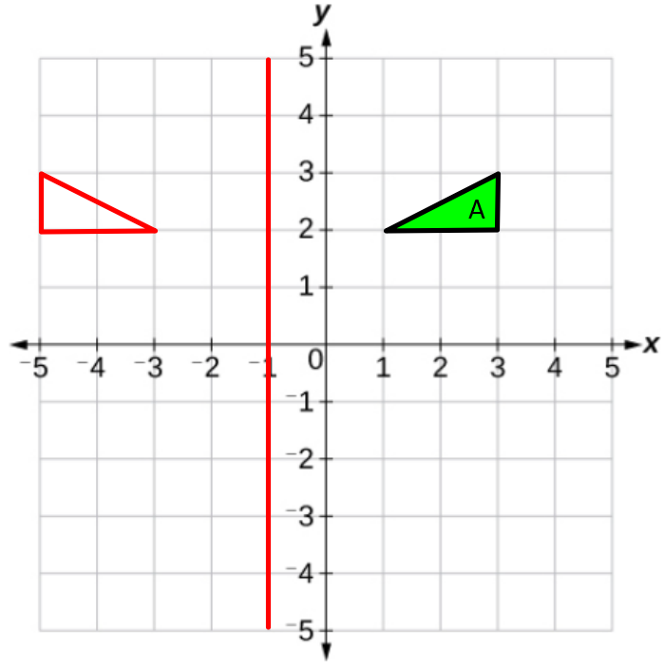
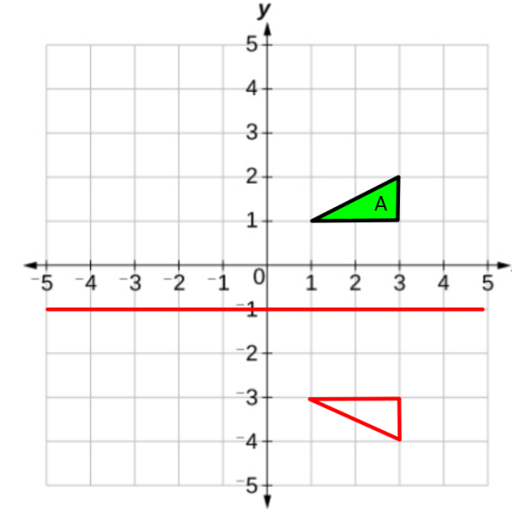
5)
7)
Reflect triangle A using y = -1
Reflect triangle A using x = -1
6)
8)
@mathsmrgordon
Reflect triangle A using y = -1
Reflect triangle A using x = -1

Slide 9
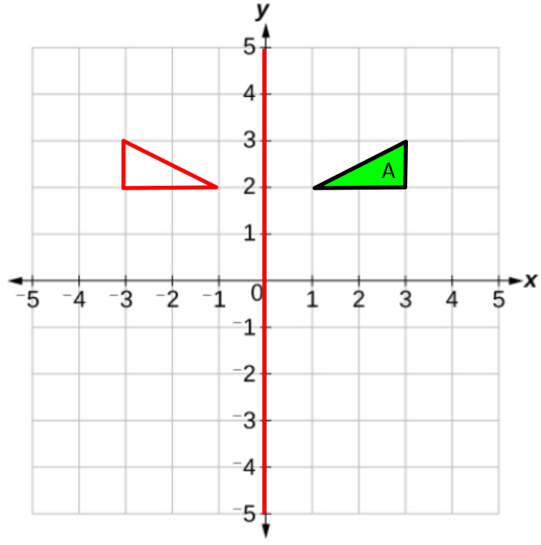
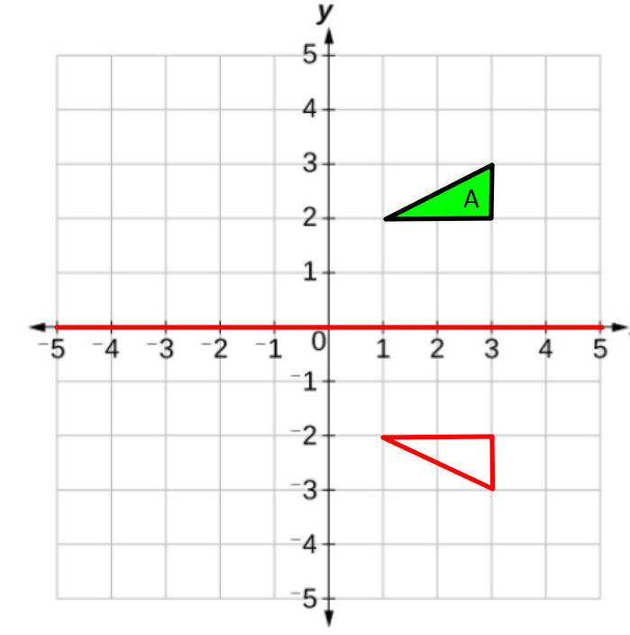
9)
11)
Reflect triangle A using x = 0
Reflect triangle A using y = 0
10)
12)
@mathsmrgordon
Reflect triangle A using the x-axis
Reflect triangle A using the y-axis

