Slide 1
Introducing algebra: Multiplying/Dividing Terms
Silent
Teacher
Intelligent Practice
Narration
Your Turn
$$2y×3x^{2} ×4y$$
$$2y^{2}×3x^{2} ×4y$$
$$\frac{2y^{2}×3x^{2} ×4y}{2}$$
Example
For more videos visit mrbartonmaths.com/videos

Slide 2
Worked Example
Your Turn
$$3x×5$$
$$6x×2$$
$$3x×5x$$
$$6x×2x$$
$$3x×5y$$
$$6x×2y$$
@fortyninecubed

Slide 3
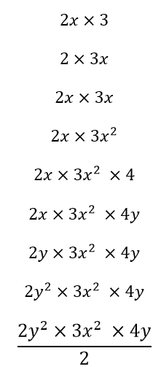
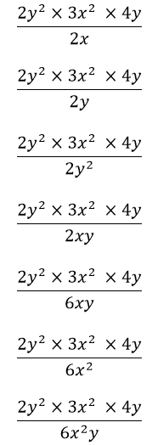
@fortyninecubed

Slide 4
@fortyninecubed

