Slide 1
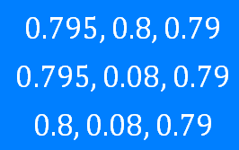
Decimals: Ordering
Silent
Teacher
Intelligent Practice
Narration
Your Turn
Example
For more videos visit mrbartonmaths.com/videos

Slide 2
Worked Example
Your Turn
Write in ascending order:
Write in ascending order:
@fortyninecubed

Slide 3
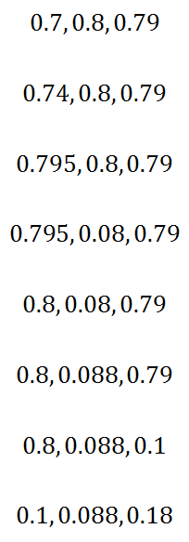
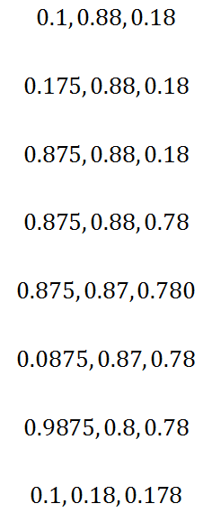
Write in ascending order:
@fortyninecubed

Slide 4
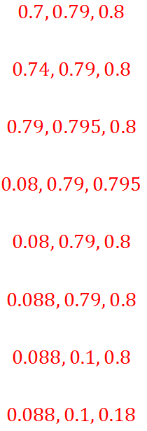
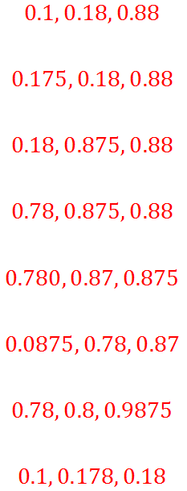
@fortyninecubed

