Slide 1
Representing data: Pie Chart angles
Silent
Teacher
Intelligent Practice
Narration
Your Turn
Transport | Frequency | Angle
Car | 4
Walk | 5
Bus | 9
Example
For more videos visit mrbartonmaths.com/videos

Slide 2
Worked Example
Your Turn
Calculate the angles needed to draw a pie chart for this data.
Calculate the angles needed to draw a pie chart for this data.
Transport | Frequency
Car | 15
Walk | 9
Bus | 12
Transport | Frequency
Car | 15
Walk | 9
Cycle | 9
Bus | 12
@fortyninecubed

Slide 3
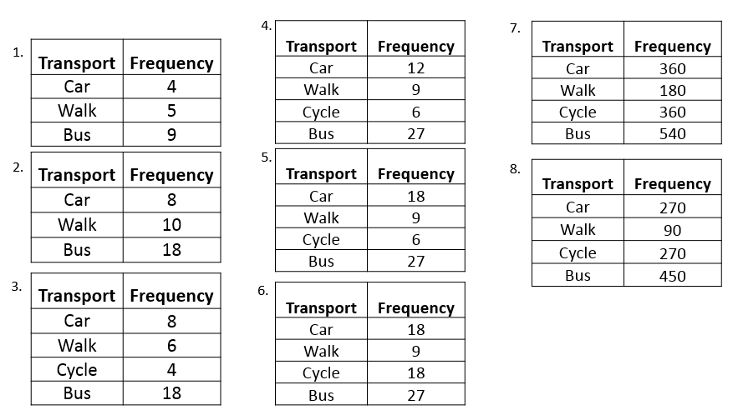
Calculate the angles needed to draw a pie chart to represent each set of data:
@fortyninecubed

Slide 4
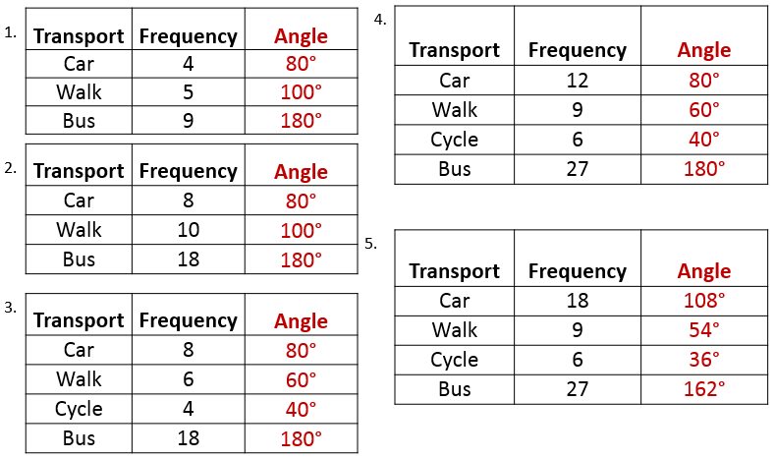
@fortyninecubed

Slide 5
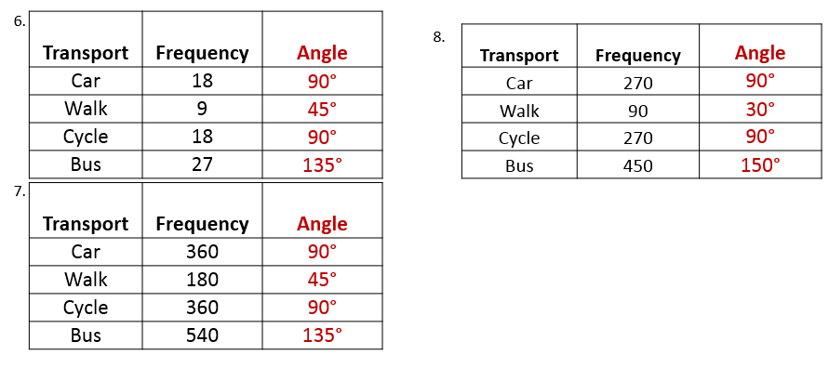
@fortyninecubed

