Slide 1
Algebraic Fractions: Simplifying
Silent
Teacher
Intelligent Practice
Narration
Your Turn
$$\frac{(x+3)(x+4)}{2x+8}$$
$$\frac{x^{2}+7x+12}{2x+8}$$
Example
For more videos visit mrbartonmaths.com/videos

Slide 2
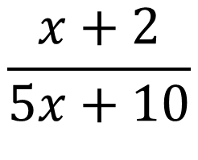
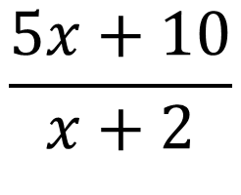
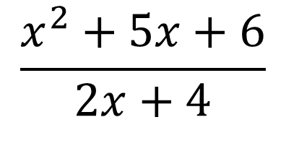
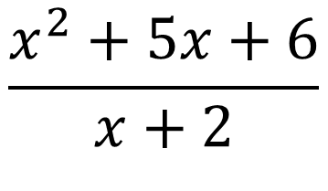
Worked Example
Your Turn
$$\frac{5x+10}{x+2}$$
$$\frac{x+2}{5x+10}$$
$$\frac{x^{2}+5x+6}{x+2}$$
$$\frac{x^{2}+5x+6}{2x+4}$$
@fortyninecubed

Slide 3
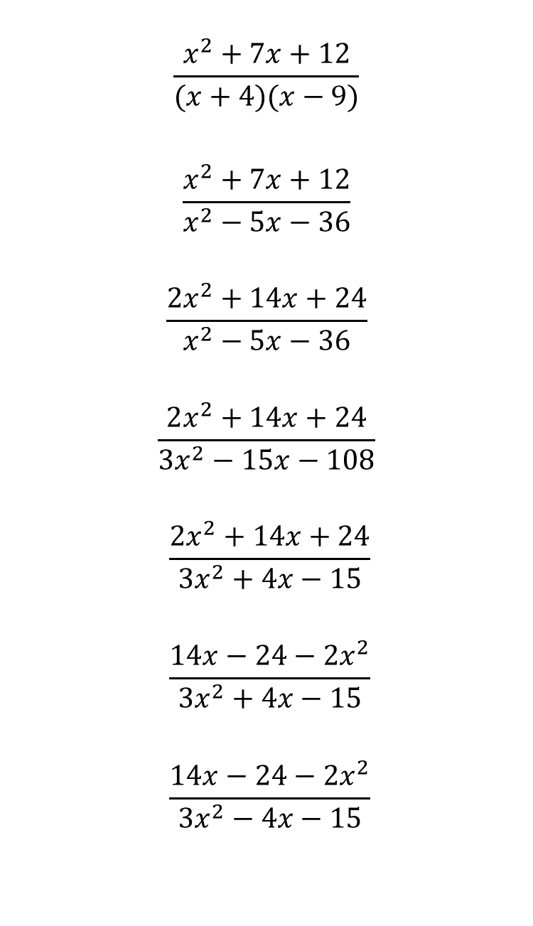
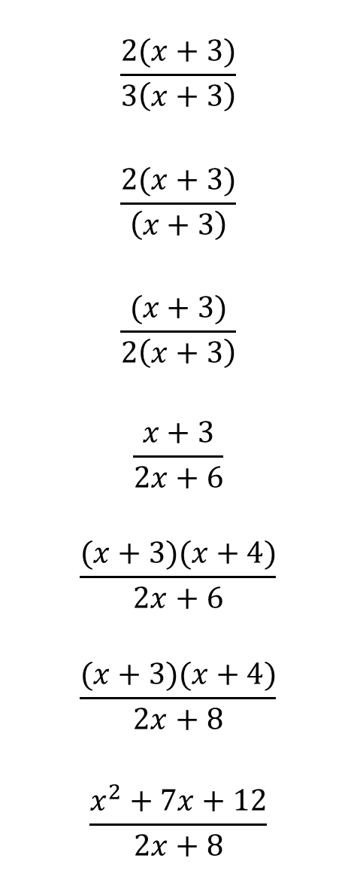
$$\frac{2(x+3)}{3\left(x+3\right)}$$
$$\frac{2(x+3)}{\left(x+3\right)}$$
$$\frac{(x+3)}{2\left(x+3\right)}$$
$$\frac{x+3}{2x+6}$$
$$\frac{(x+3)(x+4)}{2x+6}$$
$$\frac{(x+3)(x+4)}{2x+8}$$
$$\frac{x^{2}+7x+12}{2x+8}$$
$$\frac{x^{2}+7x+12}{(x+4)(x−9)}$$
$$\frac{x^{2}+7x+12}{x^{2}−5x−36}$$
$$\frac{2x^{2}+14x+24}{x^{2}−5x−36}$$
$$\frac{2x^{2}+14x+24}{{3x}^{2}−15x−108}$$
$$\frac{2x^{2}+14x+24}{{3x}^{2}+4x−15}$$
$$\frac{14x−24−2x^{2}}{{3x}^{2}+4x−15}$$
$$\frac{14x−24−2x^{2}}{{3x}^{2}−4x−15}$$
@fortyninecubed

Slide 4

$$\frac{2(x+3)}{3\left(x+3\right)}$$
$$\frac{2(x+3)}{\left(x+3\right)}$$
$$\frac{(x+3)}{2\left(x+3\right)}$$
$$\frac{x+3}{2x+6}$$
$$\frac{(x+3)(x+4)}{2x+6}$$
$$\frac{(x+3)(x+4)}{2x+8}$$
$$\frac{x^{2}+7x+12}{2x+8}$$
$$\frac{x^{2}+7x+12}{(x+4)(x−9)}$$
$$\frac{x^{2}+7x+12}{x^{2}−5x−36}$$
$$\frac{2x^{2}+14x+24}{x^{2}−5x−36}$$
$$\frac{2x^{2}+14x+24}{{3x}^{2}−15x−108}$$
$$\frac{2x^{2}+14x+24}{{3x}^{2}+4x−15}$$
$$\frac{14x−24−2x^{2}}{{3x}^{2}+4x−15}$$
$$\frac{14x−24−2x^{2}}{{3x}^{2}−4x−15}$$
$$\frac{2}{3}$$
$$2$$
$$\frac{1}{2}$$
$$\frac{1}{2}$$
$$\frac{x+4}{2}$$
$$\frac{x+3}{2}$$
$$\frac{x+3}{2}$$
$$\frac{x+3}{x−9}$$
$$\frac{x+3}{x−9}$$
$$\frac{2(x+3)}{x−9}$$
$$\frac{2(x+3)}{3(x−9)}$$
$$\frac{2(x+4)}{3(x−5)}$$
$$−\frac{2\left(x−3\right)\left(x−4\right)}{\left(3x−5\right)\left(x+3\right)}$$
$$−\frac{2(x−4)}{3x+5}$$

