Slide 1
Angles: Vertically opposite angles
Silent
Teacher
Intelligent Practice
Narration
Your Turn
Example
For more videos visit mrbartonmaths.com/videos

Slide 2
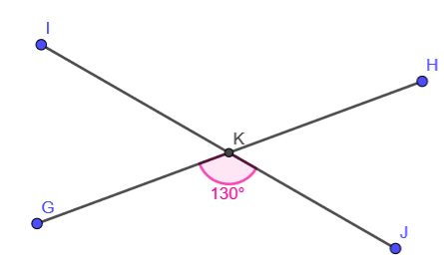
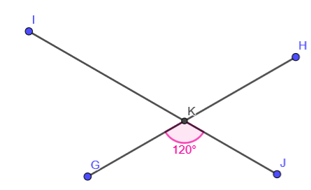
Worked Example
Your turn
Angle GKJ = 130º
Angle IKH=
Angle HKJ =
Angle IKG =
Angle GKJ = 120º
Angle IKH=
Angle HKJ =
Angle IKG =
@mathsmrgordon

Slide 3
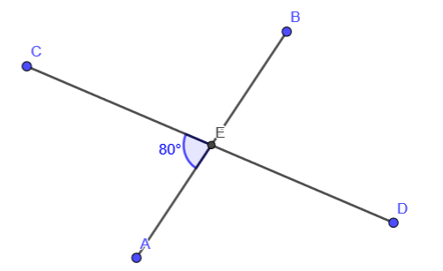
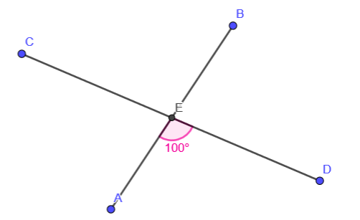
Angle BED =
Angle BED =
Angle CEB =
@mathsmrgordon

Slide 4
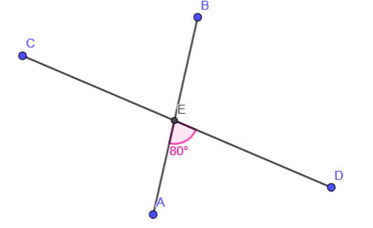
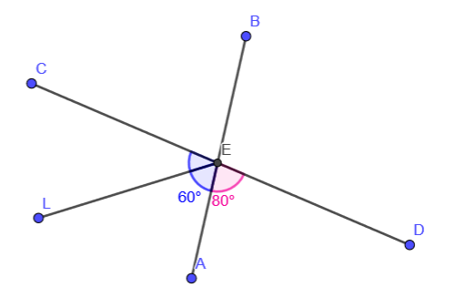
Angle CEB =
Angle AEC =
Angle LEC =
@mathsmrgordon

Slide 5
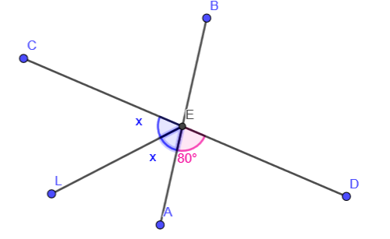
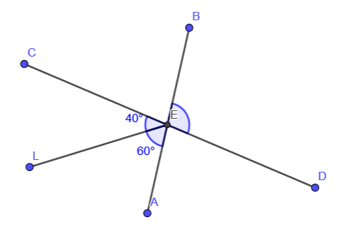
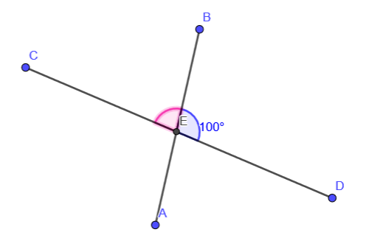
x =
Angle BED =
Angle BEC =
@mathsmrgordon

Slide 6
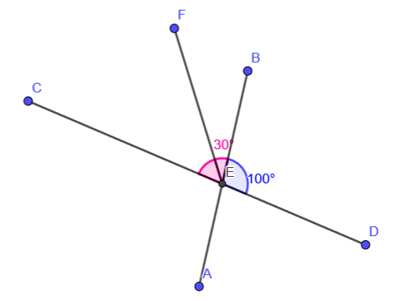
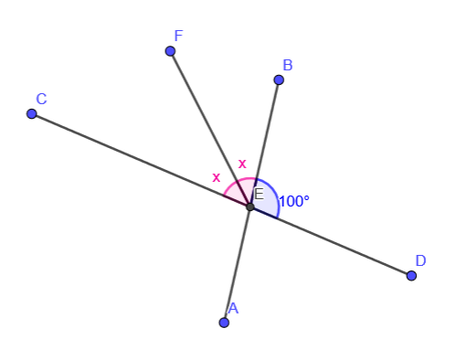
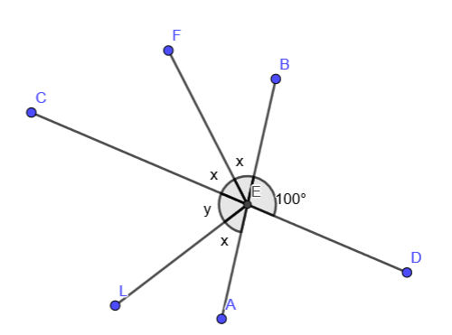
Angle FEC =
x =
x =
y =
@mathsmrgordon

Slide 7
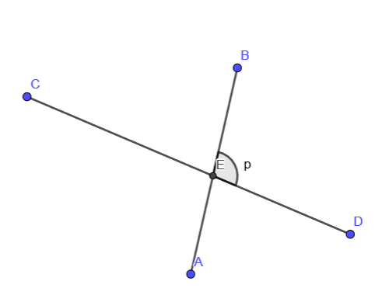
Write an expression for the angle AEC
Write an expression for the angle CEB
@mathsmrgordon

Slide 8
Angle BED = 80º
Angle BED = 80º
Angle CEB = 100º
@mathsmrgordon

Slide 9
Angle CEB = 80º
Angle AEC = 100º
Angle LEC = 40º
@mathsmrgordon

Slide 10
x = 50º
Angle BED = 100º
Angle BEC = 80º
@mathsmrgordon

Slide 11
Angle FEC = 50º
x = 40º
x = 40º
y = 60º
@mathsmrgordon

Slide 12
Write an expression for the angle AEC = p
Write an expression for the angle CEB = 180 - p
@mathsmrgordon

