Slide 1
Formula: Writing formula
Silent
Teacher
Intelligent Practice
Narration
Your Turn
$$\text{5} \text{rulers} \text{cost}\text{ £90. }\text{How} \text{much} \text{do}\text{ 4 }\text{rulers} \text{cost}\text{?}$$
$$\text{n} \text{rulers} \text{cost}\text{ £90. }\text{How} \text{much} \text{do}\text{ 4 }\text{rulers} \text{cost}\text{?}$$
$$\text{n} \text{rulers} \text{cost}\text{ £90. }\text{How} \text{much} \text{do} \text{q} \text{rulers} \text{cost}\text{?}$$
Example
For more videos visit mrbartonmaths.com/videos

Slide 2
Worked Example
Your Turn
4 rulers cost £60.
How much do 7 rulers cost?
3 rulers cost £60.
How much do 7 rulers cost?
@mrbartonmaths

Slide 3
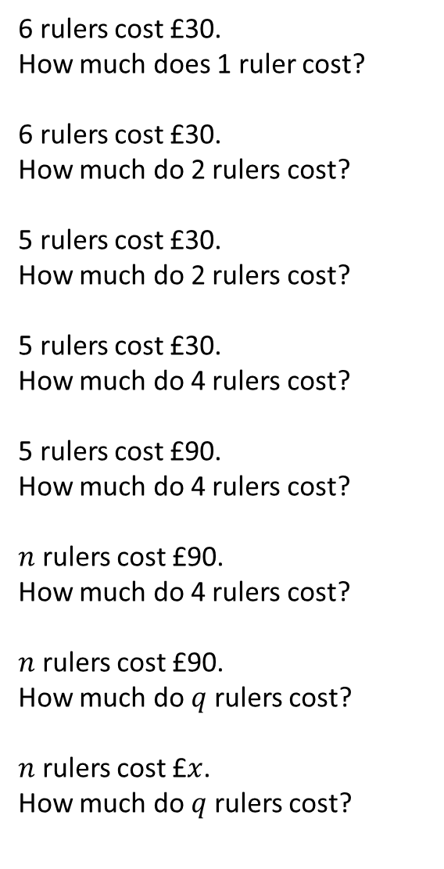
6 rulers cost £30.
How much does 1 ruler cost?
6 rulers cost £30.
How much do 2 rulers cost?
5 rulers cost £30.
How much do 2 rulers cost?
5 rulers cost £30.
How much do 4 rulers cost?
5 rulers cost £90.
How much do 4 rulers cost?
$n$ rulers cost £90.
How much do 4 rulers cost?
$n$ rulers cost £90.
How much do $q$ rulers cost?
$n$ rulers cost £$x$.
How much do $q$ rulers cost?
@mrbartonmaths

Slide 4
6 rulers cost £30.
How much does 1 ruler cost?
6 rulers cost £30.
How much do 2 rulers cost?
5 rulers cost £30.
How much do 2 rulers cost?
5 rulers cost £30.
How much do 4 rulers cost?
5 rulers cost £90.
How much do 4 rulers cost?
$n$ rulers cost £90.
How much do 4 rulers cost?
$n$ rulers cost £90.
How much do $q$ rulers cost?
$n$ rulers cost £$x$.
How much do $q$ rulers cost?
$$\frac{30}{6}$$
$$\frac{30}{6}×2$$
$$\frac{30×2}{6}$$
$$\frac{30}{5}×2$$
$$\frac{30×2}{5}$$
$$\frac{30}{5}×4$$
$$\frac{30×4}{5}$$
$$\frac{90}{5}×4$$
$$\frac{90×4}{5}$$
$$\frac{90}{n}×4$$
$$\frac{90×4}{n}$$
$$\frac{90}{n}×q$$
$$\frac{90q}{n}$$
$$\frac{x}{n}×q$$
$$\frac{xq}{n}$$
@mrbartonmaths

