Slide 1
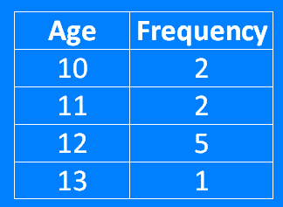
Averages: Mean from a Frequency Table
Silent
Teacher
Intelligent Practice
Narration
Your Turn
Example
For more videos visit mrbartonmaths.com/videos

Slide 2
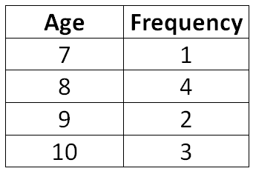
Worked Example
Your Turn
Calculate the mean age:
Calculate the mean age:
@fortyninecubed

Slide 3
Calculate the mean age for each frequency table:
1.
Age | Frequency
9 | 2
10 | 2
11 | 5
12 | 1
3.
Age | Frequency
10 | 4
11 | 4
12 | 10
13 | 2
2.
Age | Frequency
10 | 2
11 | 2
12 | 5
13 | 1
4.
Age | Frequency
10 | 5
11 | 5
12 | 11
13 | 3
@fortyninecubed

Slide 4
Calculate the mean age for each frequency table:
5.
Age | Frequency
20 | 5
22 | 5
24 | 11
26 | 3
7.
Age | Frequency
20 | 5
22 | 11
24 | 11
26 | 5
6.
Age | Frequency
20 | 5
22 | 11
24 | 11
26 | 3
8.
Age | Frequency
20 | 5
22 | 0
24 | 11
26 | 5
@fortyninecubed

Slide 5
Calculate the mean age for each frequency table:
1.
Age | Frequency
9 | 2
10 | 2
11 | 5
12 | 1
3.
Age | Frequency
10 | 4
11 | 4
12 | 10
13 | 2
2.
Age | Frequency
10 | 2
11 | 2
12 | 5
13 | 1
4.
Age | Frequency
10 | 5
11 | 5
12 | 11
13 | 3
@fortyninecubed

Slide 6
Calculate the mean age for each frequency table:
5.
Age | Frequency
20 | 5
22 | 5
24 | 11
26 | 3
7.
Age | Frequency
20 | 5
22 | 11
24 | 11
26 | 5
8.
Age | Frequency
20 | 5
22 | 0
24 | 11
26 | 5
6.
Age | Frequency
20 | 5
22 | 11
24 | 11
26 | 3
@fortyninecubed

