Slide 1
Algebraic Fractions: Adding/Subtracting
Silent
Teacher
Intelligent Practice
Narration
Your Turn
$$\frac{5}{x^{2}}+\frac{2}{x}$$
$$\frac{5}{{2x}^{2}}−\frac{2}{x}$$
Example
For more videos visit mrbartonmaths.com/videos

Slide 2


Worked Example
Your Turn
$$\frac{x}{5}+\frac{3x}{8}$$
$$\frac{5}{x}+\frac{8}{3x}$$
@fortyninecubed

Slide 3

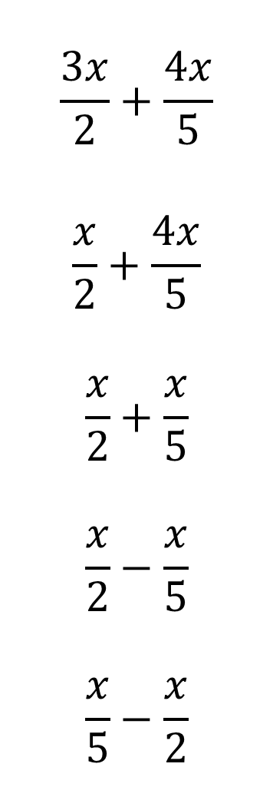
$$\frac{3x}{2}+\frac{4x}{5}$$
$$\frac{x}{2}+\frac{4x}{5}$$
$$\frac{x}{2}+\frac{x}{5}$$
$$\frac{x}{2}−\frac{x}{5}$$
$$\frac{x}{5}−\frac{x}{2}$$
$$\frac{5x}{5}−\frac{x}{2}$$
$$\frac{5}{x}+\frac{2}{x}$$
$$\frac{5}{x^{2}}+\frac{2}{x}$$
$$\frac{5}{{2x}^{2}}−\frac{2}{x}$$
$$\frac{6}{{2x}^{2}}−\frac{2}{x}$$
@fortyninecubed

Slide 4

$$\frac{6}{2xy}+\frac{2}{x}$$
$$\frac{6}{2xy}+\frac{2}{3x}$$
$$\frac{6}{2xy}−\frac{2}{3x^{2}}$$
$$\frac{6y}{2xy}+\frac{2}{3x^{2}}$$
$$\frac{y}{2xy}−\frac{2}{3x^{3}}$$
@fortyninecubed

Slide 5


$$\frac{3x}{2}+\frac{4x}{5}$$
$$\frac{x}{2}+\frac{4x}{5}$$
$$\frac{x}{2}+\frac{x}{5}$$
$$\frac{x}{2}−\frac{x}{5}$$
$$\frac{x}{5}−\frac{x}{2}$$
$$\frac{5x}{5}−\frac{x}{2}$$
$$\frac{5}{x}+\frac{2}{x}$$
$$\frac{5}{x^{2}}+\frac{2}{x}$$
$$\frac{5}{{2x}^{2}}−\frac{2}{x}$$
$$\frac{6}{{2x}^{2}}−\frac{2}{x}$$
$$\frac{23x}{10}$$
$$\frac{13x}{10}$$
$$\frac{7x}{10}$$
$$\frac{3x}{10}$$
$$−\frac{3x}{10}$$
$$\frac{x}{2}$$
$$\frac{7}{x}$$
$$\frac{2x+5}{x^{2}}$$
$$\frac{5−4x}{{2x}^{2}}$$
$$\frac{3−2x}{x^{2}}$$
@fortyninecubed

Slide 6

$$\frac{2y+3}{xy}$$
$$\frac{2y+9}{3xy}$$
$$\frac{9x−2y}{3x^{2}y}$$
$$\frac{2+9x}{3x^{2}}$$
$$\frac{3x^{2}−4}{6x^{3}}$$
$$\frac{6}{2xy}+\frac{2}{x}$$
$$\frac{6}{2xy}+\frac{2}{3x}$$
$$\frac{6}{2xy}−\frac{2}{3x^{2}}$$
$$\frac{6y}{2xy}+\frac{2}{3x^{2}}$$
$$\frac{y}{2xy}−\frac{2}{3x^{3}}$$
@fortyninecubed

