Slide 1
Worked Example
Your Turn
An object travels 40 miles in 2 hrs.
Calculate its speed?
An object travels 40 miles in 30 mins.
Calculate its speed?
@mrbartonmaths

Slide 2
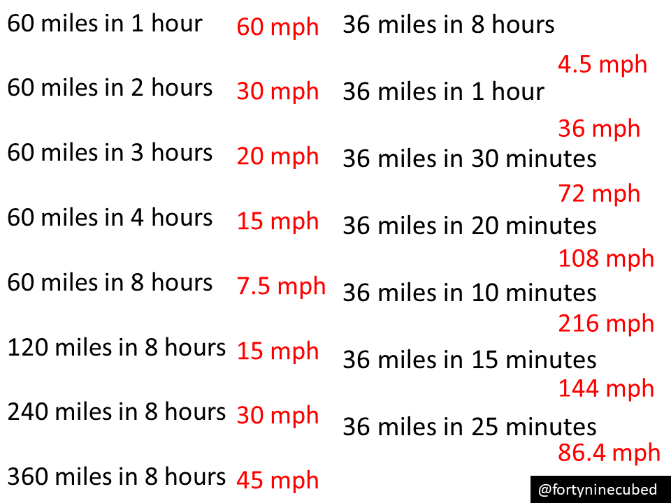

Slide 3
Worked Example
Your Turn
An object travels at 40 mph for
2 hours. How far has it travelled?
An object travels at 40 mph for 30 mins.
How far has it travelled?
@mrbartonmaths

Slide 4
60 mph in 1 hour 60 miles
60 mph in 2 hours 120 miles
60 mph in 3 hours 180 miles
60 mph in 4 hours 240 miles
60 mph in 8 hours 480 miles
30 mph in 8 hours 240 miles
45 mph in 8 hours 360 miles
95 mph in 8 hours 760 miles
9.5 mph in 8 hours 76 miles
9.5 mph in 1 hour 9.5 miles
9.5 mph in 30 mins 4.75miles
9.5 mph in 20 mins 3.17miles
9.5 mph in 10 mins 1.58 miles
9.5 mph in 15 mins 2.37 miles
9.5 miles in 12 mins 1.90 miles

Slide 5
Worked Example
Your Turn
An object travels 80 miles at 40 mph.
How long does the journey take?
An object travels 20 miles at 40 mph.
How long does the journey take?
@mrbartonmaths

Slide 6
60 miles at 60 mph 1 hr
120 miles at 60 mph 2 hrs
180 miles at 60 mph 3 hrs
240 miles at 60 mph 4 hrs
240 miles at 30 mph 8 hrs
240 miles at 15 mph 16 hrs
240 miles at 5 mph 48 hrs
24 miles at 5 mph 4 hrs 48 mins
24 miles at 7.5 mph 3 hrs 12 mins
24 miles at 30 mph 48 mins
24 miles at 60 mph 24 mins
8 miles at 60 mph 8 mins
4 miles at 30 mph 8 mins
8 miles at 45 mph 10 mins 40 s
5 miles at 72 mph 4 mins 10 s

