Slide 1
Equations: Cross-Multiplication
Silent
Teacher
Intelligent Practice
Narration
Your Turn
$$\frac{2x}{14}=\frac{3}{7}$$
$$\frac{14}{2x}=\frac{7}{3}$$
Example
For more videos visit mrbartonmaths.com/videos

Slide 2
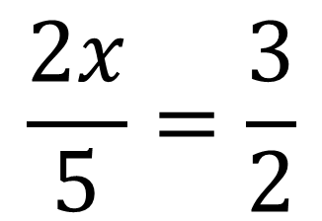
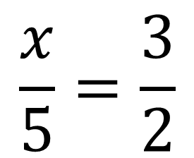
Worked Example
Your Turn
$$\frac{x}{5}=\frac{3}{2}$$
$$\frac{2x}{5}=\frac{3}{2}$$
@fortyninecubed

Slide 3

$$\frac{x}{7}=\frac{3}{2}$$
$$\frac{2x}{7}=\frac{3}{2}$$
$$\frac{2x}{7}=\frac{3}{14}$$
$$\frac{2x}{14}=\frac{3}{14}$$
$$\frac{2x}{14}=\frac{3}{7}$$
$$\frac{14}{2x}=\frac{7}{3}$$
$$\frac{14}{2x+1}=\frac{7}{3}$$
$$\frac{14}{2x−1}=\frac{7}{3}$$
$$\frac{7}{2x−1}=\frac{7}{3}$$
$$\frac{2x−1}{7}=\frac{7}{3}$$
$$\frac{2x−1}{6}=\frac{7}{3}$$
$$\frac{1−2x}{6}=\frac{7}{3}$$
Solve:
@fortyninecubed

Slide 4



$$\frac{x}{7}=\frac{3}{2}$$
$$\frac{2x}{7}=\frac{3}{2}$$
$$\frac{2x}{7}=\frac{3}{14}$$
$$\frac{2x}{14}=\frac{3}{14}$$
$$\frac{2x}{14}=\frac{3}{7}$$
$$\frac{14}{2x}=\frac{7}{3}$$
$$\frac{14}{2x+1}=\frac{7}{3}$$
$$\frac{14}{2x−1}=\frac{7}{3}$$
$$\frac{7}{2x−1}=\frac{7}{3}$$
$$\frac{2x−1}{7}=\frac{7}{3}$$
$$\frac{2x−1}{6}=\frac{7}{3}$$
$$\frac{1−2x}{6}=\frac{7}{3}$$
$$x=2.5 or x=\frac{5}{2}$$
$$x=3.5 or x=\frac{7}{2}$$
$$x=2$$
$x=8.\dot{6}$or $x=\frac{26}{3}$
$$x=7.5 or x=\frac{15}{2}$$
$$x=−6.5 or−\frac{13}{2}$$
$$x=10.5 or\frac{21}{2}$$
$x=$ $5.25 or\frac{21}{4}$
$$x=0.75 or\frac{3}{4}$$
$$x=1.5 or\frac{3}{2}$$
$$x=3$$
$$x=3$$

