Slide 1
Time: Converting decimals to hours and minutes
Silent
Teacher
Intelligent Practice
Narration
Your Turn
Example
For more videos visit mrbartonmaths.com/videos

Slide 2
Worked Example
Your Turn
@mathsmrgordon

Slide 3
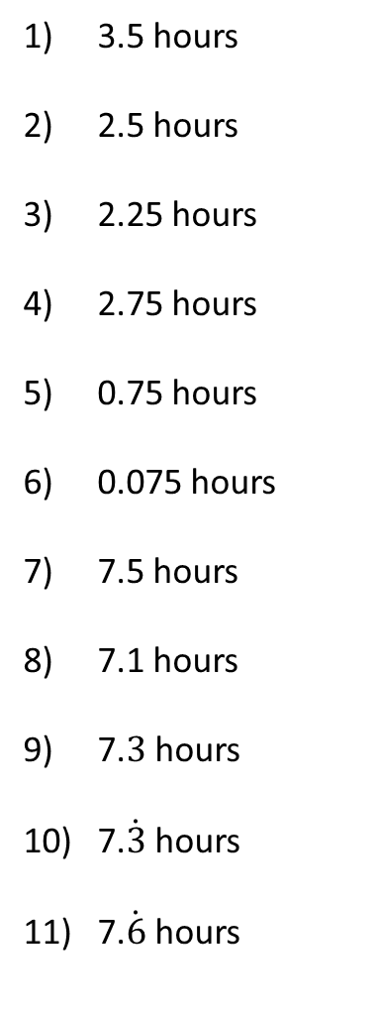
3 hours 30 minutes
2 hours 30 minutes
2 hours 15 minutes
2 hours 45 minutes
45 minutes
4.5 minutes
7 hours 30 minutes
7 hours 6 minutes
7 hours 18 minutes
7 hours 20 minutes
7 hours 40 minutes
@mathsmrgordon

Slide 4
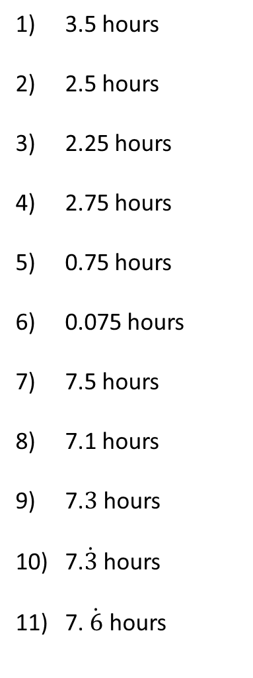
@mathsmrgordon

