Slide 1
Coordinates: Plotting co-ordinates to form a square
Silent
Teacher
Intelligent Practice
Narration
Your Turn
Example
For more videos visit mrbartonmaths.com/videos

Slide 2
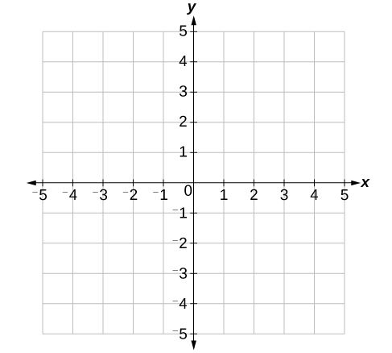
Worked Example
Your Turn
Plot (-2,2) (2,2) (2,-2). Plot another co-ordinate to create a square.
Plot (-2,1) (1,2) (2,-1). Plot another co-ordinate to create a square.
@mathsmrgordon

Slide 3
Plot (-3,0) (0,3) (3,0). Plot another co-ordinate to create a square.
Plot (-2,0) (0,2) (2,0). Plot another co-ordinate to create a square.
@mathsmrgordon
Plot (-1,0) (1,2) (3,0). Plot another co-ordinate to create a square.
Plot (-1,-2) (1,0) (3,-2). Plot another co-ordinate to create a square.

Slide 4
Plot (0,-1) (2,1) (4,-1). Plot another co-ordinate to create a square.
Plot (-1,-1) (2,2) (5,-1). Plot another co-ordinate to create a square.
@mathsmrgordon
Plot (0,0) (3,1) (4,-2). Plot another co-ordinate to create a square.
Plot (0,0) (-3,1) (-4,-2). Plot another co-ordinate to create a square.

Slide 5
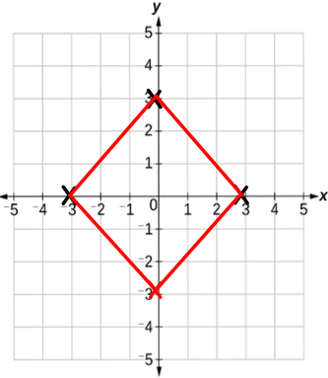
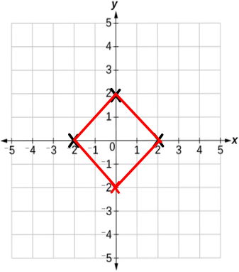
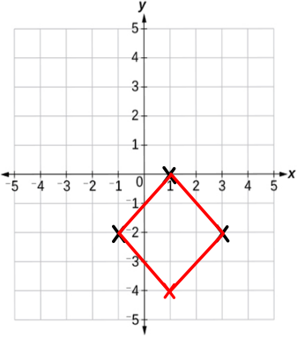
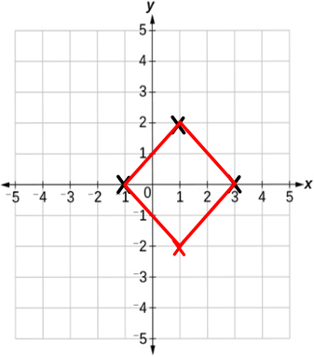
Plot (-3,0) (0,3) (3,0). Plot another co-ordinate to create a square.
Plot (-2,0) (0,2) (2,0). Plot another co-ordinate to create a square.
@mathsmrgordon
Plot (-1,0) (1,2) (3,0). Plot another co-ordinate to create a square.
Plot (-1,-2) (1,0) (3,-2). Plot another co-ordinate to create a square.

Slide 6
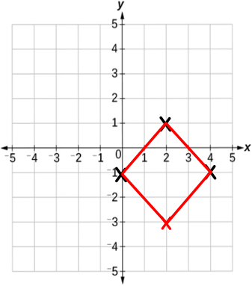
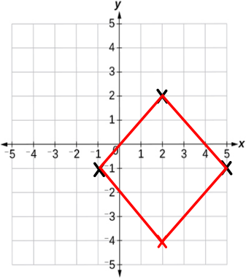
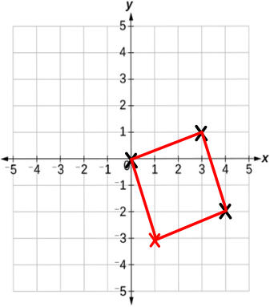
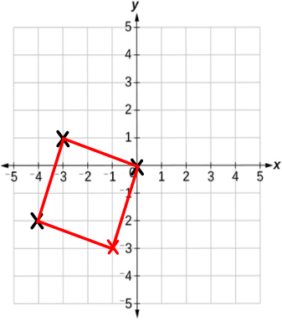
Plot (0,-1) (2,1) (4,-1). Plot another co-ordinate to create a square.
Plot (-1,-1) (2,2) (5,-1). Plot another co-ordinate to create a square.
@mathsmrgordon
Plot (0,0) (3,1) (4,-2). Plot another co-ordinate to create a square.
Plot (0,0) (-3,1) (-4,-2). Plot another co-ordinate to create a square.

