Slide 1
Straight Line Graphs: Effect of varying y co-ordinates on gradient
Silent
Teacher
Intelligent Practice
Narration
Your Turn
(3,3) and (6,3)
(3,3) and (6,0)
(3,6) and (6,0)
Example
For more videos visit mrbartonmaths.com/videos

Slide 2
Worked Example
Your turn
Calculate the gradient between
(2,2) and (4,10)
Calculate the gradient between
(2,2) and (4,20)
Calculate the gradient between
(2,2) and (4,3)
Calculate the gradient between
(2,2) and (4,1)
Calculate the gradient between
(2-8) and (4,-10)
Calculate the gradient between
(2,-9) and (4,-10)
@mathsmrgordon

Slide 3
Calculate the gradient between the co-ordinates:
(3,3) and (6,6)
(6,6) and (3,3)
(3,3) and (6,15)
(3,3) and (6,3)
(3,3) and (6,0)
(3,6) and (6,0)
(6,6) and (3,0)
(6,-6) and (3,0)
(3,6) and (6,3)
(3,6) and (6,5)
@mathsmrgordon

Slide 4
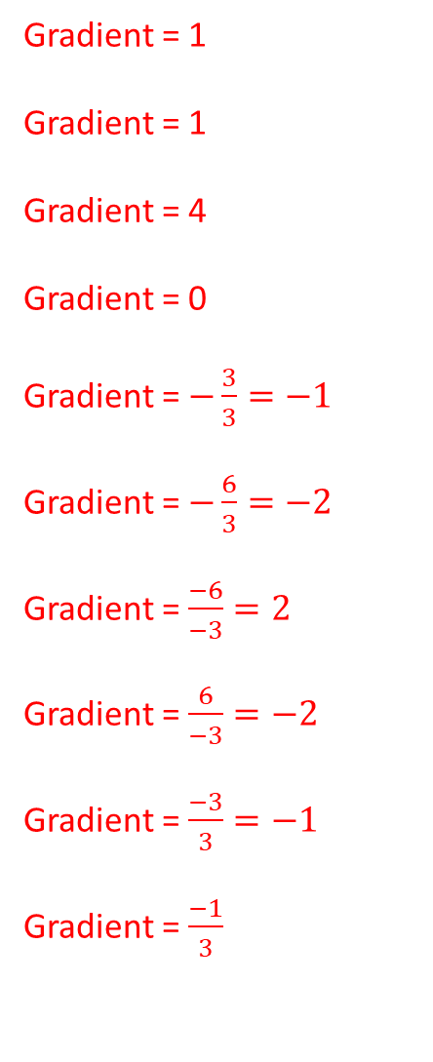
Calculate the gradient between the co-ordinates:
(3,3) and (6,6)
(6,6) and (3,3)
(3,3) and (6,15)
(3,3) and (6,3)
(3,3) and (6,0)
(3,6) and (6,0)
(6,6) and (3,0)
(6,-6) and (3,0)
(3,6) and (6,3)
(3,6) and (6,5)
Gradient = 1
Gradient = 1
Gradient = 4
Gradient = 0
Gradient = $−\frac{3}{3}=−1$
Gradient = $−\frac{6}{3}=−2$
Gradient = $\frac{−6}{−3}=2$
Gradient = $\frac{6}{−3}=−2$
Gradient = $\frac{−3}{3}=−1$
Gradient = $\frac{−1}{3}$
@mathsmrgordon

