Slide 1
Standard From: Multiplying in standard form
Silent
Teacher
Intelligent Practice
Narration
Your Turn
Example
For more videos visit mrbartonmaths.com/videos

Slide 2
Worked Examples
Your turn
@mathsmrgordon

Slide 3
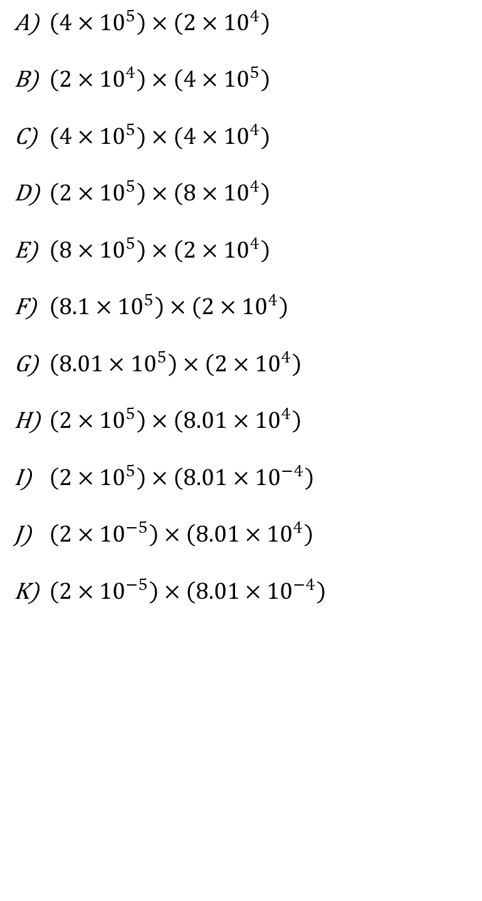
@mathsmrgordon

Slide 4
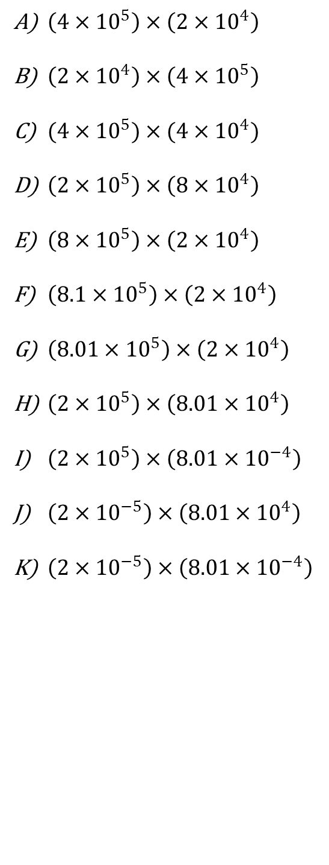
@mathsmrgordon

