Slide 1
Representing data: Scatter diagrams – correlation strength
True/false
Reflect
Your Turn
Strong
Moderate
Weak
Rule
For more videos visit mrbartonmaths.com/videos

Slide 2
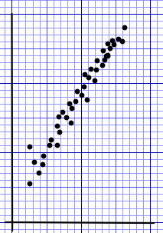
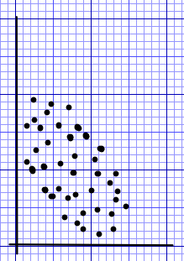
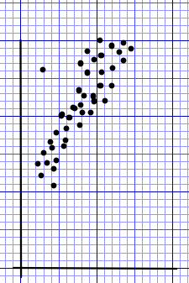
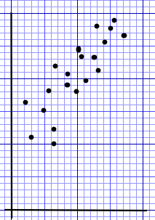
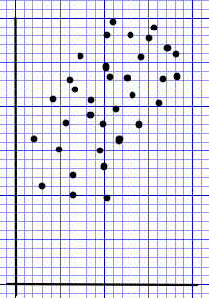
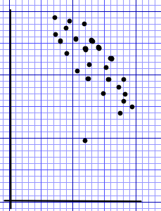
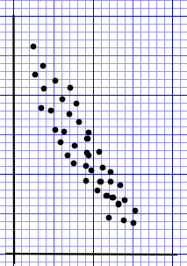
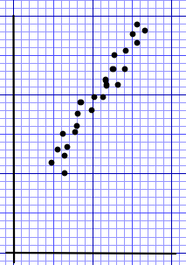
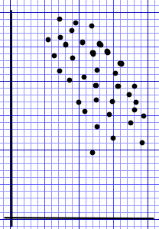
Strong
Moderate
Weak
Strong
Moderate
Weak
Strong
Moderate
Weak
Strong
Moderate
Weak
Strong
Moderate
Weak
Strong
Moderate
Weak
Strong
Moderate
Weak
Strong
Moderate
Weak
Strong
Moderate
Weak
@mathsmrgordon

Slide 3
Strong
Moderate
Weak
Strong
Moderate
Weak
Strong
Moderate
Weak
Strong
Moderate
Weak
Strong
Moderate
Weak
Strong
Moderate
Weak
Strong
Moderate
Weak
Strong
Moderate
Weak
Strong
Moderate
Weak
@mathsmrgordon

Slide 4
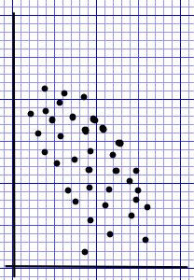
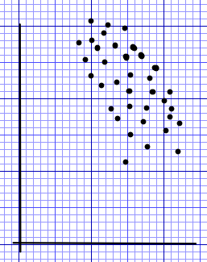
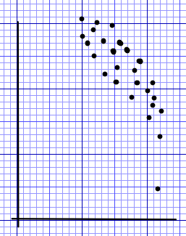
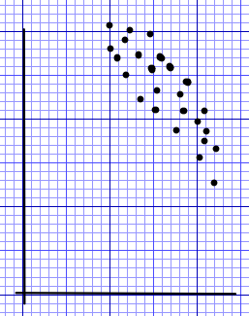
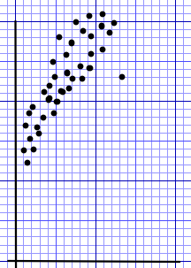
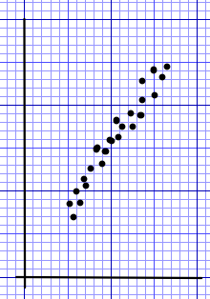
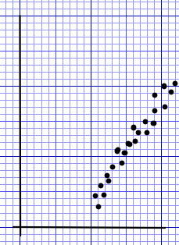
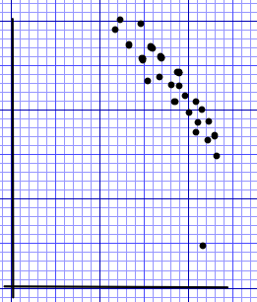
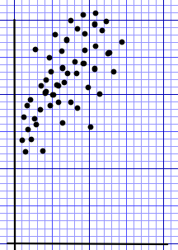
Strong
Moderate
Weak
Strong
Moderate
Weak
Strong
Moderate
Weak
Strong
Moderate
Weak
Strong
Moderate
Weak
Strong
Moderate
Weak
Strong
Moderate
Weak
Strong
Moderate
Weak
Strong
Moderate
Weak
@mathsmrgordon

Slide 5
Strong
Moderate
Weak
Strong
Moderate
Weak
Strong
Moderate
Weak
Strong
Moderate
Weak
Strong
Moderate
Weak
Strong
Moderate
Weak
Strong
Moderate
Weak
Strong
Moderate
Weak
Strong
Moderate
Weak
@mathsmrgordon

