Slide 1
Surds: Simplifying (1)
Silent
Teacher
Intelligent Practice
Narration
Your Turn
$$\sqrt{32}$$
$$\sqrt{64}$$
$$\sqrt{128}$$
Example
For more videos visit mrbartonmaths.com/videos

Slide 2
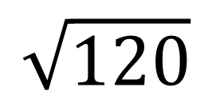
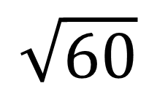
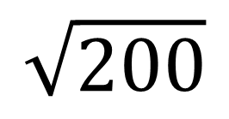
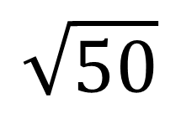
Worked Example
Your Turn
Simplify:
Simplify:
$$\sqrt{60}$$
$$\sqrt{50}$$
$$\sqrt{120}$$
$$\sqrt{200}$$
@fortyninecubed

Slide 3

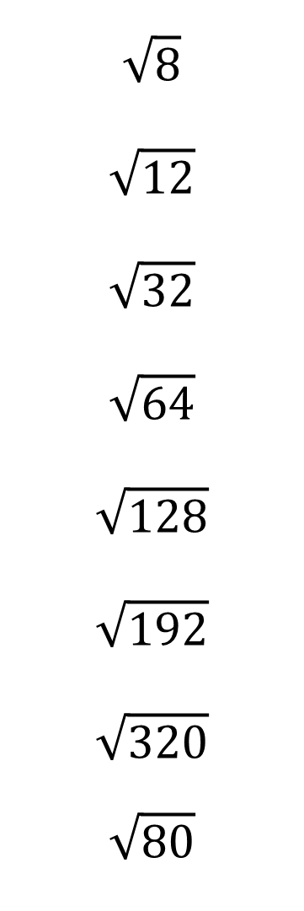
Simplify:
$$\sqrt{8}$$
$$\sqrt{12}$$
$$\sqrt{32}$$
$$\sqrt{64}$$
$$\sqrt{128}$$
$$\sqrt{192}$$
$$\sqrt{320}$$
$$\sqrt{80}$$
$$\sqrt{40}$$
$$\sqrt{90}$$
$$\sqrt{160}$$
$$\sqrt{1600}$$
$$\sqrt{200}$$
$$\sqrt{250}$$
$$\sqrt{175}$$
$$\sqrt{350}$$
@fortyninecubed

Slide 4

Simplify:
$$\sqrt{8}$$
$$\sqrt{12}$$
$$\sqrt{32}$$
$$\sqrt{64}$$
$$\sqrt{128}$$
$$\sqrt{192}$$
$$\sqrt{320}$$
$$\sqrt{80}$$
$$2\sqrt{2}$$
$$3\sqrt{2}$$
$$4\sqrt{2}$$
$$8$$
$$8\sqrt{2}$$
$$8\sqrt{3}$$
$$8\sqrt{5}$$
$$4\sqrt{5}$$
$$\sqrt{40}$$
$$\sqrt{90}$$
$$\sqrt{160}$$
$$\sqrt{1600}$$
$$\sqrt{200}$$
$$\sqrt{250}$$
$$\sqrt{175}$$
$$\sqrt{350}$$
$$2\sqrt{10}$$
$$3\sqrt{10}$$
$$4\sqrt{10}$$
$$40$$
$$10\sqrt{2}$$
$$5\sqrt{10}$$
$$5\sqrt{7}$$
$$5\sqrt{14}$$
@fortyninecubed

