Slide 1
Surds: Simplifying (2)
Silent
Teacher
Intelligent Practice
Narration
Your Turn
$$7\sqrt{49}$$
$$7\sqrt{98}$$
$$7\sqrt{147}$$
Example
For more videos visit mrbartonmaths.com/videos

Slide 2
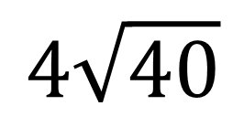
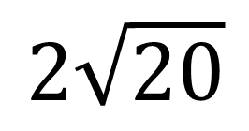
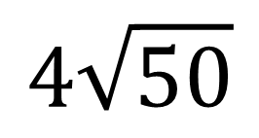
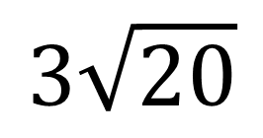
Worked Example
Your Turn
Simplify:
Simplify:
$$2\sqrt{20}$$
$$3\sqrt{20}$$
$$4\sqrt{40}$$
$$4\sqrt{50}$$
@fortyninecubed

Slide 3
Simplify:
$$\sqrt{8}$$
$$2\sqrt{8}$$
$$3\sqrt{8}$$
$$\sqrt{72}$$
$$5\sqrt{72}$$
$$5\sqrt{144}$$
$$5\sqrt{1440}$$
$$5\sqrt{720}$$
$$5\sqrt{360}$$
$$5\sqrt{36}$$
$$6\sqrt{36}$$
$$7\sqrt{49}$$
$$7\sqrt{98}$$
$$7\sqrt{147}$$
$$14\sqrt{147}$$
$$7\sqrt{294}$$
@fortyninecubed

Slide 4

$$\sqrt{8}$$
$$2\sqrt{8}$$
$$3\sqrt{8}$$
$$\sqrt{72}$$
$$5\sqrt{72}$$
$$5\sqrt{144}$$
$$5\sqrt{1440}$$
$$5\sqrt{720}$$
$$5\sqrt{360}$$
$$5\sqrt{36}$$
$$6\sqrt{36}$$
$$7\sqrt{49}$$
$$7\sqrt{98}$$
$$7\sqrt{147}$$
$$14\sqrt{147}$$
$$7\sqrt{294}$$
$$30\sqrt{10}$$
$$30$$
$$36$$
$$49$$
$$49\sqrt{2}$$
$$49\sqrt{3}$$
$$98\sqrt{3}$$
$$49\sqrt{6}$$
$$2\sqrt{2}$$
$$4\sqrt{2}$$
$$6\sqrt{2}$$
$$6\sqrt{2}$$
$$30\sqrt{2}$$
$$60$$
$$12\sqrt{10}$$
$$60\sqrt{5}$$
@fortyninecubed

